Slide 1
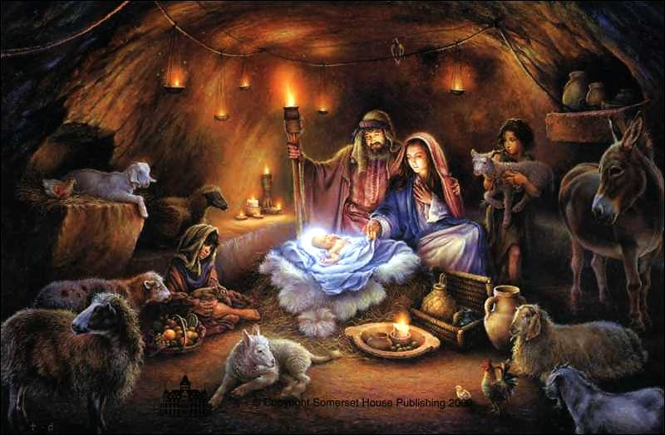
S2 Advent Service
Trinity High School

Slide 2
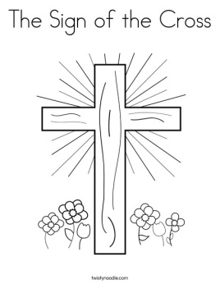
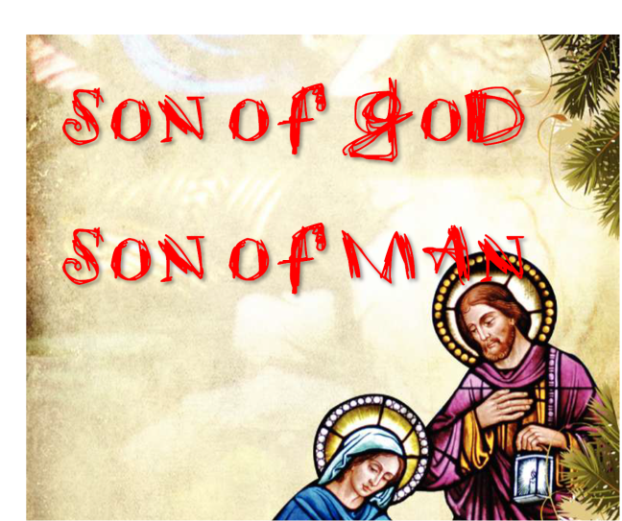
Sign of the cross: In the Name of the Father….
Introduction:
During this season of Advent we come together to pray and reflect on some passages from Scripture that help us deepen our understanding and gratitude of the gift of Jesus, known to us as the Messiah, Son of God and Son of Man.

Slide 3
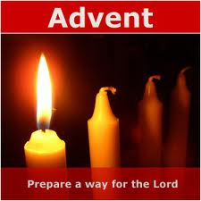
Today, we come together to pray as a school community in the spirit of Advent. Advent is a time of waiting. We wait for the birth of Jesus, who came to show us God the Father’s love and to free us from sin, so that we could be with him together forever. We wait for him to be born again in our hearts, our classrooms, our homes, our parish community, and in the whole world. ________________________.

Slide 4
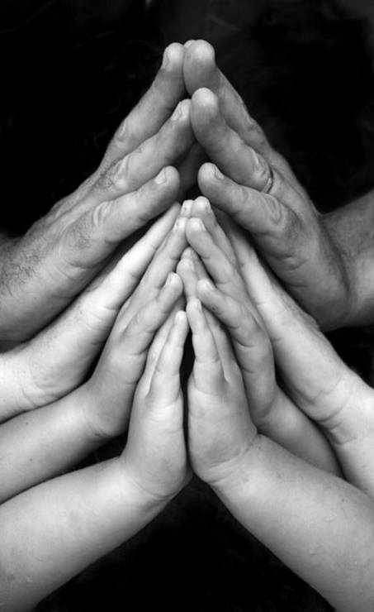
Opening prayer – say together
God our Father, you created us to be with you forever, and sent your Son Jesus to lead us to eternal life. We ask you now to help us pray with one heart and one mind as we begin this Advent season. We make this prayer to you through Christ our Lord.
Amen.

Slide 5
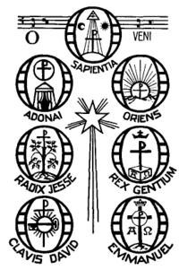
O Antiphons
The O Antiphons are seven short verses sung before the Magnificat during Evening Prayer of the Church on the seven days before the vigil of Christmas. They each begin with the exclamation "O". Each of them ends with a plea for the Messiah to come. As Christmas approaches the cry becomes more urgent.
The O Antiphons were composed in the seventh or eighth century when monks put together texts from the Old Testament which looked forward to the coming of our salvation. They form a rich mosaic of scriptural images. They became very popular in the Middle Ages. While the monastic choirs sang the antiphons the great bells of the church were rung.

Slide 6
O Antiphons Reflection.

Slide 8
First Reading
Our reading focuses on the birth of Christ. That wonderful moment when light entered into our dark world and we get the first glimpse of the long awaited Messiah.

Slide 9
First Reading Luke 2:5-7,21
⁴ So Joseph set out from the town of Nazareth in Galilee for Judaea, to David's town called Bethlehem, since he was of David's House and line,
⁵ in order to be registered together with Mary, his betrothed, who was with child.
⁶ Now it happened that, while they were there, the time came for her to have her child,
⁷ and she gave birth to a son, her first-born. She wrapped him in swaddling clothes and laid him in a manger because there was no room for them in the living-space.
⁸ In the countryside close by there were shepherds out in the fields keeping guard over their sheep during the watches of the night.
⁹ An angel of the Lord stood over them and the glory of the Lord shone round them. They were terrified,
¹⁰ but the angel said, 'Do not be afraid. Look, I bring you news of great joy, a joy to be shared by the whole people.
¹¹ Today in the town of David a Saviour has been born to you; he is Christ the Lord.
¹² And here is a sign for you: you will find a baby wrapped in swaddling clothes and lying in a manger.'
¹³

Slide 10
Oh Holy Night
Jesus is known as the ‘Son of God’ and the ‘Son of Man’. He is fully God and fully human.
Watch the following clip and reflect on the humble human conditions that our Messiah was born in to.
Take time to reflect on his human nature.
http://www.youtube.com/watch?v=4Zh-yR0pbmU

Slide 11
Oh Holy Night

Slide 12
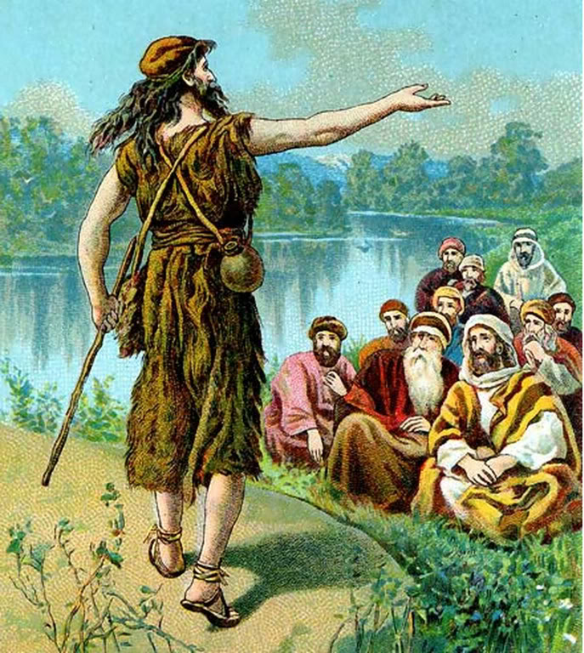
Second Reading Mark 1:1-11
¹ The beginning of the gospel about Jesus Christ, the Son of God.
² It is written in the prophet Isaiah: Look, I am going to send my messenger in front of you to prepare your way before you.
³ A voice of one that cries in the desert: Prepare a way for the Lord, make his paths straight.
⁴ John the Baptist was in the desert, proclaiming a baptism of repentance for the forgiveness of sins.
⁵ All Judaea and all the people of Jerusalem made their way to him, and as they were baptised by him in the river Jordan they confessed their sins.
⁶ John wore a garment of camel-skin, and he lived on locusts and wild honey.
⁷ In the course of his preaching he said, 'After me is coming someone who is more powerful than me, and I am not fit to kneel down and undo the strap of his sandals.
⁸ I have baptised you with water, but he will baptise you with the Holy Spirit.'

Slide 13
We take a moment to reflect on the importance of John the Baptist in helping to prepare the Jews and to prepare us to accept Jesus as the long awaited Messiah.

Slide 15
Prayers of the faithful
Winter is coming, Lord Jesus. The sky is dark by dinnertime, and it is colder every day. We wait for you, Light of the World, to warm our hearts with your joy.
We respond...
All - COME, LORD JESUS

Slide 16
The trees outside have lost their leaves. But the pine and spruce will always have their green needles. Green is the colour of life and hope. We wait for you, Prince of Peace, to bring new life and hope to our world.
We respond...
All - COME, LORD JESUS

Slide 17
Our days begin early and end when we sleep. But your love, O Lord has no beginning or end. We wait for you, Emmanuel, to show us the Father’s everlasting love.
We respond...
All - COME, LORD JESUS

Slide 18
We live in warm homes and fall asleep under blankets and sheets. Lord Jesus, you came to us as a baby, born in a chilly stable. The heat from animals, a bed of straw and rags kept you warm. Son of God and Son of Mary, help us to welcome you in the poor and hungry.
We respond...
All - COME, LORD JESUS

Slide 19
Let us pray for peace in the world. That all Christians and people of good will might become peace-makers in their actions and words, so that every one living where there is war and fighting will know the peace of Christ’s coming. We pray to the Lord...
All - LORD, HEAR OUR PRAYER

Slide 20
Let us pray for the people in our community who are sick and lonely. That they might find hope and comfort as we reach out to them this Advent and Christmas. We pray to the Lord...
All - LORD, HEAR OUR PRAYER

Slide 21
Let us pray for all of our parents, grandparents, brothers and sisters, aunts and uncles, friends and relatives. May the coming of Jesus bring them peace, good health and safety always. We pray to the Lord...
All - LORD, HEAR OUR PRAYER

Slide 22
Let us pray for all of us, that the Holy Spirit may fill our hearts with love, that we may welcome Jesus in everyone with compassion and kindness.
We pray to the Lord...
All -LORD, HEAR OUR PRAYER

Slide 23
Let us stop for a moment to bring our own private intentions before God in the quiet of our hearts.
And now, let us bring all of our prayers and needs to God the Father in the words that Jesus taught us. Our Father...

Slide 24
Closing Prayer
Lord, God, you show us the tenderness of your love in Mary’s newborn Son. Like Mary, may we always be ready to say “yes” to your plan, so that Jesus may be born in us. We ask you to prepare our hearts to welcome him, so that like the angels who announced his birth, we too might greet his coming with joy. We ask you this through this same Christ our Lord.
Amen.

Slide 25
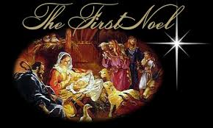
Noel Noel
http://www.youtube.com/watch?v=9DxQNBGKsX0&list=AL94UKMTqg-9A5Tcd9Ert-ux4XNaJcpuKx

