Slide 1
Prayer to the Holy Spirit
Come Holy Spirit, fill the hearts of your faithful and kindle in them the fire of your love.
Send forth your Spirit and they shall be created. And You shall renew the face of the earth. O, God, who by the light of the Holy Spirit, did instruct the hearts of the faithful, grant that by the same Holy Spirit we may be truly wise and ever enjoy His consolations, Through Christ Our Lord, Amen.

Slide 2
Starter: I see… I think… I wonder…

Slide 3
S2 Advent

Slide 4
L1: What is Advent?
Learning Intentions
Consider the liturgical events of Advent and Christmastide.
Success Criteria
Explain the significance of Advent.

Slide 5
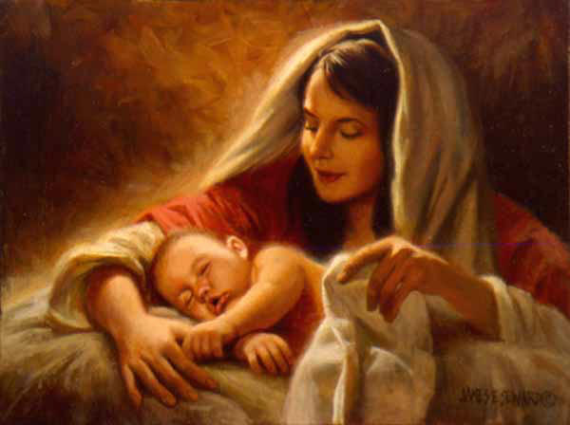
What is Advent?
Read pages 2-3 of your booklets and complete activity 1.
4 weeks before Christmas.
Preparation for Christmas.
Waiting for the Messiah, who has saved us from our sins.

Slide 6
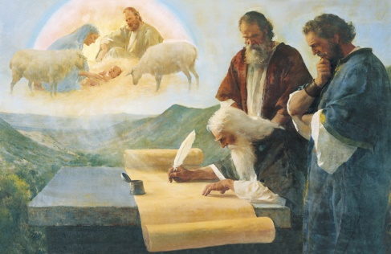
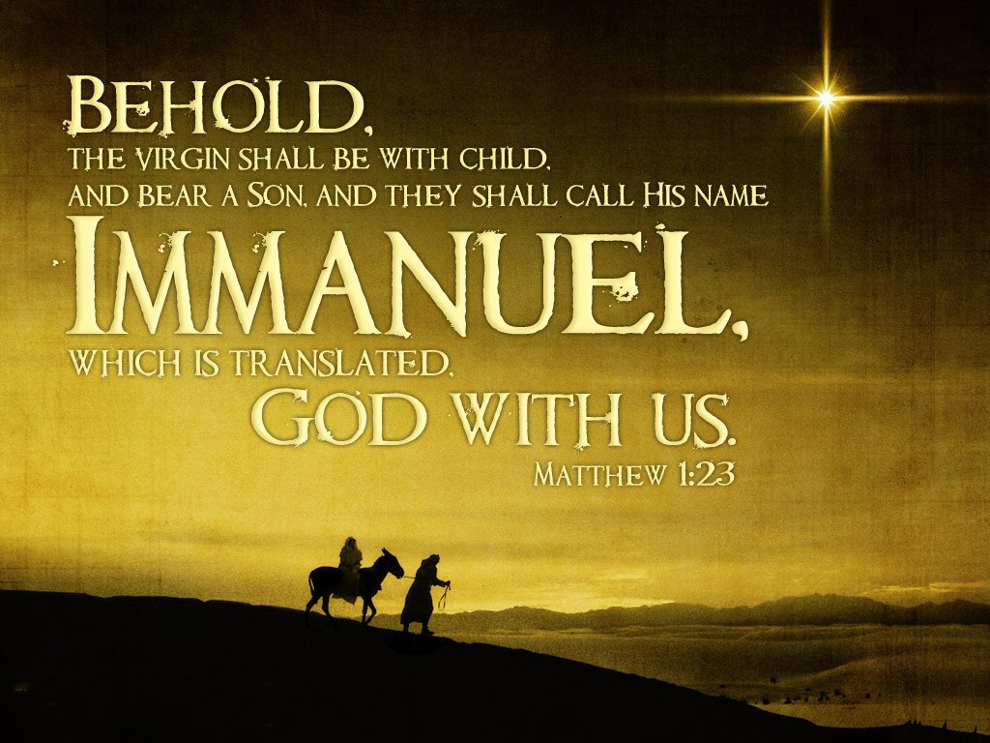
Isaiah’s Prophecy
Complete activity 2 on page 4 of your booklet.

Slide 7
Task
Read pages 4-5 of your booklet and complete activities 3 and 4.

Slide 8
L1: What is Advent?
Learning Intentions
Consider the liturgical events of Advent and Christmastide.
Success Criteria
Explain the significance of Advent.

