Slide 1
Confirmation
S1
Notes:
Explain that the purpose of these lessons is to re-cap on learning that should have taken place in preparation for receiving the sacrament of Confirmation. You may all of have been at different stages in this development but the learning here gives us another opportunity to explore the sacraments and, in particular, the sacrament of Confirmation.
You may wish to begin the lesson in prayer which can be found on the following slide.

Slide 2
Opening Prayer
Come Holy Spirit, fill the hearts of your faithful and kindle in them the fire of your love. ​
Send forth your Spirit and they shall be created.
And You shall renew the face of the earth. ​
O God, who by the light of the Holy Spirit, did instruct the hearts of the faithful, grant us in the same Spirit to be truly wise and ever to rejoice in His consolation. Through Christ our Lord.
Amen.​
Notes:
Invite pupils to say the responses in bold.
Depending on how long you take to deliver these resources, you may wish to use this prayer to begin each section/lesson.

Slide 3
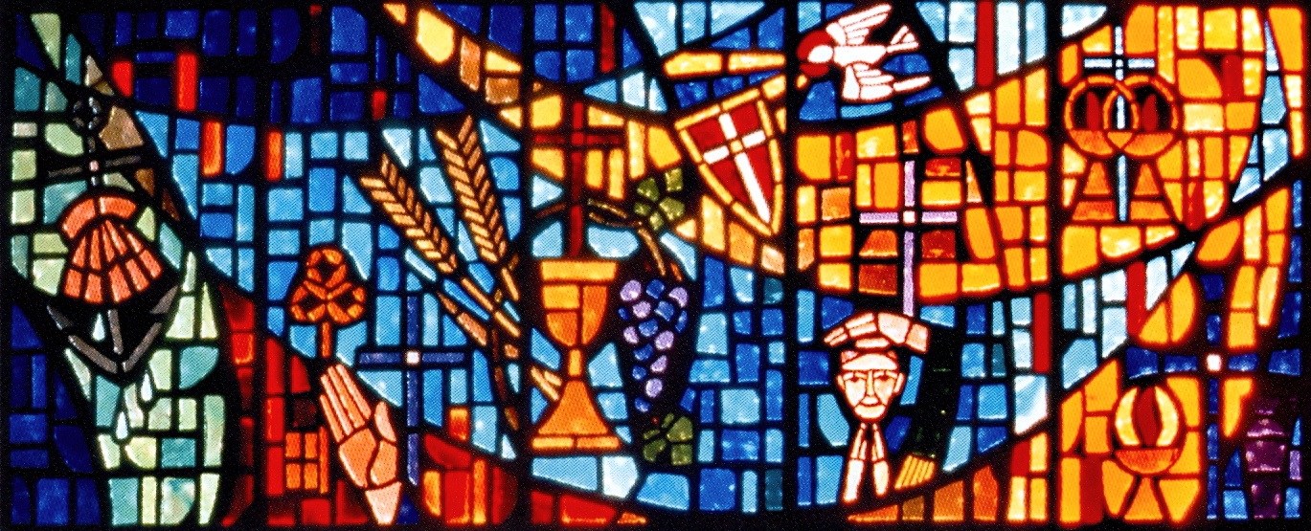
Notes:
Ask the pupils what they think the image in slide is.
It is a stained glass window depicting the seven sacraments of the Catholic Church.
Activity: Ask how many sacraments they can identify from this image and to list the symbols they think fit with each sacrament.
Answers are on the following page

Slide 4
Confirmation
Marriage
Holy Orders
Sacrament of the sick
Eucharist
Baptism
Reconciliation
Notes:
Baptism – symbolised by water. They may also mention the scallop shell which was traditionally used for pouring water during baptism and the anchor which symbolises hope and security.
Reconciliation – symbolised by the penitent (the person confessing their sins) and the raised hand of the priest as he grants absolution (forgives their sins). We also see the stole - the black scarf-like object – which shows us that the priest is officially celebrating a sacrament. Like a police officer wearing a badge, for example.
Eucharist – probably the sacrament we are most familiar with. We see this sacrament through the grapes, which we make wine from and the chalice and the wheat that is used to make bread which becomes the Body of Christ at Mass. We can also see the gold cup that is used to hold the precious blood.
Sacrament of the sick – we see the Eucharist here again because those receiving the sacrament of the sick would receive communion as part of this. We can also see the jar of holy oils with which the sick would be anointed with.
Marriage – symbolised here by the two interlinked rings.
Confirmation – symbolised by the Dove which is a traditional symbol of the Holy Spirit, and the shield which symbolises the courage we gain when at Confirmation to defend the faith.
Why are the sacraments and the objects or symbols important? Because they allow us to experience, to touch to taste and smell God’s presence in our lives, something which might otherwise be invisible to our senses.
The sacraments are how we stay in a living relationship with Jesus and how he continues to communicate with us and help us grow throughout our lives.

Slide 5
The Sacrament of Confirmation
Establishes you as a full member of the Church
This sacrament is called Confirmation because the faith given in Baptism is now confirmed and made strong
At Confirmation, you renew the promises, made on your behalf at Baptism, this time speaking for yourself.
The focus of Confirmation is the Holy Spirit, who confirmed the apostles on Pentecost and gave them courage to practice their faith.
Notes:
Let’s look specifically at the Sacrament of Confirmation now.
Confirmation is one of the “Sacraments of Initiation”.
Ask students what they know about this term.
Explain that the sacraments of Reconciliation, Eucharist and Confirmation are the three primary sacraments on which the rest of our lives depend. Just as bodies and minds grow, Catholics believe that the soul also needs to grow in the life of grace. The sacrament of Confirmation builds on the sacraments of Baptism, Penance, and Holy Communion, completing the process of initiation into the Catholic community.
Click for bullet points
Confirmation establishes young adults as full-fledged members of the faith. This sacrament is called Confirmation because the faith given in Baptism is now confirmed and made strong. During your Baptism, your parents and godparents make promises to renounce Satan and believe in God and the Church on your behalf. At Confirmation, you renew those same promises, this time speaking for yourself.
During Confirmation, the focus is on the Holy Spirit, who confirmed the apostles on Pentecost and gave them courage to practice their faith. Catholics believe that the same Holy Spirit confirms Catholics during the Sacrament of Confirmation and gives them the same gifts.

Slide 6
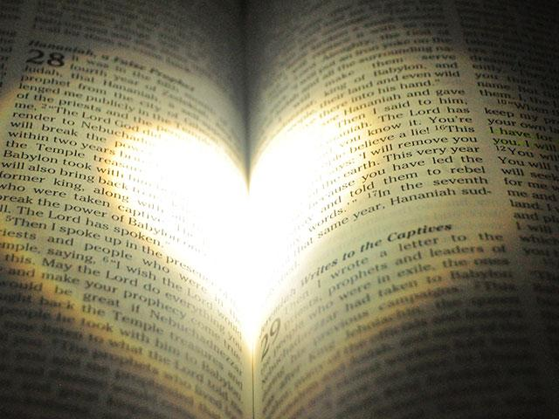
Jesus, filled with the Holy Spirit
Luke 4: 16-21
Mark: 22-24
Notes:
Jesus’ whole life on earth was open to and inspired by the Holy Spirit. Jesus was filled with the Holy Spirit and so His words, deeds and attitudes towards others help us to understand something of the power of the Holy Spirit.
Activity: Ask pupils to choose one of the scripture passages. Ask each pupil to read their chosen passage and then summarise Jesus’ actions and qualities.
If current restrictions do not allow for access to Bibles, you will find each scripture passage on the next slide. You may also prefer to chose one passage and complete this activity as a whole class/group.

Slide 7
Luke 4: 16-21 Mark 8: 22-24
The Rejection of Jesus at Nazareth
When he came to Nazareth, where he had been brought up, he went to the synagogue on the sabbath day, as was his custom. He stood up to read, and the scroll of the prophet Isaiah was given to him. He unrolled the scroll and found the place where it was written:
“The Spirit of the Lord is upon me, because he has anointed me to bring good news to the poor. He has sent me to proclaim release to the captives and recovery of sight to the blind, to let the oppressed go free, to proclaim the year of the Lord’s favour.”
And he rolled up the scroll, gave it back to the attendant, and sat down. The eyes of all in the synagogue were fixed on him. Then he began to say to them, “Today this scripture has been fulfilled in your hearing.”
Jesus Cures a Blind Man at Bethsaida
They came to Bethsaida. Some people brought a blind man to him and begged him to touch him. He took the blind man by the hand and led him out of the village; and when he had put saliva on his eyes and laid his hands on him, he asked him, “Can you see anything?” And the man looked up and said, “I can see people, but they look like trees, walking.”

Slide 8
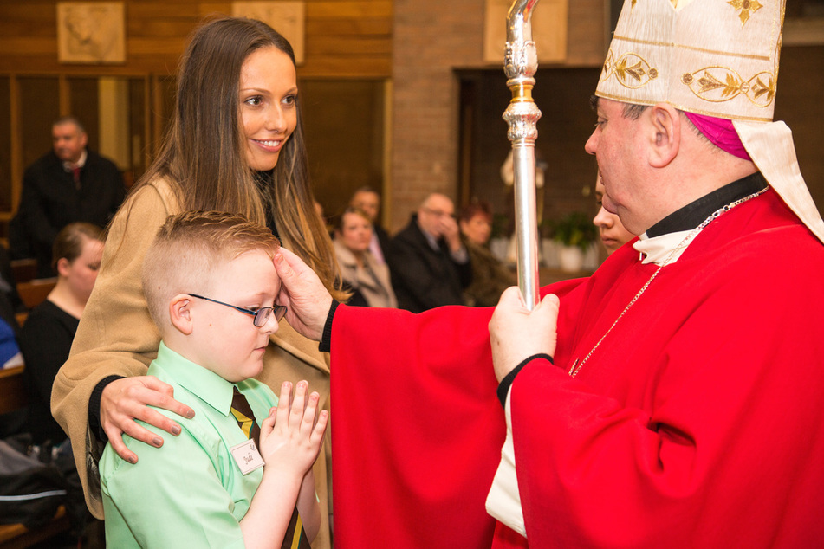
"Be sealed with the gift
of the Holy Spirit..."
Notes:
When we are anointed with the Holy Spirit at Confirmation, the Bishop says: "Be sealed with the gift of the Holy Spirit." Just as we have read in the scripture passages, Jesus was filled with the Holy Spirit and we were able to see this in everything he said and everything that he did. When the Bishop says these words to us at Confirmation, we too are filled with the Holy Spirit. This is why Confirmation cannot be repeated - because the gift of the Holy Spirit remains with us forever.
Let's learn a little more about the Holy Spirit.

Slide 9
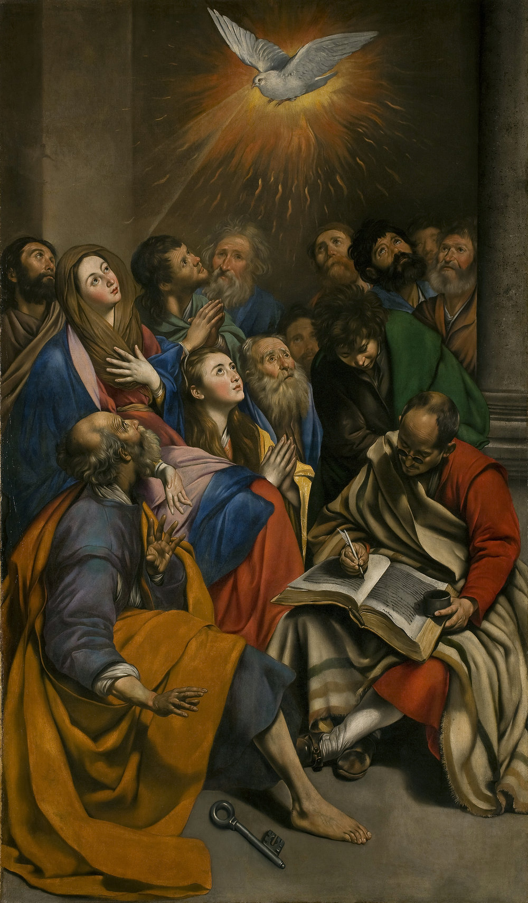
The Day of Pentecost
Notes:
Ask pupils what they know about Pentecost. This could be details from the story, clues from the image, words or symbols associated with the Holy Spirit.

Slide 10
What does scripture tell us about Pentecost?
The Coming of the Holy Spirit
When the day of Pentecost had come, they were all together in one place. And suddenly from heaven there came a sound like the rush of a violent wind, and it filled the entire house where they were sitting. Divided tongues, as of fire, appeared among them, and a tongue rested on each of them. All of them were filled with the Holy Spirit and began to speak in other languages, as the Spirit gave them ability.
Notes:
Explain that originally, Pentecost was a Jewish holiday held 50 days after Passover. One of three major feasts during the Jewish year, it celebrated Thanksgiving for harvested crops. However, Pentecost for Christians means something far different.
Before Jesus was crucified, he told his disciples that the Holy Spirit would come after him and 40 days after Jesus was resurrected (10 days after he ascended into heaven), that promise was fulfilled when Peter and the early Church were in Jerusalem for Pentecost. Read scripture passage.
Either as whole group/class summarise the main points of the passage or you could ask pupils to summarise individually in jotters.

Slide 11
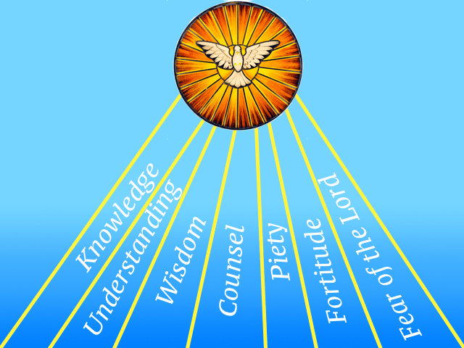
Notes:
Let's look now at the Gifts of the Holy Spirit.
Explain that they receive the Gifts of the Holy Spirit at Baptism, and that these will bear fruit as they develop positive qualities during their spiritual life journey.
Ask pupils to consider what their gifts might be.
We'll now look at each of these gifts in a bit more detail.

Slide 12
...helps us recognise the importance of others and the importance of keeping God central in our lives.
Wisdom

Slide 13
Understanding
...is the ability to comprehend the meaning of God's message.

Slide 14
...is the ability to think about and explore God's revelation, and also to recognize there are mysteries of faith beyond us.
knowledge

Slide 15
Counsel
...is the ability to see the best way to follow God's plan when we have choices that relate to him.

Slide 16
Fortitude
...is the courage to do what one knows is right.

Slide 17
Piety
...helps us pray to God in true devotion.

Slide 18
...is the feeling of amazement before God, who is all-present, and whose friendship we do not want to lose.
Fear of the Lord

Slide 19
Individual Reflection
At Baptism, God gave you each of these seven gifts: Wisdom, Understanding, Counsel, Fortitude, Knowledge, Piety, Fear of the Lord.
Can you write a prayer asking for God's help to live these gifts more fully after Confirmation?
Notes:
Give pupils some time on their own to write their prayer.

Slide 20
Notes:
To finish off this short re-cap on Confirmation, consolidate what you have learned with the video on the slide. After you have watched the video, draw attention to the following points:
Points to draw out:
In the sacraments, God gives us special graces to live like he does – unselfishly and for the good of others
The outpouring of the Holy Spirit seals and you - it is the same outpouring that God gave to his Apostles
After his death and resurrection, Jesus said he would give them the Holy Spirit and through it they would have the strength to tell the world about Jesus
Pentecost – the outpouring of the Holy Spirit – transformed the Apostles from being scared to being string and courageous
Jesus is sending you out in the same way in which he sent the Apostles out
When you are confirmed, you receive the seven Gifts of the Holy Spirit which you can develop by spending time in prayer with God and living a life ,modelled on Jesus

