Slide 1
Prayer to the Holy Spirit
Come Holy Spirit, fill the hearts of your faithful and kindle in them the fire of your love.
Send forth your Spirit and they shall be created. And You shall renew the face of the earth. O, God, who by the light of the Holy Spirit, did instruct the hearts of the faithful, grant that by the same Holy Spirit we may be truly wise and ever enjoy His consolations, Through Christ Our Lord, Amen.

Slide 2
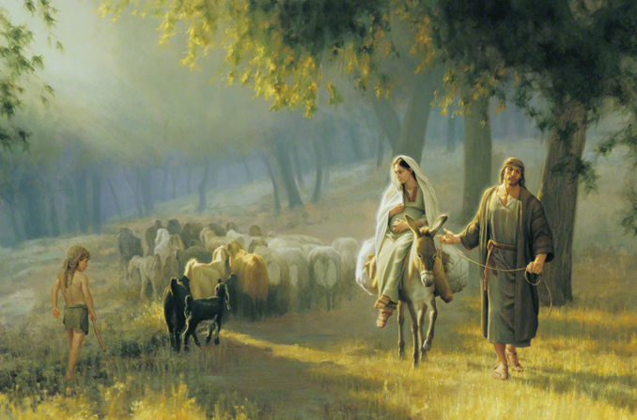
Starter – create thought bubbles in your jotter for what you think each person in this image was thinking
Joseph:
Mary:
Any guesses who this might be?
The donkey

Slide 3
L5 The Nativity
Learning Aims
Explore the Nativity story.
Deepen my understanding of the nature of Jesus.
Success Criteria
Show some understanding of the human nature of Jesus in the birth of Jesus.

Slide 4
http://www.youtube.com/watch?v=WROBkjlm0Pw
http://www.youtube.com/watch?v=vZrf0PbAGSk
The story of the birth of Jesus is found in two books of the Bible… Matthew and Luke
Watch these two short video clips and complete this table in your jotter:
Questions | Original | Modern
How did Mary find out she would be pregnant?
2. How did Mary and Joseph find a room for the night?
3. In what way did others find out about the birth of Jesus?

Slide 5
Immanuel
“A virgin will have a baby boy, and he will be called Immanuel,” which means “God is with us.”
Matthew 1:23
Christians believe that Jesus was Fully Human but also Fully Divine.
He was a man, living on the earth and he was God.
This is called the ‘Incarnation’ where God took on human form and lived on earth as Jesus.

Slide 6
Task
Read chapter 5 and complete activities 1-4.

Slide 7
L5 The Nativity
Learning Aims
Explore the Nativity story.
Deepen my understanding of the nature of Jesus.
Success Criteria
Show some understanding of the human nature of Jesus in the birth of Jesus.

