Slide 1
Prayer to the Holy Spirit
Come Holy Spirit, fill the hearts of your faithful and kindle in them the fire of your love.
Send forth your Spirit and they shall be created. And You shall renew the face of the earth. O, God, who by the light of the Holy Spirit, did instruct the hearts of the faithful, grant that by the same Holy Spirit we may be truly wise and ever enjoy His consolations, Through Christ Our Lord, Amen.

Slide 2
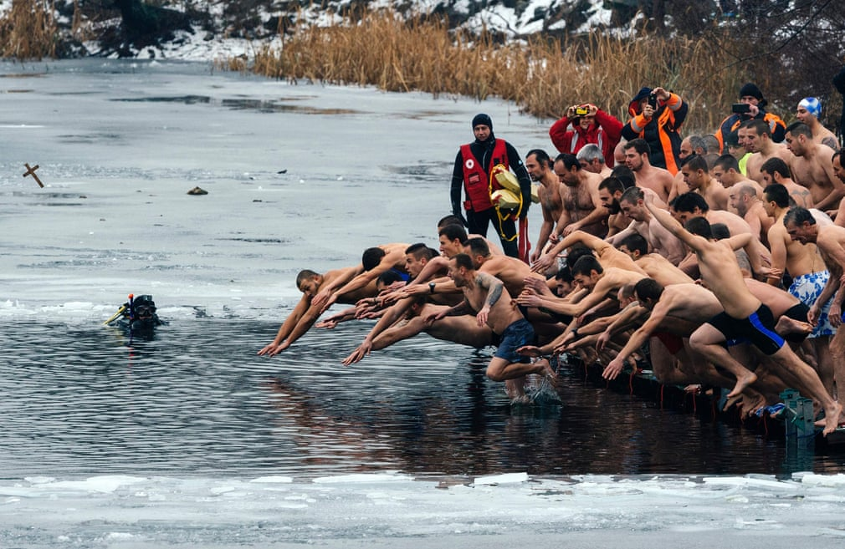
Starter – what are people celebrating in these pictures?
The Epiphany
Bulgarians plunge into the icy winter water of a lake in Sofia to try to catch a cross

Slide 3
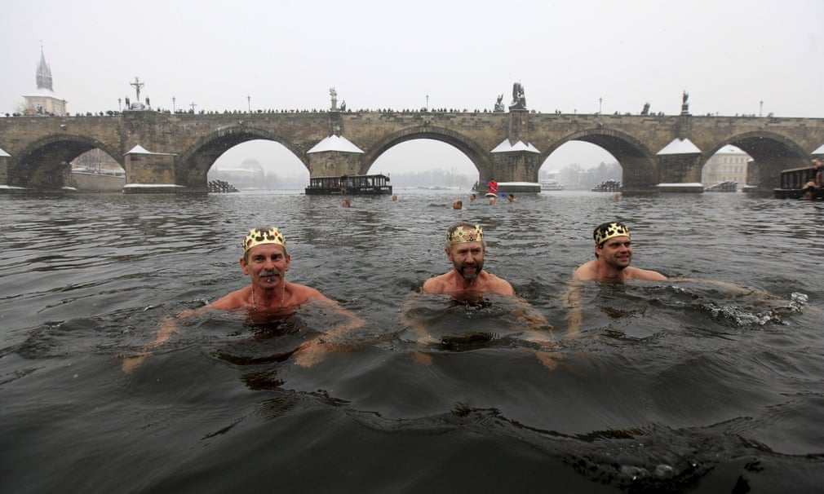
Starter – what are people celebrating in these pictures?
The Epiphany
Participants take part in the traditional Three Kings swim alongside the medieval Charles bridge in Prague, Czech Republic

Slide 4
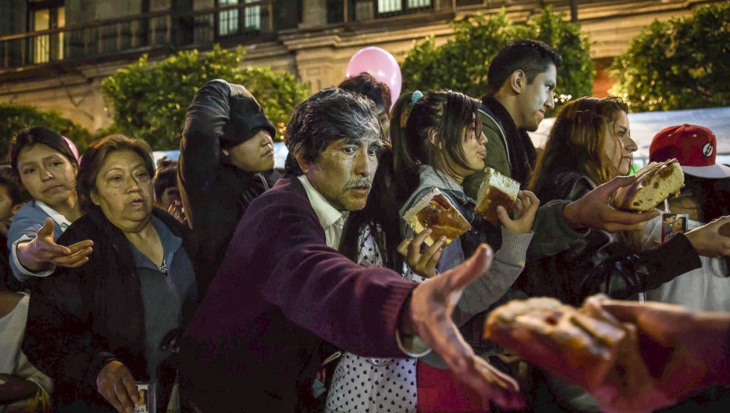
Starter – what are people celebrating in these pictures?
The Epiphany
A man takes a slice of traditional Rosca de Reyes (king's cake pastry), which is distributed to celebrate the Epiphany in Mexico City

Slide 5
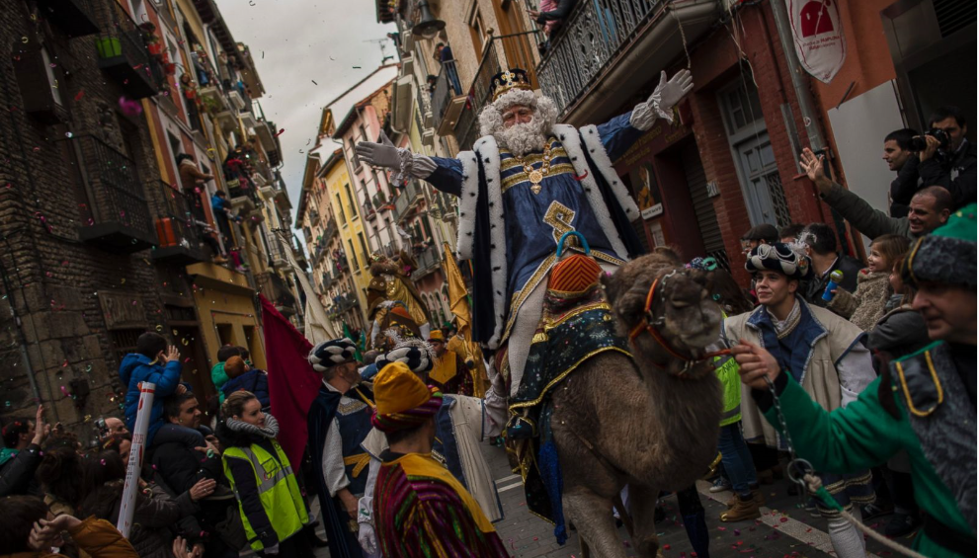
Parade to celebrate the epiphany in Spain

Slide 6
Gondolieri dressed up as "Befana" (an old woman) steer their boats during a gondola regatta on the Grand Canal as part of the Befana feast celebrations on Epiphany Day, in Venice, Italy, Jan.6 2016. "La Befana" is an imaginary old woman in the Italian folklore who is thought to bring gifts to children on the Epiphany Day.

Slide 7
L6 Feast Days in the Christmas Season
Learning Aims
Develop my understanding of the significance of special feast days within the Christmas period.
Success Criteria
Explain the significance of at least one of the following Church feast days in detail:
The Epiphany
The Holy Family
The Solemnity of Mary, the Mother of God

Slide 8
Presentation Task
Create a presentation for the class on a feast day within the Christmas period using the information in chapter 6 of your booklets.
This should include:
How did the feast day come about?
What do people celebrate on this feast day?
When is this feast day celebrated?
What do people do to celebrate this feast day?
Why is this feast day significant for Catholics?
Images and colour

