Slide 1
Prayer to the Holy Spirit
Come Holy Spirit, fill the hearts of your faithful and kindle in them the fire of your love.
Send forth your Spirit and they shall be created. And You shall renew the face of the earth. O, God, who by the light of the Holy Spirit, did instruct the hearts of the faithful, grant that by the same Holy Spirit we may be truly wise and ever enjoy His consolations, Through Christ Our Lord, Amen.

Slide 2
Starter
Write down 3 things you associate with each of the following colours:
Eg. Red – anger, passion, danger.
White –
Pink -
Green –
Purple –

Slide 3
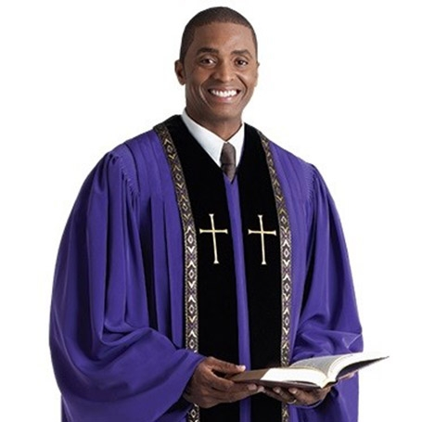
Advent Symbolism
Learning intentions
Today I will explore:
The colour of the vestments priests wear.
The advent wreath
The significance of the Sundays of Advent.

Slide 4
Advent Symbolism
Success Criteria
I will be able to:
Identify the significance of the colours of the priest’s robes during the liturgical year.
Explain what the different parts of the advent wreath symbolise.
Identify the key themes of advent.

Slide 5
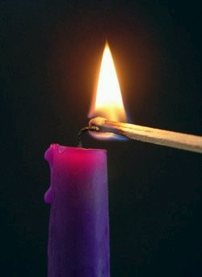
Re-cap Advent
The word Advent means “Arrival”.
During this season we prepare for the arrival of Jesus,
The son of God.
The First Sunday of Advent is the Sunday closest to 30
November. This Sunday is 4 Sundays before Christmas.

Slide 6
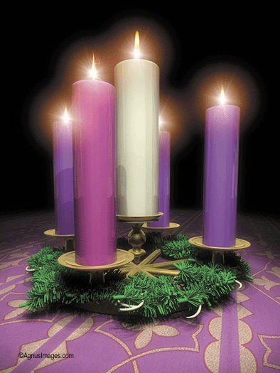
The Candles
The wreath consists of 5 candles. These candles also symbolise aspects of advent.
There are 3 purple candles. These are to symbolise the prayer and penance we should be undertaking in preparation for the birth of Jesus.
There is 1 pink candle to show how we should be rejoicing the coming birth of the Messiah.
Jesus is known as the “Light of the World”
A final white candle is placed on Christmas eve for the coming of Jesus.

Slide 7
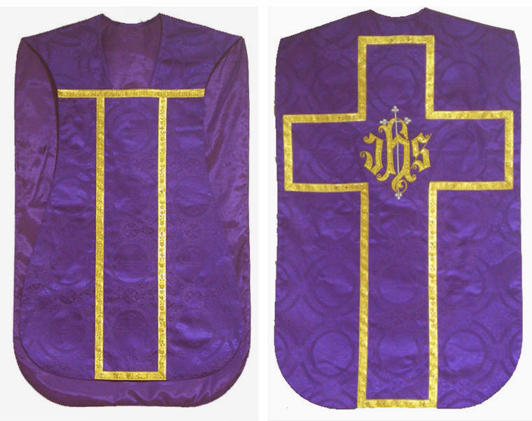
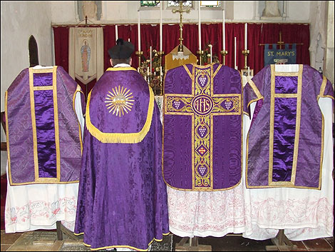
Vestments
During the season of Advent the Clergy wear purple vestments; again in prayer and hope awaiting the coming of Jesus.
Prayer
Hope

Slide 8
Read page 5 of our booklet
Complete task 1:
Try and think of and write down at least 3 examples of when people in general tend to wear certain colours for certain times. E.g., Brides often wear white on their wedding day to symbolise purity.

Slide 9
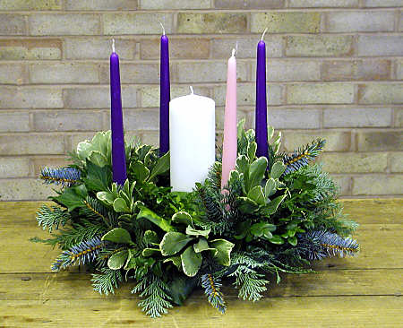
The Advent Wreath
An Advent wreath is key to the preparation for Christmas as it is a symbol of many important things for Christians. The wreath is circular and made from evergreens.
Why do you think this is?

Slide 10
The Advent Wreath
An Advent wreath is key to the preparation for Christmas as it is a symbol of many important things for Christians. The wreath is circular and made from evergreens.
These symbolise very important beliefs about God, one that he is eternal, no beginning, no end – just like a circle.
It is made from evergreens, which symbolises life and Continuous growth – the gifts which God gives to us.

Slide 11
Read page 6 and complete task 2
a. An Advent wreath is a key symbol of the season, it is made in a circular shape and of evergreens. Why is this significant to our beliefs about God? Explain your answer.
b. Draw an annotated advent wreath in your jotter, explaining what each of the candles and the wreath represent, and when they are lit.

Slide 12
Advent Symbolism
Success Criteria
I will be able to:
Identify the significance of the colours of the priest’s robes during the liturgical year.
Explain what the different parts of the advent wreath symbolise.
Identify the key themes of advent.

