Slide 1
Prayer to the Holy Spirit
Come Holy Spirit, fill the hearts of your faithful and kindle in them the fire of your love.
Send forth your Spirit and they shall be created. And You shall renew the face of the earth. O, God, who by the light of the Holy Spirit, did instruct the hearts of the faithful, grant that by the same Holy Spirit we may be truly wise and ever enjoy His consolations, Through Christ Our Lord, Amen.

Slide 2
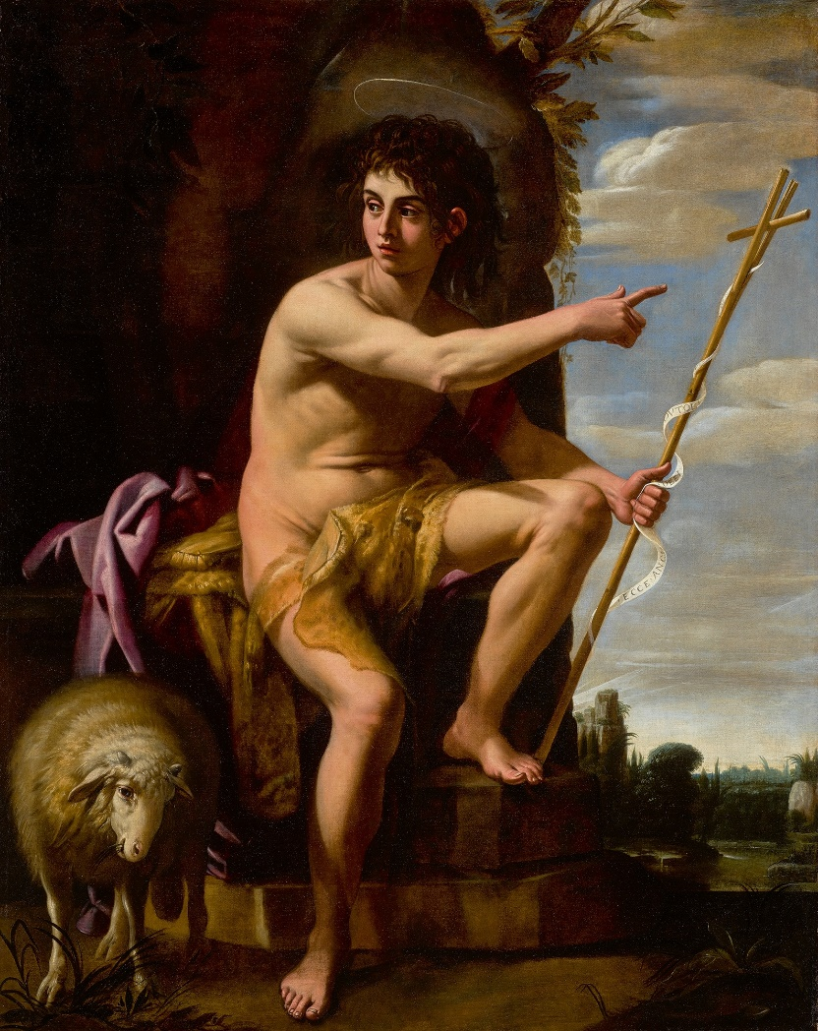
Starter Who do you think this is?

Slide 3
L4 John the Baptist
Learning Aims
Assess the importance of John the Baptist, in preparing the way for Jesus.
Success Criteria
Give my opinion as to whether John the Baptist was significant in preparing the way for Jesus.

Slide 4
Video Task
https://www.youtube.com/watch?v=7NMHOLPWeTM
Take notes from the video with as much information as you can on John the Baptist.
Good responses will have at least 3 notes.
Better will have at least 5.
The best will have 6 or more.

Slide 5
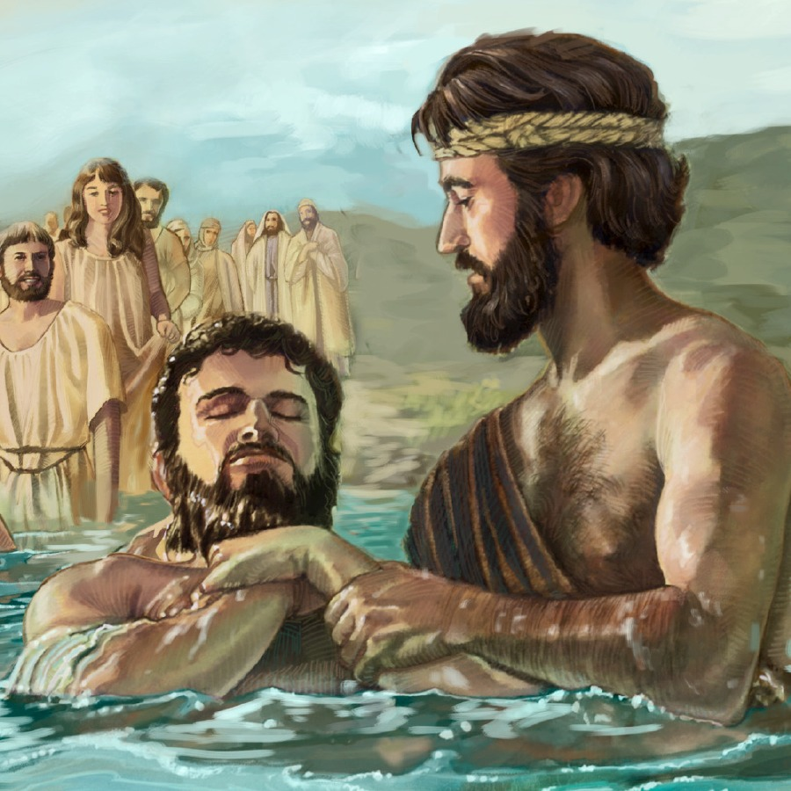
Task
Read chapter 4 and complete activities 1-4.

Slide 6
L4 John the Baptist
Learning Aims
Assess the importance of John the Baptist, in preparing the way for Jesus.
Success Criteria
Give my opinion as to whether John the Baptist was significant in preparing the way for Jesus.

