Slide 1
Prayer to the Holy Spirit
Come Holy Spirit, fill the hearts of your faithful and kindle in them the fire of your love.
Send forth your Spirit and they shall be created. And You shall renew the face of the earth. O, God, who by the light of the Holy Spirit, did instruct the hearts of the faithful, grant that by the same Holy Spirit we may be truly wise and ever enjoy His consolations, Through Christ Our Lord, Amen.

Slide 2
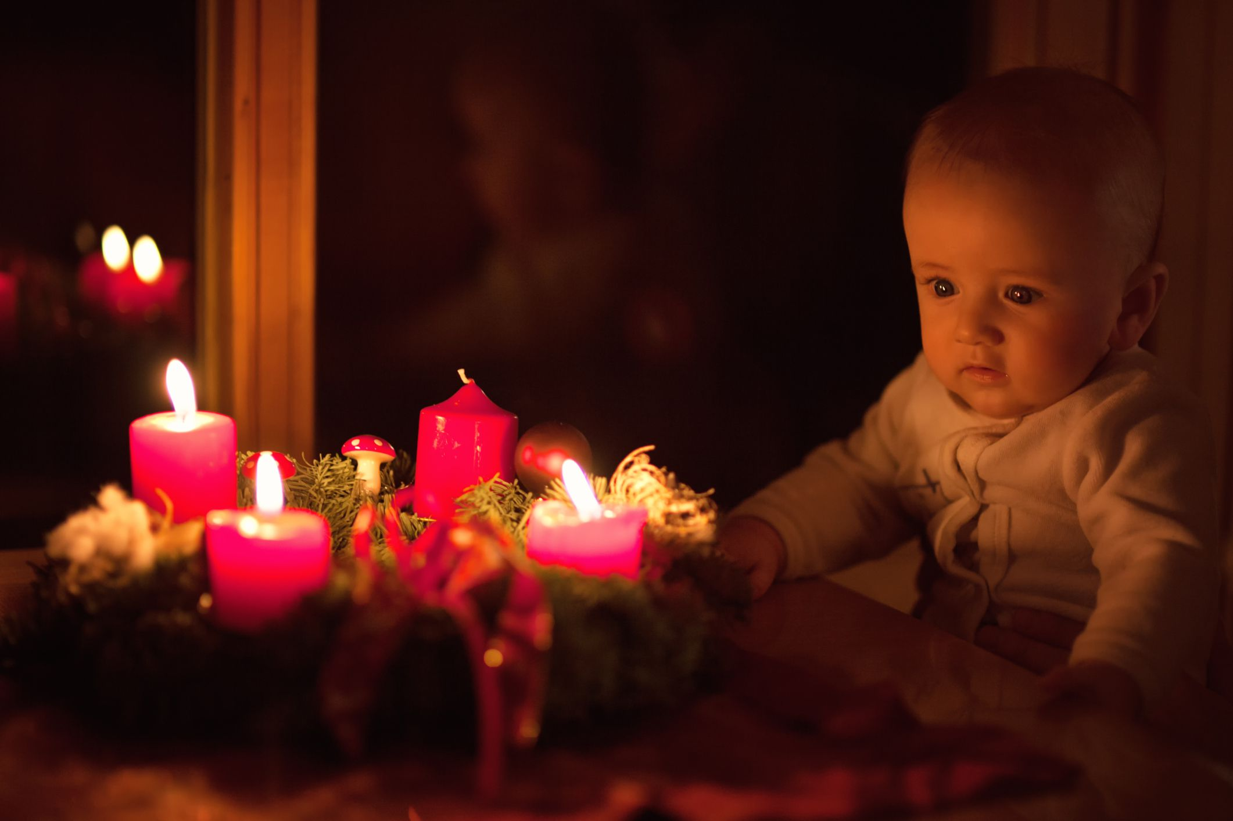
Starter: I see… I think… I wonder…

Slide 3
L2: The Advent Wreath
Learning Intentions
Explore the symbols of the Advent wreath.
Success Criteria
Be able to discuss the symbolism of the advent wreath.

Slide 4
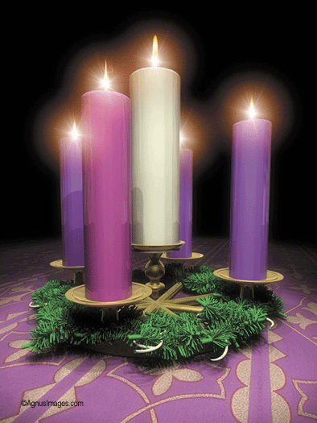
The wreath consists of 5 candles. These candles also symbolise aspects of advent.
There are 3 purple candles. These are to symbolise the prayer and penance we should be undertaking in preparation for the birth of Jesus.
There is 1 pink candle to show how we should be rejoicing the coming birth of the Messiah.
A final white candle is placed on Christmas eve for the coming of Jesus.

Slide 5
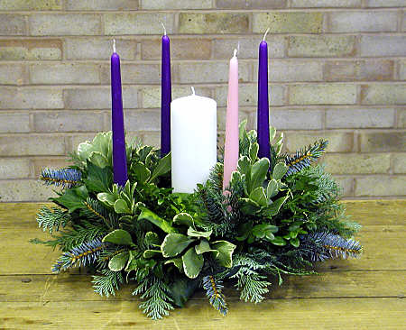
An Advent wreath is key to the preparation for Christmas as it is a symbol of many important things for Christians. The wreath is circular and made from evergreens.
These symbolise very important beliefs about God, one that he is eternal, no beginning, no end – just like a circle.
It is made from evergreens, which symbolises life and Continuous growth – the gifts which God gives to us.

Slide 6
Tasks
Read pages 6-7 and complete activities 1 and 2.

Slide 7
L2: The Advent Wreath
Learning Intentions
Explore the symbols of the Advent wreath.
Success Criteria
Be able to discuss the symbolism of the advent wreath.

