Slide 1
Prayer to the Holy Spirit
Come Holy Spirit, fill the hearts of your faithful and kindle in them the fire of your love.
Send forth your Spirit and they shall be created. And You shall renew the face of the earth. O, God, who by the light of the Holy Spirit, did instruct the hearts of the faithful, grant that by the same Holy Spirit we may be truly wise and ever enjoy His consolations, Through Christ Our Lord, Amen.

Slide 2
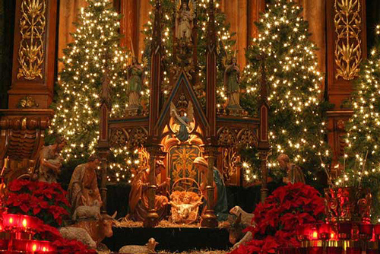
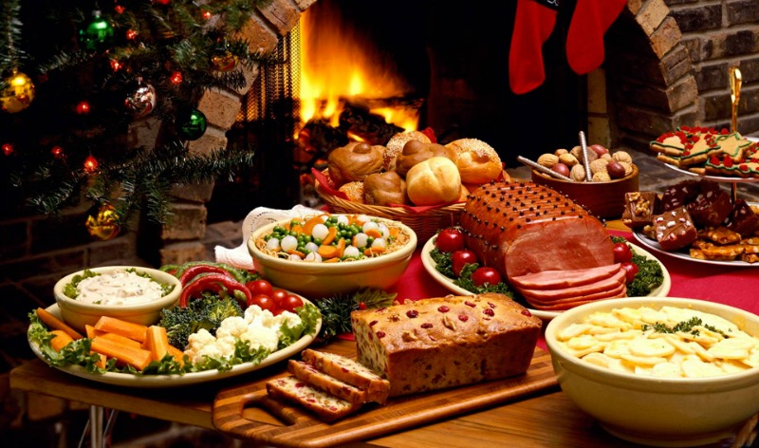
Starter
Find three people in the class and ask them what they usually do to celebrate Christmas.

Slide 3
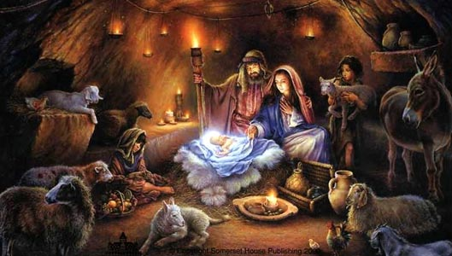
Learning intentions
L3 Advent – The Nativity
Today I will explore:
• the events of “The Nativity” as detailed by Gospel writers.
• what the Birth of Jesus means for Christians today

Slide 4
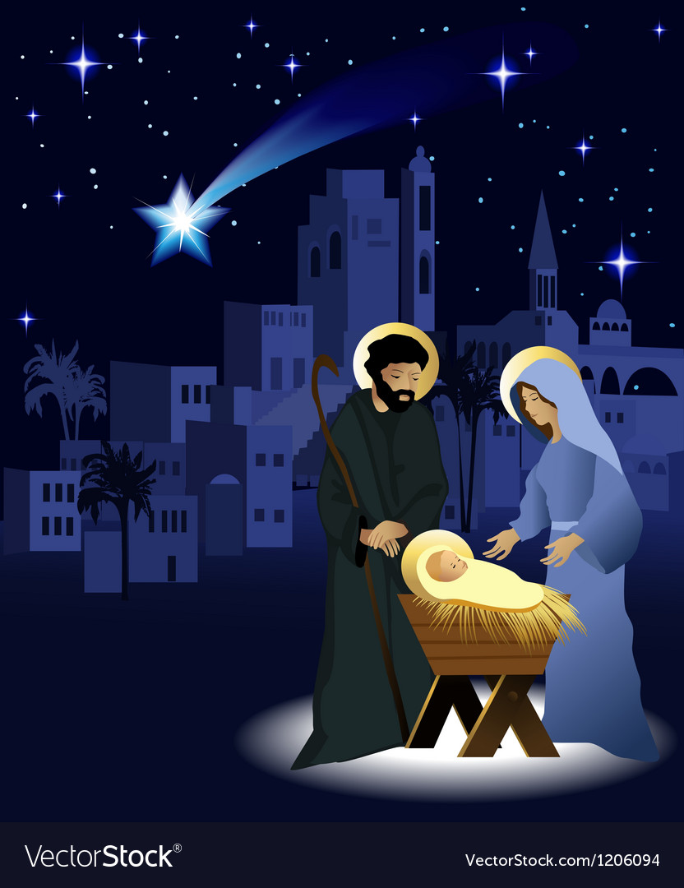
Success Criteria:
L3 Advent – The Nativity
Be able to:
Describe the story of the Nativity by creating a comic strip on the key events described in Luke’s Gospel.
Explain why the birth of Jesus is important to Catholics today.

Slide 5
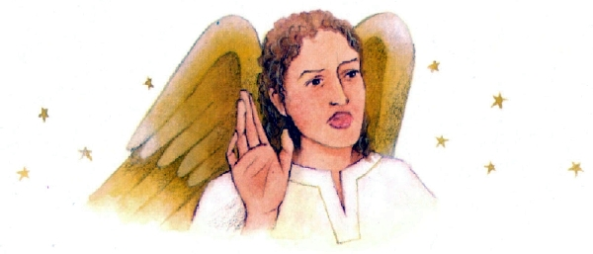
The Christmas Story

Slide 6
The Christmas Story Bingo
Egypt
Holy Spirit
Manger
Bethlehem
myrrh
Elizabeth
God saves
Wise men
Dream

Slide 7
In those days Caesar Augustus issued a decree that a census should be taken of the entire Roman world. Everyone went to their own town to register.

Slide 8
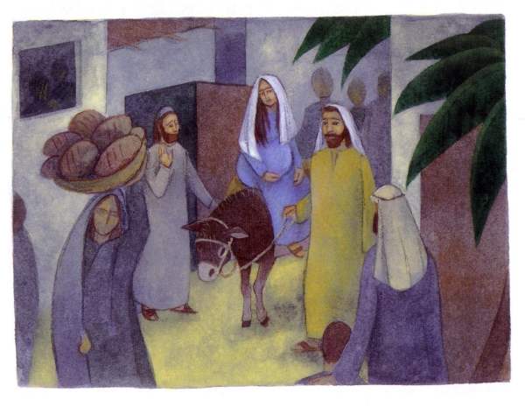
So Joseph also went up from the town of Nazareth in Galilee to Judea, to Bethlehem the town of David, because he belonged to the house and line of David.
He went there to register with Mary, who was pledged to be married to him and was expecting a child.

Slide 9
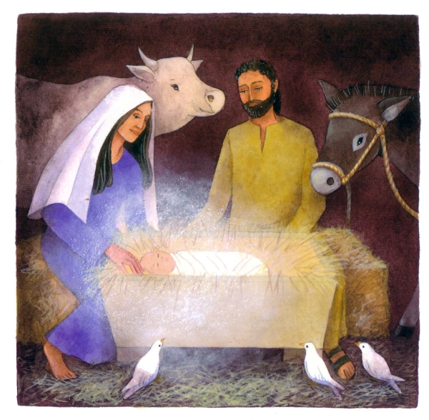
While they were there, the time came for the baby to be born, and she gave birth to her firstborn, a son. She wrapped him in cloths and placed him in a manger, because there was no guest room available for them.

Slide 10
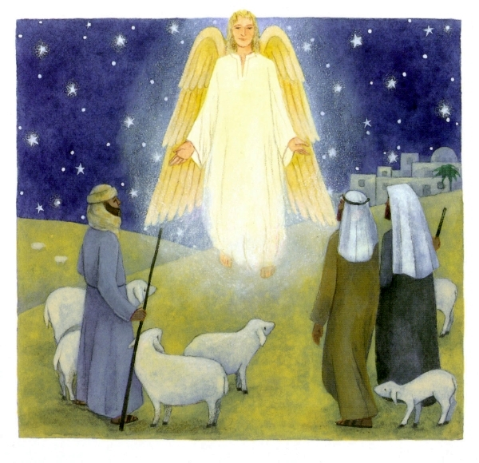
And there were shepherds living out in the fields nearby, keeping watch over their flocks at night. An angel of the Lord appeared to them, and the glory of the Lord shone around them, and they were terrified. But the angel said to them, “Do not be afraid. I bring you good news that will cause great joy for all the people. Today in the town of David a Saviour has been born to you; he is the Messiah, the Lord. This will be a sign to you: You will find a baby wrapped in cloths and lying in a manger.”

Slide 11
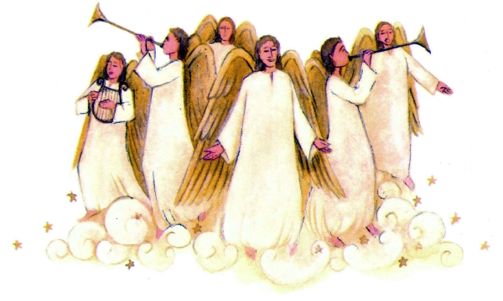
Suddenly a great company of the heavenly host appeared with the angel, praising God and saying,
“Glory to God in the highest heaven,
and on earth peace to those on whom his favour rests.”

Slide 12
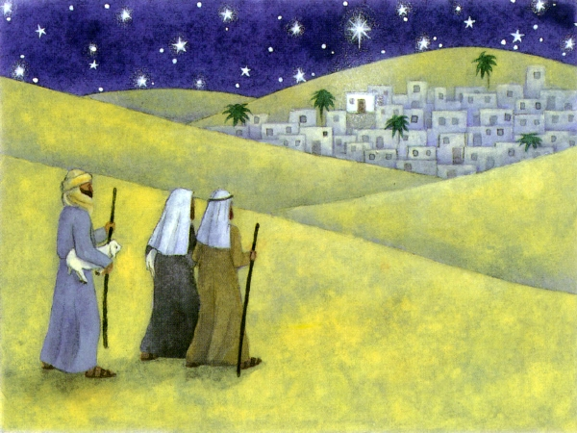
When the angels had left them and gone into heaven, the shepherds said to one another, “Let’s go to Bethlehem and see this thing that has happened, which the Lord has told us about.”

Slide 13
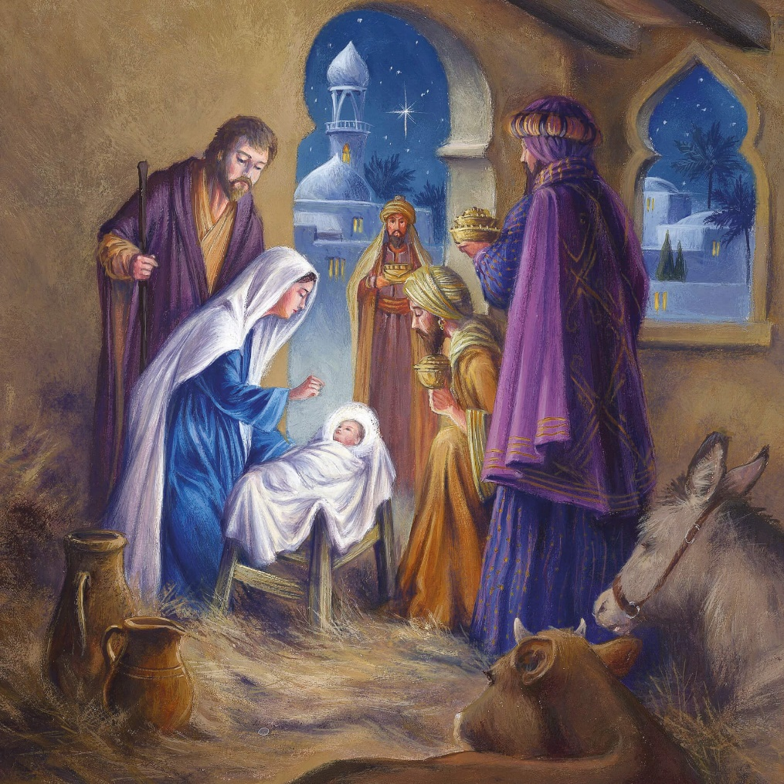
So they hurried off and found Mary and Joseph, and the baby, who was lying in the manger.

Slide 14
Why is Jesus’ Birth Important to Christians today?
https://request.org.uk/festivals/christmas/why-christmas/
The incarnation of God – God becomes Man (Fully man and fully God) to save us from the consequences of sin.

Slide 15
Read pages 9 and 10 and complete tasks 1 and 2.
Task 1 – Make a storyboard of the Nativity story (the birth of Jesus)
Task 2 – make a spider diagram or write a paragraph explaining why Christmas is significant for Christians.

Slide 16
Success Criteria:
L3 Advent – The Nativity
Be able to:
Describe the story of the Nativity by creating a comic strip on the key events described in Luke’s Gospel.
Explain why the birth of Jesus is important to Catholics today.

