Slide 1
Prayer to the Holy Spirit
Come Holy Spirit, fill the hearts of your faithful and kindle in them the fire of your love.
Send forth your Spirit and they shall be created. And You shall renew the face of the earth. O, God, who by the light of the Holy Spirit, did instruct the hearts of the faithful, grant that by the same Holy Spirit we may be truly wise and ever enjoy His consolations, Through Christ Our Lord, Amen.

Slide 2
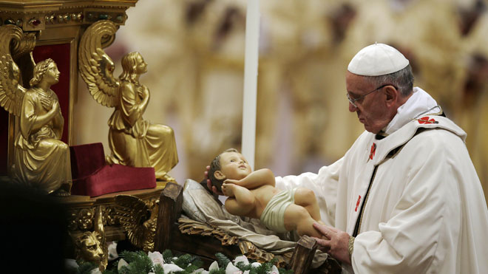
Starter Task
What do you think is happening in this picture?
At midnight Mass (the late Mass on Christmas eve), the priest blesses the crib.

Slide 3
L5: Christmas Liturgy
Learning Intentions
Today I will explore:
What happens at midnight Mass.
The significance of the decorations in the church at Christmas.

Slide 4
L5: Christmas Liturgy
Success Criteria
I will be able to:
Describe why the crib is an important part of the Church’s liturgy at Christmas.
Write a newspaper article, telling the story of the first crib.
Create my own, real life crib.

Slide 5
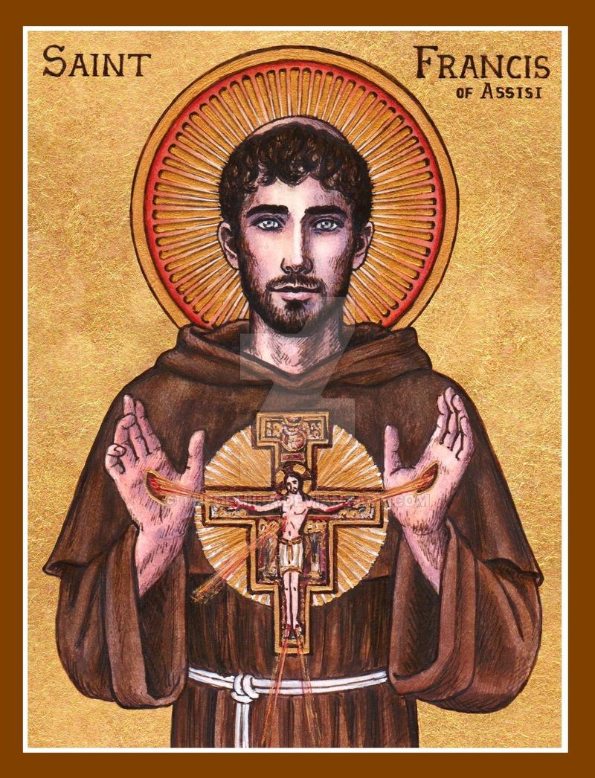
Where did the crib come from?
In 1223, St. Francis of Assisi wanted to celebrate the birth of Jesus in a special way.
He wanted to make people realise that when Jesus was born, he was deprived of the comforts most people would have (a warm bed inside, medical care, good sanitation).

Slide 6
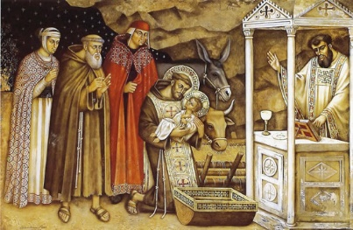
Where did the idea of a crib come from?
St. Francis and his friends lit torches and candles and took an ox and a donkey to a cave in a hillside in Greccio in Italy.
In this cave, he set up a Christmas crib.
They sang songs and celebrated Mass there, celebrating the poor King who was born in a stable in Bethlehem.

Slide 7
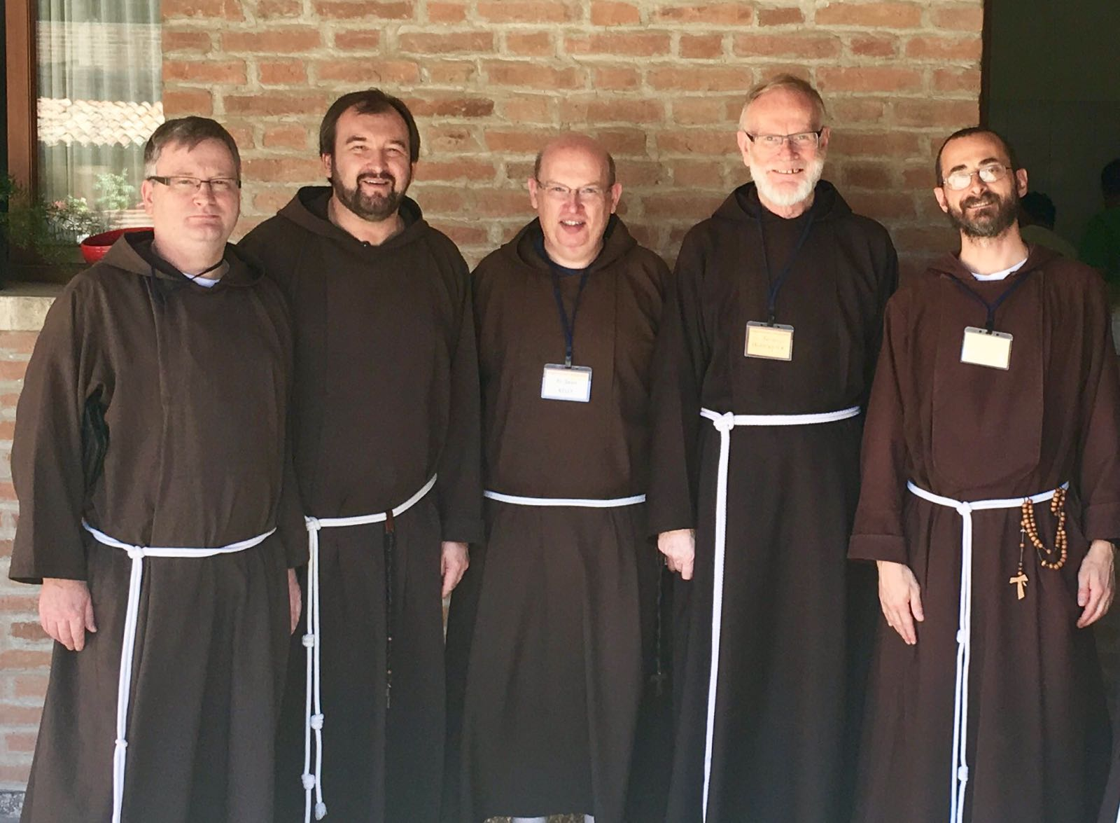
Where did the idea of a crib come from?
St. Francis started an order of monks called the Franciscans.
Due to their work promoting the crib, it became normal to have a crib in your house by the 17th century.

Slide 8
Task
Read pages 11-12 of your booklet and complete task 1.

Slide 9
Task – We are going to make our own real life crib and take a photo of this.
We need:
Joseph
Mary
Wise men
Shepherds
An ox
A donkey
Angels

Slide 10
L5: Christmas Liturgy
Success Criteria
I will be able to:
Describe why the crib is an important part of the Church’s liturgy at Christmas.
Write a newspaper article, telling the story of the first crib.
Create my own, real life crib.

