Slide 1
Prayer to the Holy Spirit
Come Holy Spirit, fill the hearts of your faithful and kindle in them the fire of your love.
Send forth your Spirit and they shall be created. And You shall renew the face of the earth. O, God, who by the light of the Holy Spirit, did instruct the hearts of the faithful, grant that by the same Holy Spirit we may be truly wise and ever enjoy His consolations, Through Christ Our Lord, Amen.

Slide 2
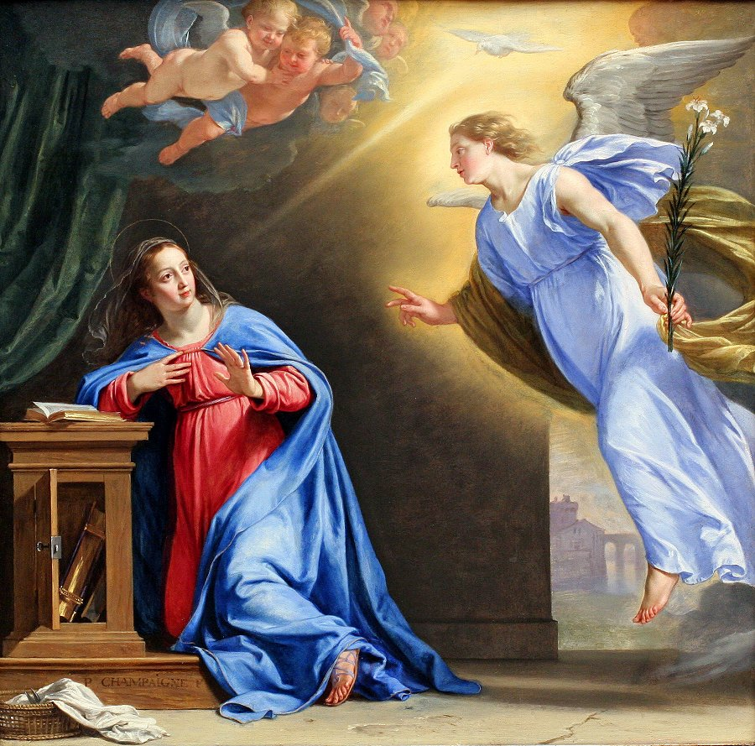
Starter – What is happening in this picture?

Slide 3
L3: The Annunciation
Learning aims:
how God communicates with Mary through the angel Gabriel.
how the Holy Spirit worked in this event and continues to work in the world today.
the prayer ‘The Angelus’

Slide 4
L3: The Annunciation
Success Criteria:
I will be able to:
Briefly describe the significance of the annunciation.
Explain the ways in which the Holy Spirit works in the world today.
Participate in different forms of prayer.

Slide 5
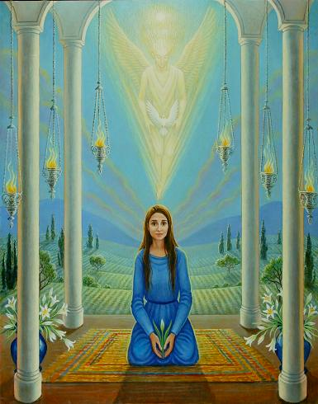
What is the Annunciation?
It is the Announcement by the Angel Gabriel to the Virgin Mary that she would become mother of Jesus, the Son of God.
We celebrate this event on the 25th March.

Slide 6
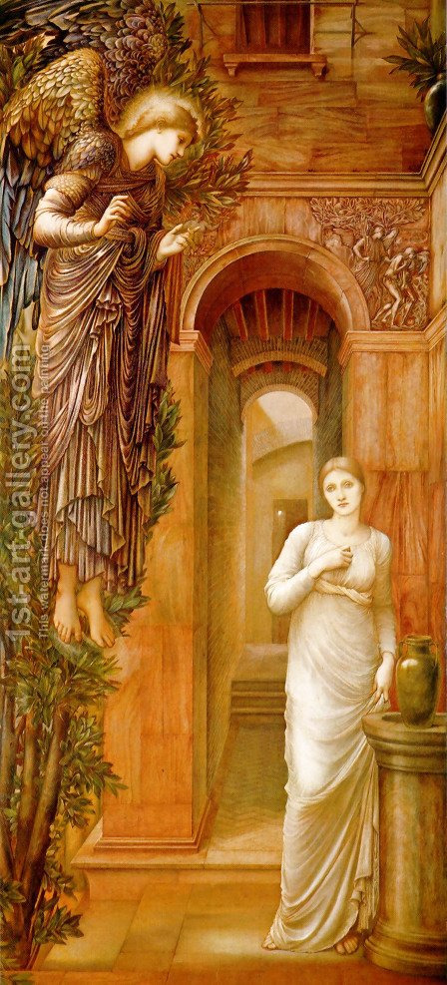
How it happened…
The Angel Gabriel was sent by God as a messenger of the most significant news.
The Angel spoke to Mary and told her about the miracle that was going to happen.
Read page 7 and complete task 1 on page 8.

Slide 7
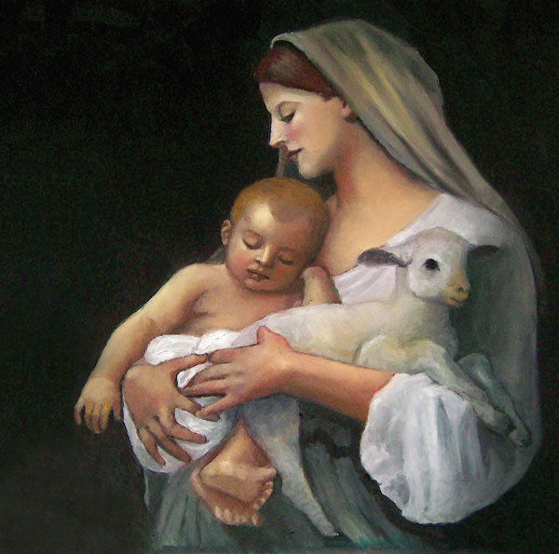
Why this event is significant?
The Incarnation: Through Mary’s ‘Yes’, God became a man and walked among us.
Jesus being born as a baby, innocent and helpless demonstrates his humility and love for humankind.
This was always part of Gods plan.

Slide 8
Who or what do you think ‘the Holy Spirit’ Is?
Write your answer on the board.

Slide 9
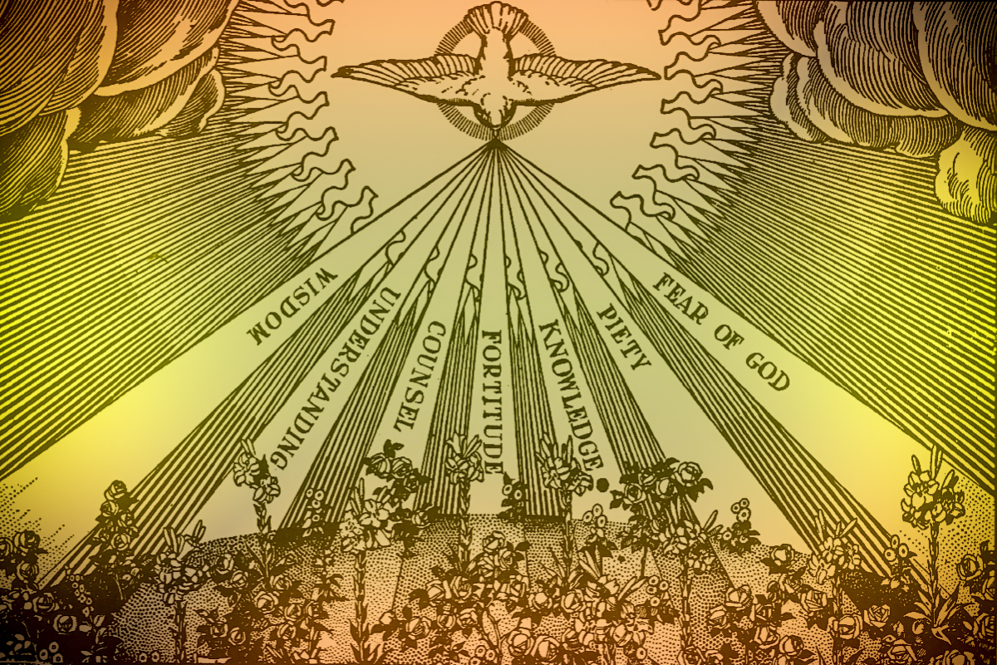
Who is the Holy Spirit?
God!
The third person of the Trinity
The Holy Spirit makes us receptive to God, He teaches us to pray and helps me to be there for others.

Slide 10
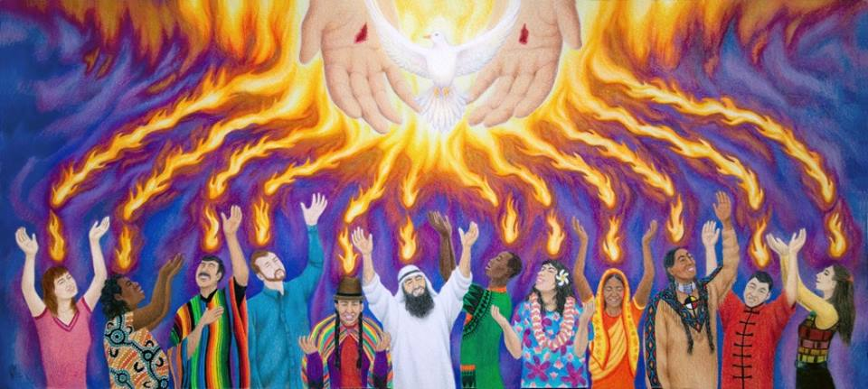
Who is the Holy Spirit?
We believe that by the Holy Spirit God will renew the earth, and bring not only our souls into eternal life, but also a final, definitive resurrection of our human bodies as well.

Slide 11
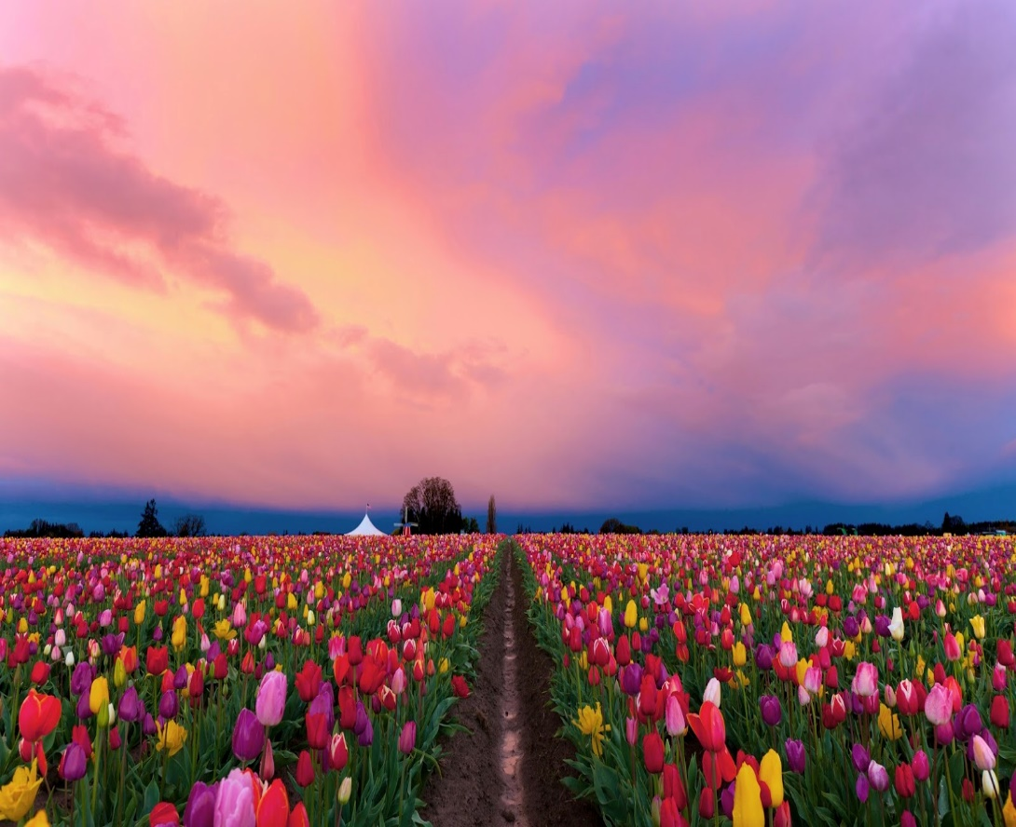
Ways the Holy Spirit Reveals Himself to Us Today
Through His Word - 2 Timothy 3:16 says that all Scripture is “God-breathed.”
Through His Son, Jesus Christ
Through Nature and God’s Creation

Slide 12
Ways the Holy Spirit Reveals Himself to Us Today
Through our Conscience
Through Prayer
Through Other Believers
Through Music

Slide 13
What is the Holy Spirit?
What does the Holy Spirit empower people to do in the Bible?
How does the Holy Spirit continue to reveal the nature of God in the world today?
https://www.youtube.com/watch?v=oNNZO9i1Gjc

Slide 14
Task
Read the rest of page 8 and complete task 2.

Slide 15
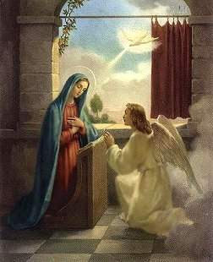
The Angelus
The Angelus is a meditation on Mary’s role in the incarnation.
Like all prayers to Virgin Mary, we ask her for guidance and prayers. The first three verses are taken from Scripture.

Slide 16
The Angelus
The Angelus is traditionally said daily at 12 noon. Many Catholic churches ring their church bells at noon, the Angelus bells, to call the faithful to prayer.
This is often said as a group prayer, with the leader speaking the V parts and the group responding with the R lines (in white).
Let’s have a go…

Slide 17
The Angelus
V — The Angel of the Lord declared unto Mary.
R — And she conceived by the Holy Spirit.
Hail Mary…

Slide 18
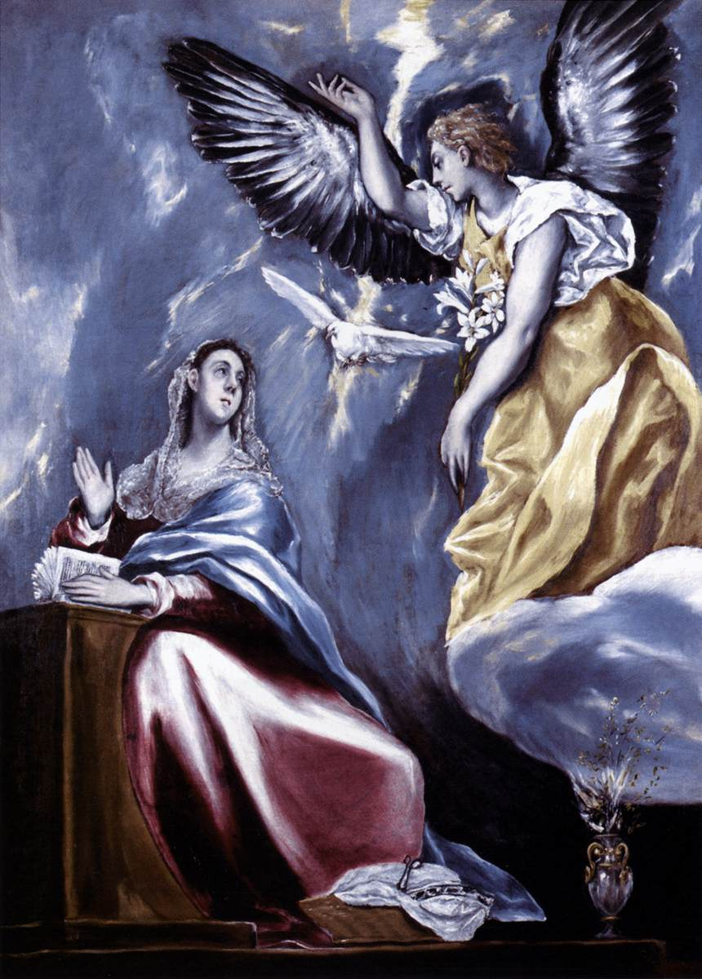
The Angelus
V — Behold the handmaid of the Lord.
R — Be it done unto me according to thy word. Hail Mary…

Slide 19
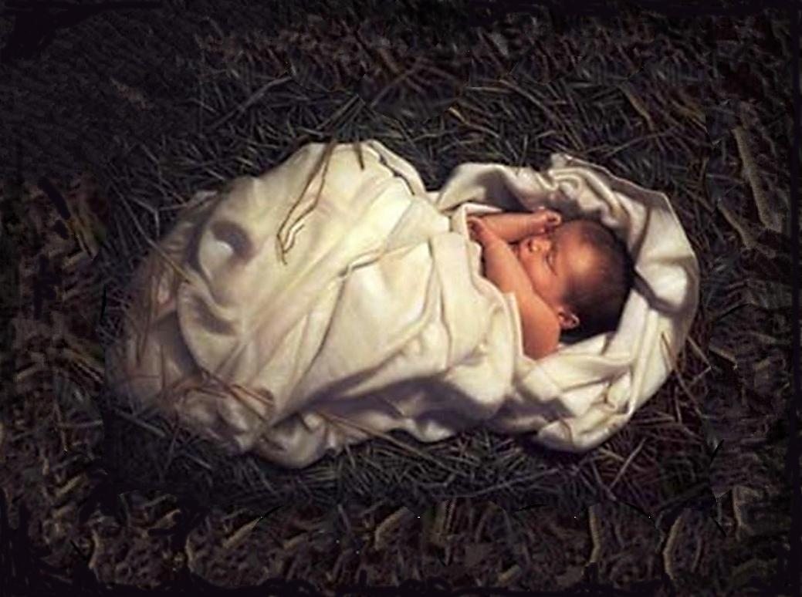
The Angelus
V — And the Word was made Flesh.
R — And dwelt among us. Hail Mary…

Slide 20
The Angelus
V — Pray for us, O Holy Mother of God.
R — That we may be made worthy of the promises of Christ.
Pour forth, we beseech you, O Lord, your grace into our hearts, that we to whom the incarnation of Christ, your Son, was made known by the message of an angel, may by his passion and cross be brought to the glory of his resurrection. Through the same Christ our Lord. Amen.

Slide 21
L3: The Annunciation
Success Criteria:
I will be able to:
Briefly describe the significance of the annunciation.
Explain the ways in which the Holy Spirit works in the world today.
Participate in different forms of prayer.

