Slide 1
Confirmation
S1 Home Session
Notes:
This is the home session presentation which is designed to supplement the learning which is taking place in your child’s school.

Slide 2
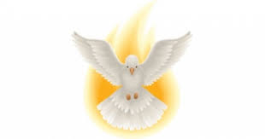
You are invited to participate fully in your child’s preparation for Confirmation, alongside school and parish.
Your child may have prepared for Confirmation at primary using the family workbook
Preparation for this sacrament is continuing at you child’s new school
This presentation is intended to supplement this preparation and to support you and your child as they are Confirmed
The home session power point is designed to be broken down into smaller parts to suit your own setting
Notes:
If your child has their Family workbook, this could also be used to recap on previous learning done in primary school but this presentation can be completed without the workbook if it isn’t available. The presentation can be split into sections and used over a number of sessions to suit your family circumstances and your child’s concentration span. It’s better to do a little over a number of evenings rather than do too much in one sitting.

Slide 3
Praying together…
Set aside some time to do this preparation with no distractions
Perhaps you could light a candle to remind us God is with us during this time of prayer
Others in your household are welcome to join you in prayer
Begin with sign of the cross…
Notes:
If you are using a candle, ensure it is extinguished at the end or alternatively use a battery operated one. If other members of the family wish to participate this is fine. Try to reduce distractions such as TV or phones.

Slide 4
Opening Prayer
Come Holy Spirit, fill the hearts of your faithful and kindle in them the fire of your love. ​
Send forth your Spirit and they shall be created.
And You shall renew the face of the earth. ​
O God, who by the light of the Holy Spirit, did instruct the hearts of the faithful, grant us in the same Spirit to be truly wise and ever to rejoice in His consolation. Through Christ our Lord.
Amen.​
Notes:
This prayer can be used to start each short session if you are doing this presentation over a number of sittings.

Slide 5
What can you Remember….?
Q. What are the 7 Sacraments of the Catholic Church?
Q Which Sacraments have you received already?
Q What did we receive when we were baptised?
Q Who made our baptismal promises for us at our baptism?
Q Why do we renew our baptismal promises?
Q Why are we confirmed?
A Baptism, Reconciliation, Eucharist, Confirmation, Matrimony, Holy Orders and The Sacrament of the Sick
A Baptism, Reconciliation and Eucharist
A We received the Holy Spirit at our baptism
A Our parents and God parents made these on our behalf
A As we are confirmed, we renew these baptismal promises for ourselves
At our Confirmation, the Holy Spirit gives us the strength to use the Gifts we have been given to bear the Fruits of the Holy Spirit in our lives as Christians

Slide 6
The Sacrament of Confirmation
Establishes you as a full member of the Church
This sacrament is called Confirmation because the faith given in Baptism is now confirmed and made strong
At Confirmation, you renew the promises, made on your behalf at Baptism, this time speaking for yourself.
The focus of Confirmation is the Holy Spirit, who confirmed the apostles on Pentecost and gave them courage to practice their faith.
Notes:
Let’s look specifically at the Sacrament of Confirmation now.
Confirmation is one of the “Sacraments of Initiation”.
This is a re-cap of what the children have learned in school.
They learned that the sacraments of Reconciliation, Eucharist and Confirmation are the three primary sacraments on which the rest of our lives depend. Just as bodies and minds grow, Catholics believe that the soul also needs to grow in the life of grace. The sacrament of Confirmation builds on the sacraments of Baptism, Penance, and Holy Communion, completing the process of initiation into the Catholic community.
Click for bullet points
Confirmation establishes young adults as full-fledged members of the faith. This sacrament is called Confirmation because the faith given in Baptism is now confirmed and made strong. During your Baptism, your parents and godparents make promises to renounce Satan and believe in God and the Church on your behalf. At Confirmation, you renew those same promises, this time speaking for yourself.
During Confirmation, the focus is on the Holy Spirit, who confirmed the apostles on Pentecost and gave them courage to practice their faith. Catholics believe that the same Holy Spirit confirms Catholics during the Sacrament of Confirmation and gives them the same gifts.

Slide 7
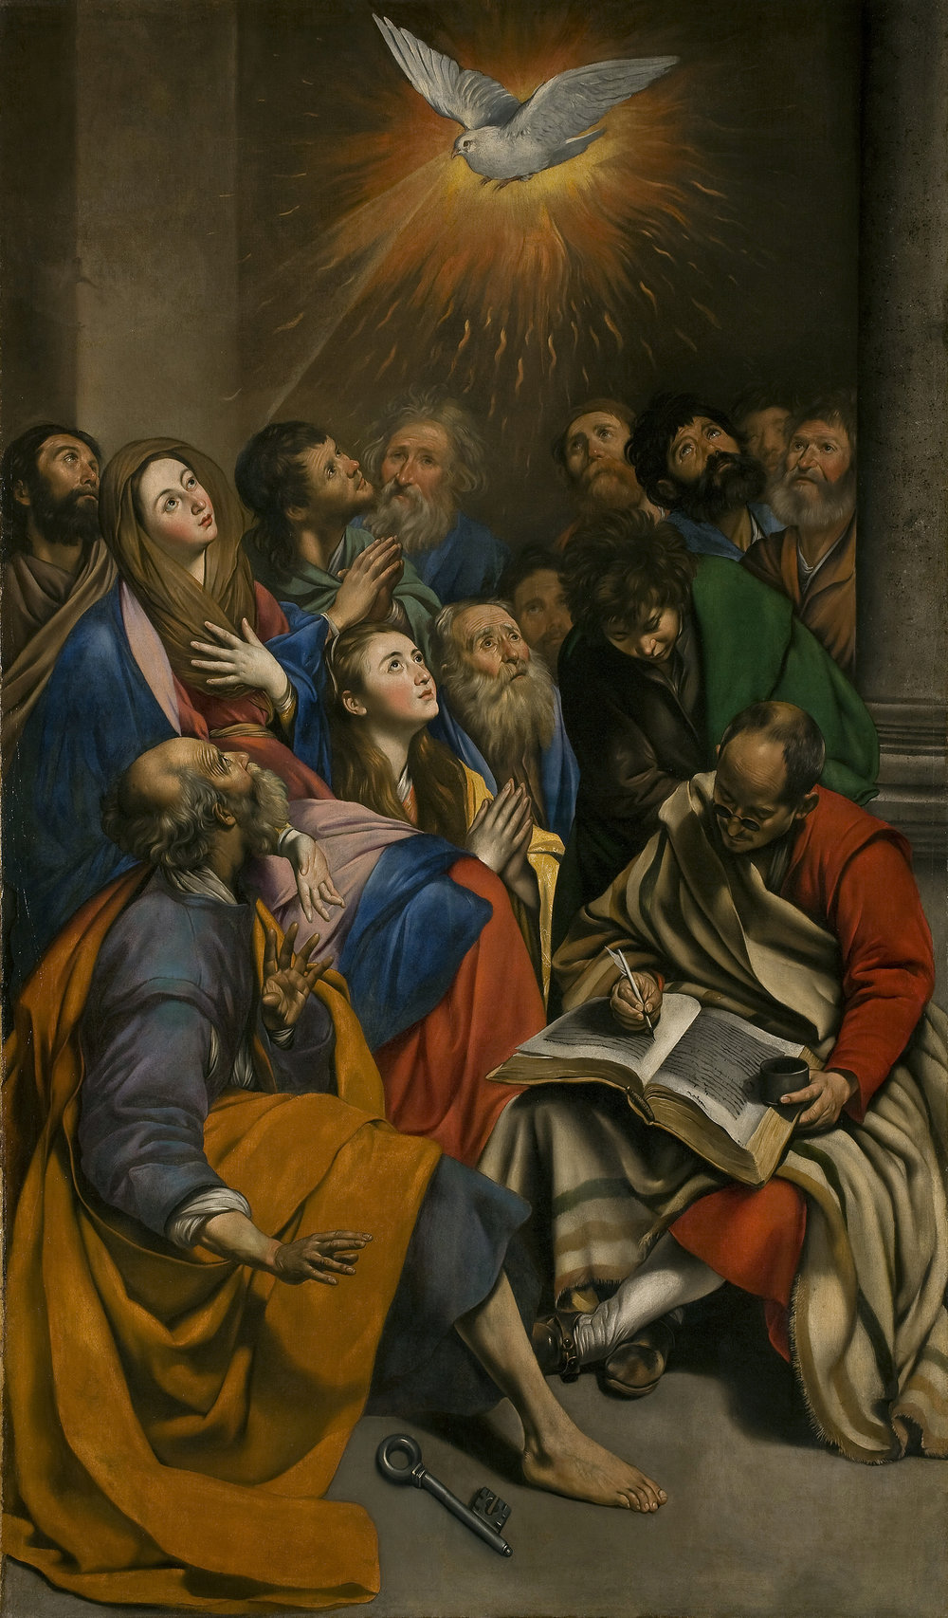
The Day of Pentecost
Notes:
Ask pupils what they know about Pentecost. This could be details from the story, clues from the image, words or symbols associated with the Holy Spirit.

Slide 8
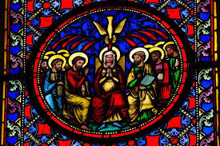
Act 2:1-4
Notes:
If no bible is available, this scripture is available to read on the next slide.

Slide 9
Acts 2:1-4
When Pentecost day came round, they had all met in one room, when suddenly they heard what sounded like a powerful wind from heaven, the noise which filled the entire house in which they were sitting; and something appeared to them that seemed like tongues of fire; these separated and came to rest on the head of each one of them.
They were all filled with the Holy Spirit, and began to speak foreign languages as the Spirit gave them the gift of speech

Slide 10
Discussion Task
How do you think those gathered felt before the Holy Spirit descended on them?
How do you think they felt afterwards?
During Confirmation, you will receive an out-pouring of the Holy Spirit-what do you think will be different for you afterwards?
Can you remember what the gifts of the Holy Spirit are from your learning in school?
Which gift do you think you need most at present?

Slide 11
The gifts and fruits of the holy spirit

Slide 12
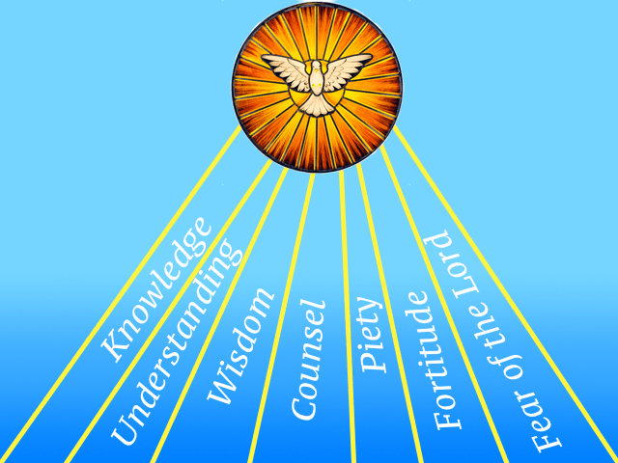
Which of the Gifts of the Holy Spirit
Can you remember?

Slide 13
The Fruits of the Holy Spirit

Slide 14
Fruits of the Spirit Task
After watching the video discuss what you remember
Are there any of the Fruits that you are aware of developing and growing in your own life?
Which of the Fruits of the Spirit do you think you need pray for more help with?

Slide 15
Choosing a Confirmation Name

Slide 16
Why do we choose a confirmation name?
Traditionally, we take a confirmation name to make a new stage in our life
We choose a saint’s name
We choose a saint who we particularly admire and wish to emulate in our own lives as we grow as Christians
We can pray for our confirmation saint to intercede for us when we find it hard to live as God wants us to

Slide 17
Confirmation Name Task
What facts have you found out about your confirmation saint?
What appeals to you about this saint?
What do you hope this saint will inspire you to do?
Perhaps you could write a prayer to ask for your chosen saint’s intercession as you prepare for Confirmation
Notes:
You may have already done some research in school about your confirmation saint. If not you could research this using a website such as https://notsoformulaic.com/patron-saints-exceptional-catholic-kids/ or watch this video on https://www.youtube.com/watch?v=RG6vo6wbaC4

Slide 18
The rite of confirmation
Renewal of Baptismal promises
Notes:
Over the next few slides, there will be an opportunity to practice the renewal of baptismal promises which will form part of your Confirmation Mass. Usually, it is the who would be the main celebrant during the confirmations but in exceptional circumstances, he can confer this to the parish priest. The sacrament of Confirmation is equally valid whether the bishop or the priest is the main celebrant.

Slide 19
Renewal of Baptismal Promises
After the homily the Bishop questions those to be confirmed, who stand, as he says:
Do you renounce Satan,
and all his works and empty promises?
Together, all those to be confirmed reply: I do.
Bishop/Priest:
Do you believe in God,
the Father almighty,
Creator of heaven and earth?
Those to be confirmed: I do.

Slide 20
Bishop/priest:
Do you believe in Jesus Christ, his only Son, our Lord,
who was born of the Virgin Mary,
suffered death and was buried,
rose again from the dead
and is seated at the right hand of the Father?
Those to be confirmed: I do.
Bishop/priest:
Do you believe in the Holy Spirit,
the Lord, the giver of life,
who today through the Sacrament of Confirmation
is given to you in a special way
just as he was given to the Apostles on the day of Pentecost?
Those to be confirmed: I do.

Slide 21
Bishop/priest:
Do you believe in the holy Catholic Church,
the communion of saints,
the forgiveness of sins,
the resurrection of the body,
and life everlasting?
Those to be confirmed: I do.
The Bishop gives his assent to the profession
by proclaiming the faith of the Church:
This is our faith. This is the faith of the Church. We are proud to profess it in Christ Jesus our Lord.
The gathering of the faithful gives its assent by replying: Amen.

Slide 22
The rite of confirmation
The Laying on of hands

Slide 23
Then the Bishop/priest standing, facing the people, with hands joined, says:
Dearly beloved, let us pray to God the almighty Father, for these, his adopted sons and daughters,
already born again to eternal life in Baptism, that he will graciously pour out the Holy Spirit upon them
to confirm them with his abundant gifts, and through his anointing conform them more fully to Christ, the Son of God.
And all pray in silence for a while.

Slide 24
Then the Bishop/priest lays hands over all those to be confirmed (as do the Priests who are associated with him). But the celebrant alone says:
Almighty God, Father of our Lord Jesus Christ,
who brought these your servants to new birth
by water and the Holy Spirit, freeing them from sin:
send upon them, O Lord, the Holy Spirit, the Paraclete;
give them the spirit of wisdom and understanding, the spirit of counsel and fortitude, the spirit of knowledge and piety;
fill them with the spirit of the fear of the Lord.
Through Christ our Lord. Amen

Slide 25
The rite of confirmation
The anointing with chrism

Slide 26
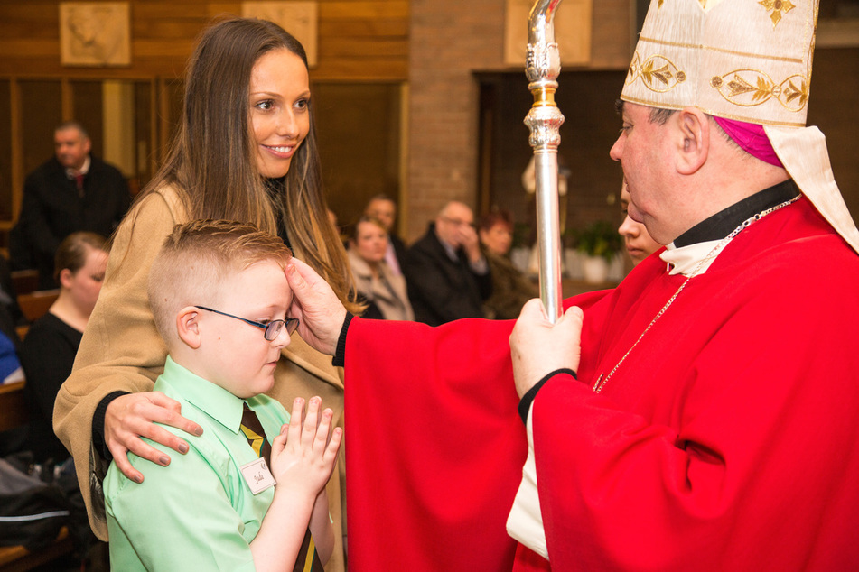
"Be sealed with the gift
of the Holy Spirit..."
Notes:
When we are anointed with the Holy Spirit at Confirmation, the Bishop says: "Be sealed with the gift of the Holy Spirit." Just as we have read in the scripture passages, Jesus was filled with the Holy Spirit and we were able to see this in everything he said and everything that he did. When the Bishop says these words to us at Confirmation, we too are filled with the Holy Spirit. This is why Confirmation cannot be repeated - because the gift of the Holy Spirit remains with us forever.

Slide 27
The sponsor who presents the person to be confirmed places his (her) right hand on his (her) shoulder the Master of Ceromonies will read the Confirmation name to the bishop displayed on the badge worn by the candidate.
The Bishop/priest dips his right thumb into the Chrism and makes the sign of the cross on the forehead of the one to be confirmed saying:
N., be sealed with the Gift of the Holy Spirit.
The newly confirmed replies: Amen.
The Bishop/priest adds:
Peace be with you.
The newly confirmed: And with your spirit.

Slide 28
Confirmation Video
Sophia Sketchpad video
Notes:
The following video is a round up about the sacrament of Confirmation.

Slide 29
Notes:
To finish off this short re-cap on Confirmation, consolidate what you have learned with the video on the slide. After you have watched the video, draw attention to the following points:
Points to draw out:
In the sacraments, God gives us special graces to live like he does – unselfishly and for the good of others
The outpouring of the Holy Spirit seals and you - it is the same outpouring that God gave to his Apostles
After his death and resurrection, Jesus said he would give them the Holy Spirit and through it they would have the strength to tell the world about Jesus
Pentecost – the outpouring of the Holy Spirit – transformed the Apostles from being scared to being string and courageous
Jesus is sending you out in the same way in which he sent the Apostles out
When you are confirmed, you receive the seven Gifts of the Holy Spirit which you can develop by spending time in prayer with God and living a life ,modelled on Jesus

