Slide 1
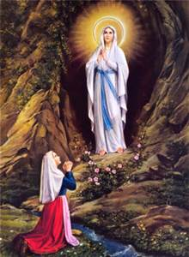
Lourdes

Slide 2
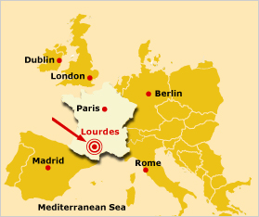
Lourdes, France
The town of Lourdes lies in a valley in the south western part of the Hautes-Pyrenees.

Slide 3
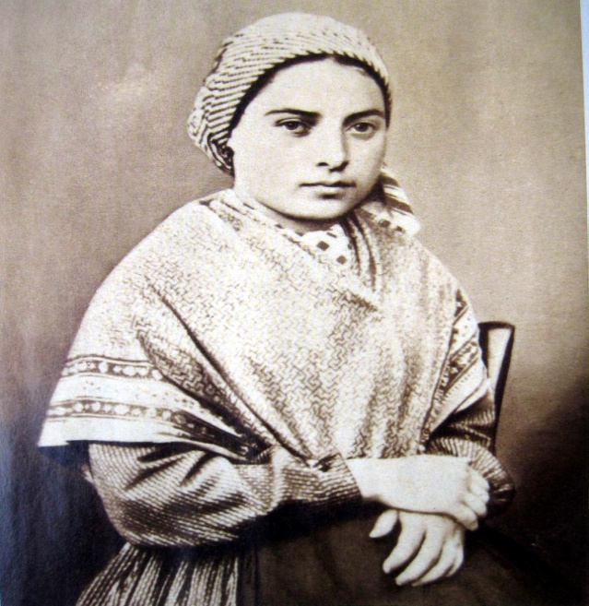
Saint Bernadette
Bernadette Soubirous was born in Lourdes on January 7,
1844. She was the oldest of nine children and her family
were very poor. She was baptised in St. Pierre’s Parish
Church when she was two days old. She contracted
cholera as a small child and suffered from extreme
asthma her whole life.

Slide 4
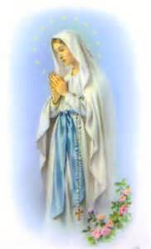
Beautiful Lady
On Thursday, February 11, 1858, fourteen year old
Bernadette left her home, an abandoned jail called Le
Cachot, with her sister and friend to find firewood. They
went to a grotto called Massabielle, and Bernadette was
just about to cross a small stream when she saw a vision
of a beautiful lady. The ‘lady’ wore blue and
white and said the rosary with Bernadette. Only
Bernadette saw the ‘lady’.

Slide 5
Visions
Bernadette returned to the grotto three days later and had
her second vision. On February 18, Bernadette had her
third vision and the ‘lady’ told her,
“I do not promise to make you happy in this world, but the next.”
Over a five month period Bernadette had eighteen
visions. During these the ‘lady’ gave her messages of
prayer and penitence to share with the world.

Slide 6
Disbelief
Unfortunately many people didn’t believe Bernadette,
including the Parish Priest. Local officials questioned her
and threatened her with prison. On March 25, the day of
the sixteenth vision, the ‘lady’ told Bernadette,
“I am the Immaculate Conception.”
Finally the Parish Priest believed her as he knew
Bernadette couldn’t have made this information up.

Slide 7
Religious Life
On July 29, 1866, Bernadette joined the Sisters of Charity at their motherhouse at Nevers. The rest of her life was spent working as an infirmary assistant, and later a sacristan. Sadly she was diagnosed with tuberculosis of the bone in her right knee and was unable to take part in convent life. She died on April 16, 1879 at the age of 35 while saying the rosary. Saint Bernadette’s body is preserved in a shire in the chapel at the convent of St. Gilard of Nevers.
Pope Pius XI declared Bernadette a saint in December 1933. We celebrate her feast day every 18th February.

Slide 8
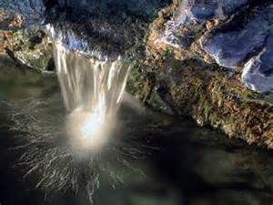
Water
During the ninth vision the ‘lady’ asked Bernadette to dig
the ground, drink water and wash in it. She also
asked her to eat a herb from the ground. Bernadette did
as she was asked and water began to flow. Miracles and
cures have occurred for people who have used the water.

Slide 9
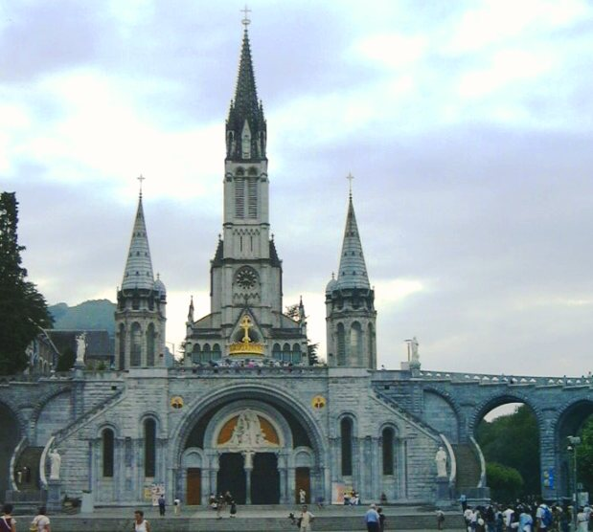
Basilica
The ‘lady’ asked Bernadette to go to the priests and ask
for a chapel to be built in her honour at the grotto.
The Basilica of Our Lady of the Rosary is the third of the
churches to be built at the grotto – after the Crypt and
Upper Basilica.

Slide 10
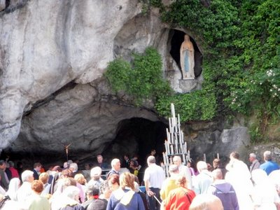
Lourdes Today
Pilgrims today come in their millions to visit the
churches, attend Mass, wash in the healing water and
pray the rosary.
www.directfromlourdes.com/lourdes_live_tv

Slide 11
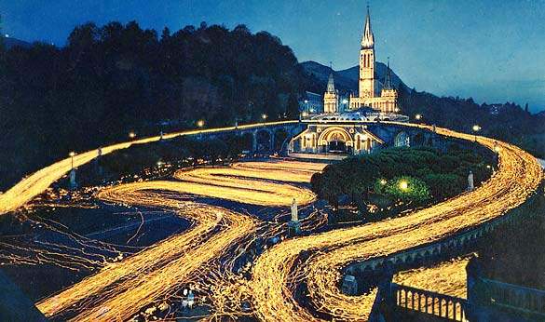
Torchlight Procession
The torchlight procession takes place daily at 9pm, with
the candles creating a sea of light. At the head of the
procession a statue of Our Lady is carried. The rosary is
recited and the hymn ‘Immaculate Mary’ sung.

Slide 12
Suggested Activites
Class visit to Carfin Grotto.
www.carfingrotto.org
Summarise the story of St. Bernadette and the visions.
Research Project.
Newspaper article from the time of the visions.
Interview questions to St. Bernadette.
Prayer Service.
Art work – model of grotto.
Class visitor from HCPT – The Pilgrimages Trust. www.hcpt.org.uk

Slide 13
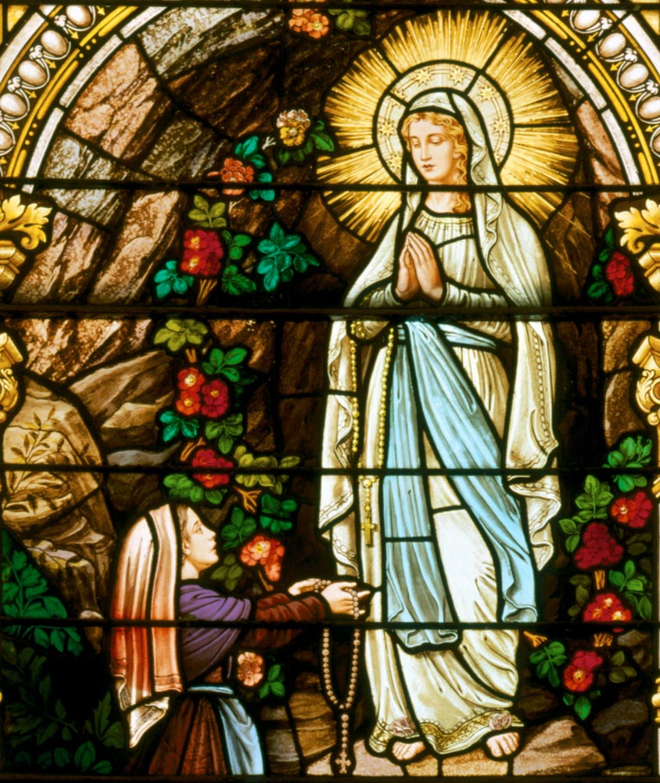
Immaculate Mary
Immaculate, Mary!
Our hearts are on fire.
That title so wondrous
Fills all our desire!
Refrain Ave, Ave, Ave, Maria! Ave, Ave, Ave, Maria!
We pray for God's glory,
May His Kingdom come.
We pray for His Vicar,
Our Father, and Rome. Refrain
We pray for our Mother,
The Church upon earth.
And bless, sweetest Lady,
The land of our birth. Refrain

