Slide 1
A brief introduction to the
Synod 2021-2023
The synodal process in our Diocese
Key notes for parishes and groups
Diocese of Motherwell, Mission & Evangelisation
@LectioMotherwe1

Slide 2
Pope Francis has called a Synod to discuss the theme
For a Synodal Church:
Communion, Participation, and Mission.
Diocese of Motherwell, Mission & Evangelisation
@LectioMotherwe1

Slide 3
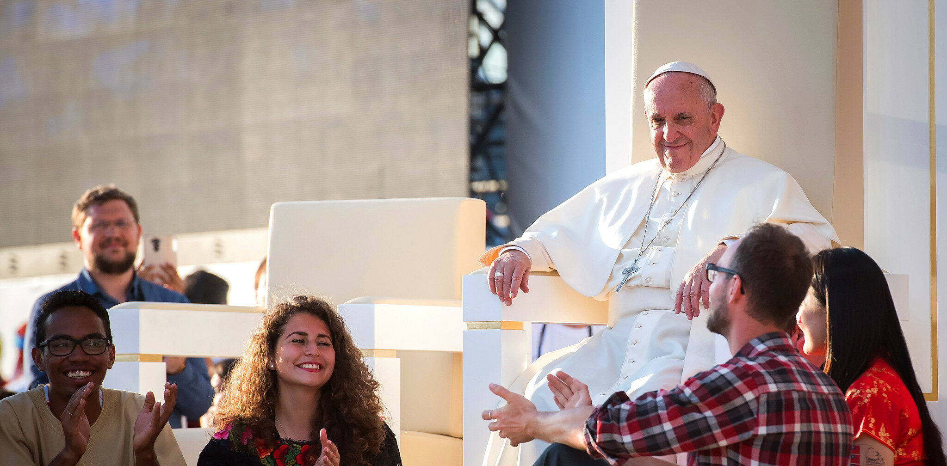
What makes this Synod unique is
the invitation from Pope Francis
for the whole People of God to participate
He has asked that
every diocese
set up a process through which all the baptised
can meet in prayer, listening, and discernment to hear
what the Holy Spirit is saying to the Church
(cf. Revelation 3.22)
at this moment in history.
Diocese of Motherwell, Mission & Evangelisation
@LectioMotherwe1

Slide 4
The fundamental question we are asked to reflect upon and respond to is:
A synodal Church, in announcing the Gospel, “journeys together:”
How is this “journeying together” happening today in your particular Church?
What steps does the Spirit invite us to take in order
to grow in our “journeying together”?
Diocese of Motherwell, Mission & Evangelisation
@LectioMotherwe1

Slide 5
Synod
‘Synod’ indicates
the path along which
the People of God
walk together.
Equally, it refers
to the Lord Jesus,
who presents Himself as
‘the way, the truth
and the life’ (John 14,6)
Diocese of Motherwell, Mission & Evangelisation
@LectioMotherwe1

Slide 6
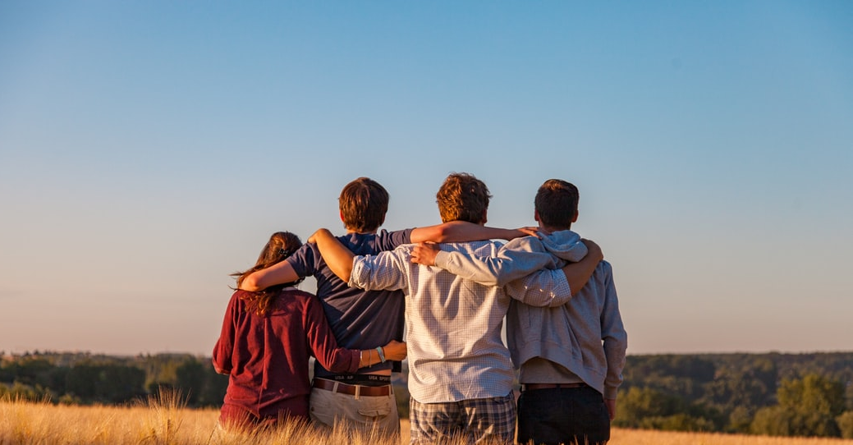
Synodality
“Walking together”
An essential dimension
of the Church
Diocese of Motherwell, Mission & Evangelisation
@LectioMotherwe1

Slide 7
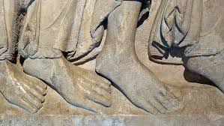
Our response to this question has
the potential of being the most transformative moment in the Church since the Second Vatican Council.
In listening to the People of God
in this way,
the Holy Father,
together with the bishops,
is seeking a new way and style of living
and working
as Church.
Diocese of Motherwell, Mission & Evangelisation
@LectioMotherwe1

Slide 8
The call to journey together
A global tragedy such as the COVID-19 pandemic “momentarily revived the sense that we are a global community, all in the same boat, where one person’s problems are the problems of all.”
“Once more we realized that no one is saved alone; we can only be saved together”
Diocese of Motherwell, Mission & Evangelisation
@LectioMotherwe1

Slide 9
“Church and Synod are synonymous”
Diocese of Motherwell, Mission & Evangelisation
@LectioMotherwe1

Slide 10
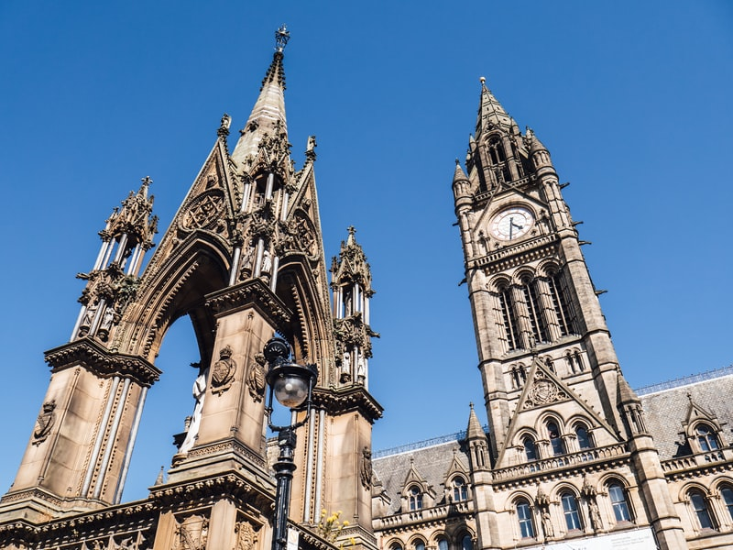
Kairos
The Synod is a moment which we can definitively identify as “Kairos”, since we can see specific features of the active presence
of God, and of a calling to missionary discipleship,
to be witness of a credible Church
“Kairos (καιρός) is an Ancient Greek word meaning the right, critical, or opportune moment.”
Diocese of Motherwell, Mission & Evangelisation
@LectioMotherwe1

Slide 11
Key Words for the Synodal Process
.
This opportunity to become a synodal church,
to deepen our communion and participation
in the life and mission of the Church,
is truly not only an awesome gift from God
and also a great responsibility laid before us all.
Diocese of Motherwell, Mission & Evangelisation
@LectioMotherwe1

Slide 12
Communion
Communion
“The communion
we share finds its deepest roots in the love and
unity of the Trinity.
It is Christ who
reconciles us
to the Father
and unites us
with each other
in the Holy Spirit.”
Diocese of Motherwell, Mission & Evangelisation
@LectioMotherwe1

Slide 13
Participation
In a synodal Church
the whole community
– laity, consecrated and ordained –, in the free and rich diversity
of its members, is called together
to pray, listen, analyse, dialogue, discern and offer advice on making pastoral decisions
which correspond as closely as
possible to God’s will.
Diocese of Motherwell, Mission & Evangelisation
@LectioMotherwe1

Slide 14
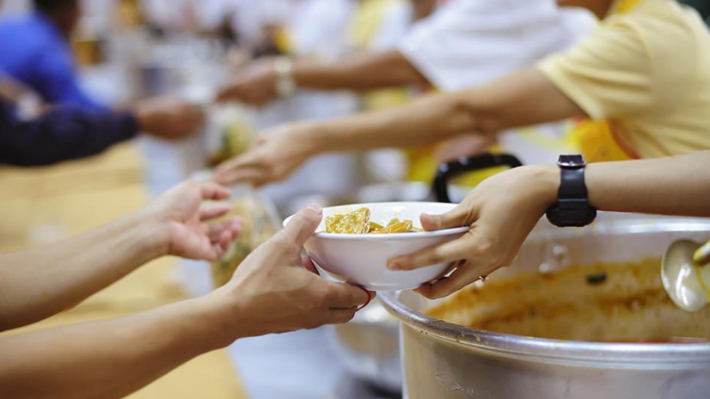
Mission
“Our mission is to witness
to the love of God in the midst
of the whole human family.”
Diocese of Motherwell, Mission & Evangelisation
@LectioMotherwe1

Slide 15
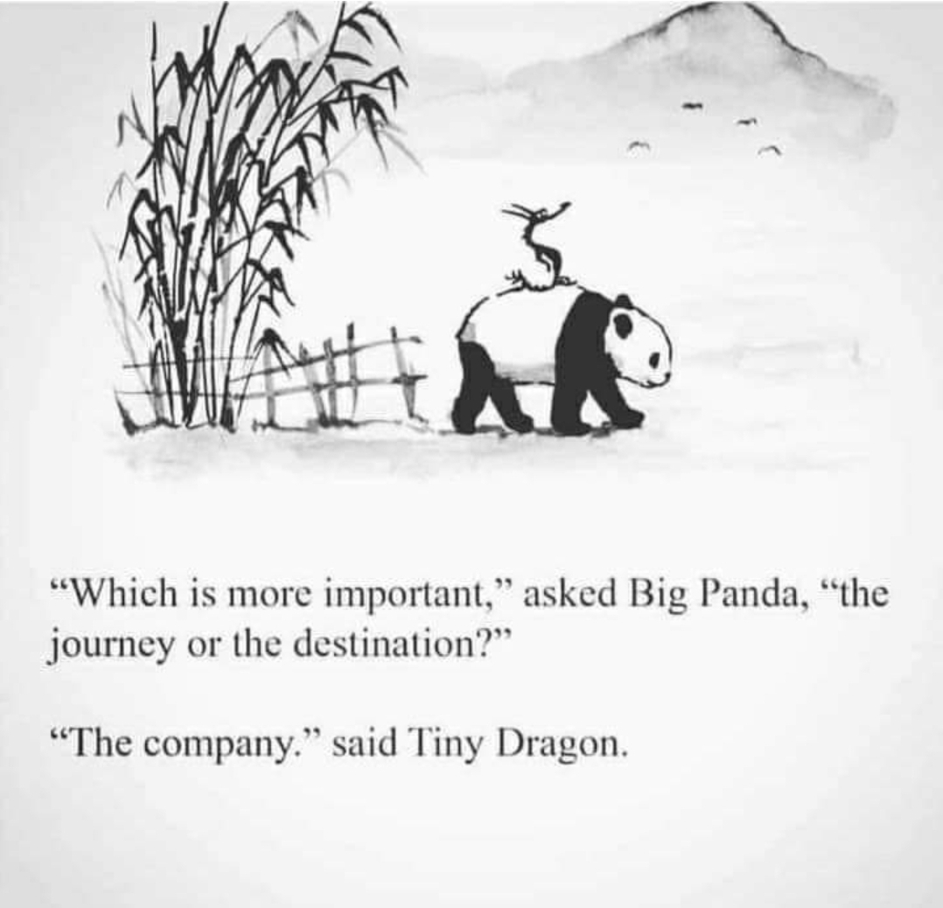
The Synodal Process
Where we are,
where we are going…
and how we are getting there
Diocese of Motherwell, Mission & Evangelisation
@LectioMotherwe1

Slide 16
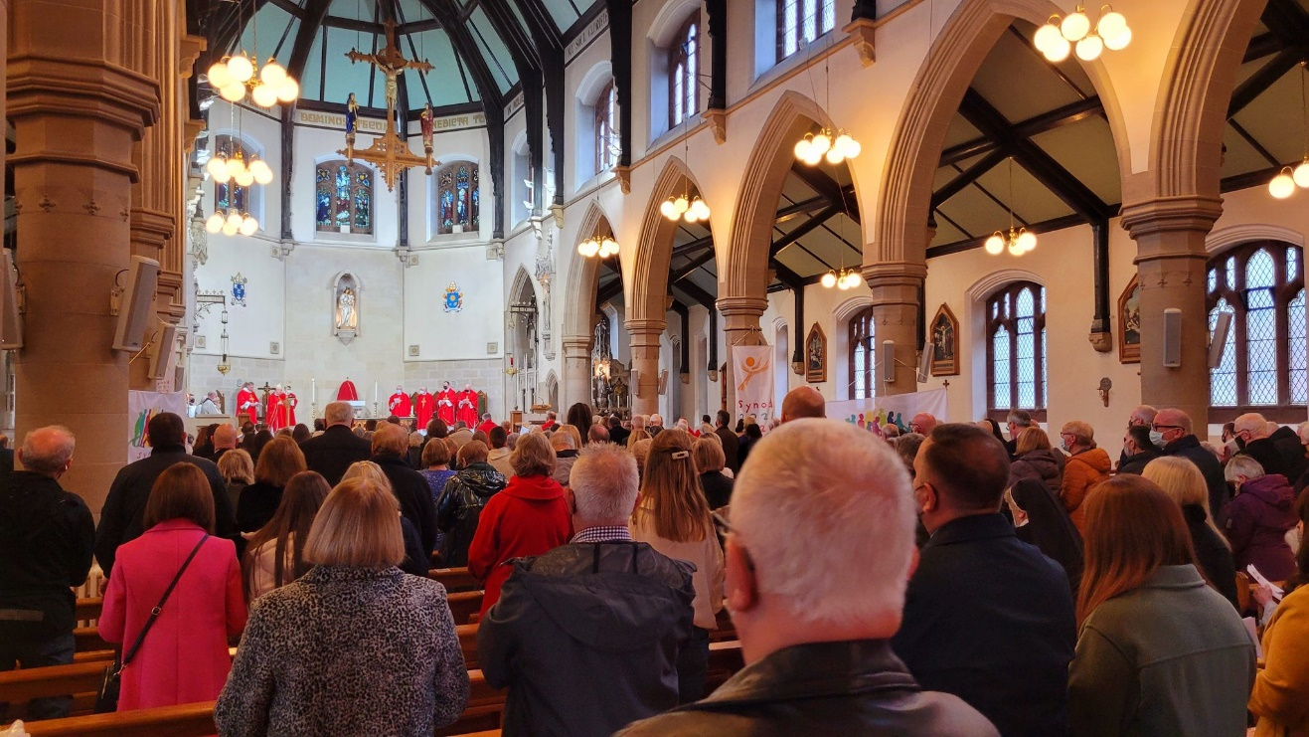
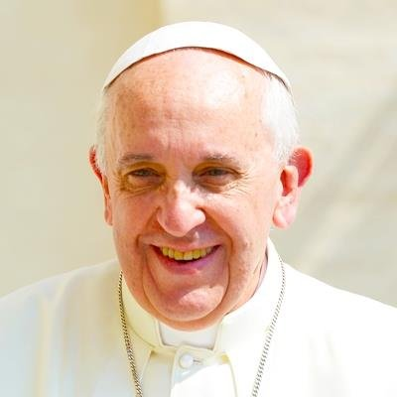
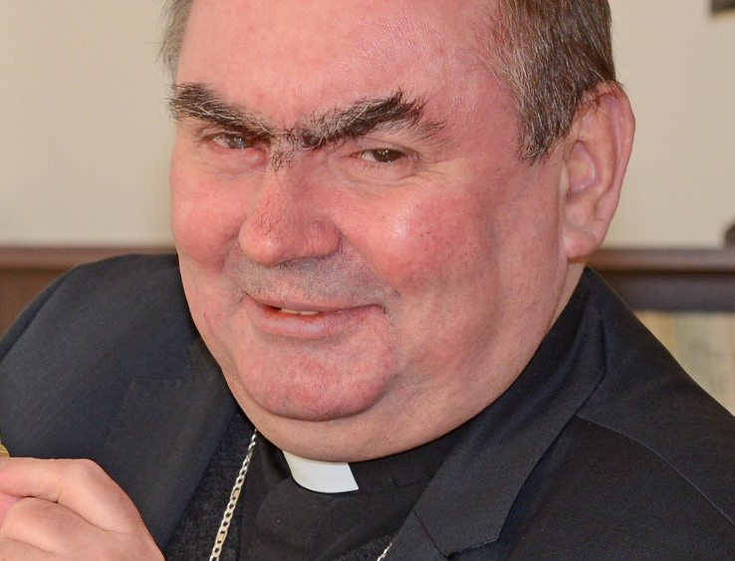
The Synod 2021 – 2023 on Synodality solemnly opened on the 9th – 10th of October 2021 in Rome
… and on the following 17th of October in each particular Church.
.
Bishop Toal marked the beginning of this synodal process with the celebration of Mass in Motherwell Cathedral on Sunday 17th October.
Diocese of Motherwell, Mission & Evangelisation
@LectioMotherwe1

Slide 17
Timeline for the diocesan process in Motherwell Diocese
May-August: Presentation of the Diocesan Report to the Bishops’ Conference.
Sunday 17th October: Bishop Toal opens the Synod in our diocese with the celebration of Mass
May: Presentation of the diocesan report to Bishop Toal
Oct – Nov: meetings with parish priests and “training sessions” with parishes and groups leaders.
2021 >>
2022 >>
Aug 15th
November 2021 – March 2022:
meetings in all parishes / groups for the discernment process.
1st April:
collated reports to be returned to
missions@rcdom.org.uk
May: Diocesan report sent to all priests and parish leaders for review and amendments
Conference report to be sent to the General Secretariat Synod of Bishops
Group and parish leaders:
Coordinate with parish priests the schedule for parish and group sessions
Supporting material to prepare and run sessions as well as to report back (a collated summary) to the diocese – available at www.rcdom.org.uk/synod
Send the Diocesan Report also to the General Secretariat Synod of Bishops
April: Parish reports collated into one diocesan report
Diocese of Motherwell, Mission & Evangelisation
@LectioMotherwe1

Slide 18
Ten themes to explore
To enable us to respond fully to the fundamental question, the Holy See suggest ten themes to explore:
.
1. Companions on the journey
2. Listening
3. Speaking out
4. Celebration
5. Sharing Responsibility for our
Common Mission
6. Dialogue in Church and Society
7. Ecumenism
8. Authority and Participation
9. Discerning and Deciding
10. Forming ourselves in
Synodality
Diocese of Motherwell, Mission & Evangelisation
@LectioMotherwe1

Slide 19
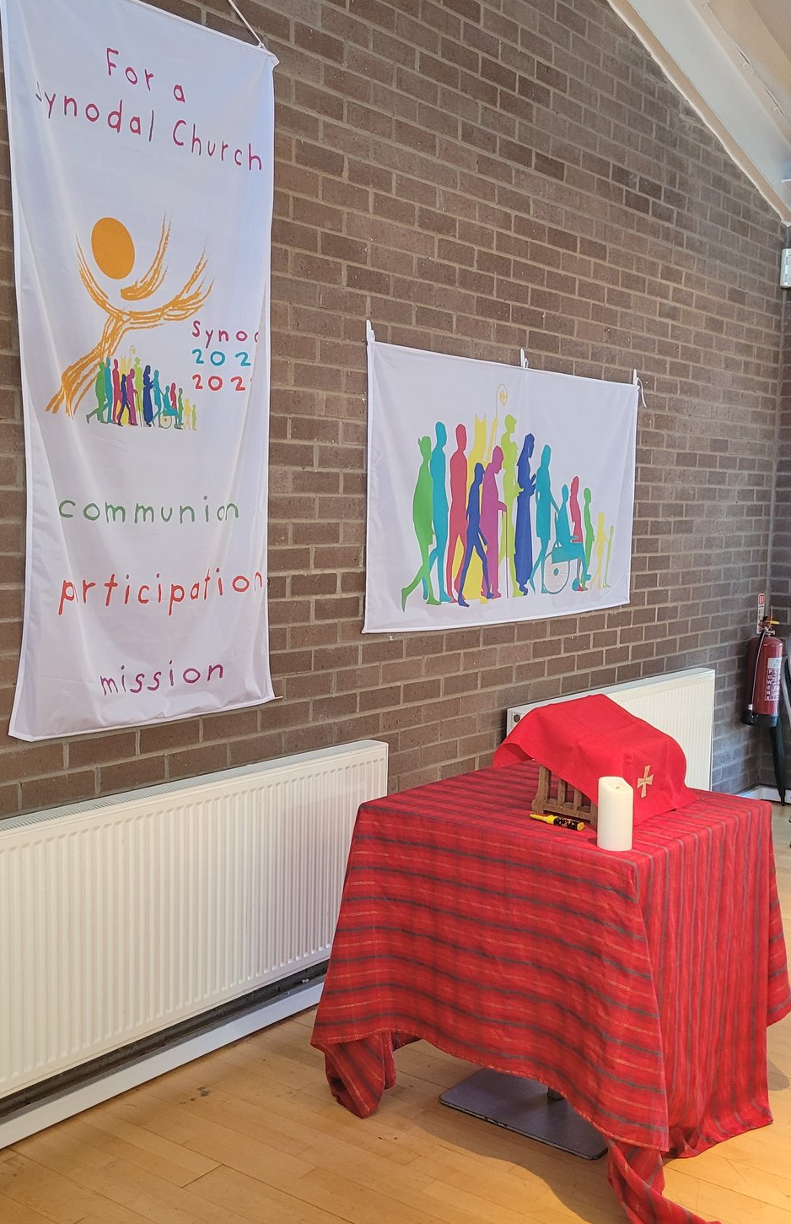
Basic attitudes for the Synodal Process
Prayer: Synodality is a spiritual experience rooted in prayer.
Attentive Listening: We pay deep attention to the person speaking, welcoming without judgment what is being said. We listen with humility, patience and a readiness to learn – aware of the Holy Spirit, present amongst us.
Speaking from the Heart: We speak from our personal experience, paying attention to our feelings.
Diocese of Motherwell, Mission & Evangelisation
@LectioMotherwe1

Slide 20
Listening
“A synodal church is
a listening church, aware that listening is more than hearing.
It is a reciprocal listening in which each one
has something to learn.”
Pope Francis, 2015
Diocese of Motherwell, Mission & Evangelisation
@LectioMotherwe1

Slide 21
Conversion
God calls us to conversion at every stage of life
“Every moment,
every instant of our existence is precious time to love God and neighbour,
and thereby enter into eternal life.”
Pope Francis, 2021
Diocese of Motherwell, Mission & Evangelisation
@LectioMotherwe1

Slide 22
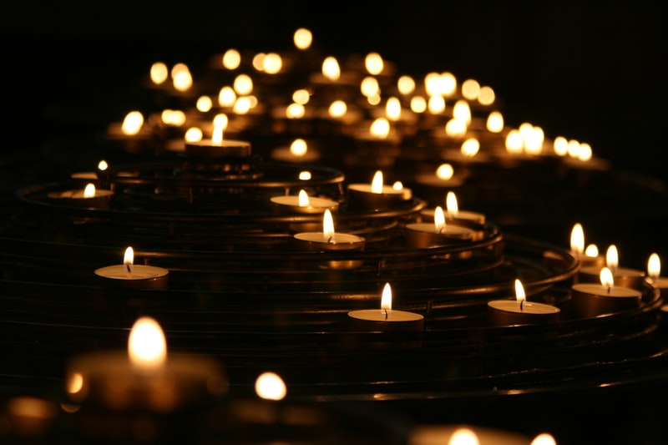
“How can we know if something comes from the Holy Spirit […]?
The only way is through discernment, which calls for something
more than intelligence or
common sense.
It is a gift which we must implore.
If we ask with confidence
that the Holy Spirit grant us this gift,
and then seek to develop it
through prayer, reflection,
reading and good counsel,
then surely we will grow
in this spiritual endowment.”
Discernment
Pope Francis, Gaudete et Exsultate, 2018
Diocese of Motherwell, Mission & Evangelisation
@LectioMotherwe1

Slide 23
The path of synodality
seeks to make pastoral decisions that reflect the will of God as closely as possible, grounding them in the living voice of the People of God.
Diocese of Motherwell, Mission & Evangelisation
@LectioMotherwe1

Slide 24
Adsumus Sancte Spiritus
We stand before You, Holy Spirit,
as we gather together in Your name.
With You alone to guide us,
make Yourself at home in our hearts;
Teach us the way we must go
and how we are to pursue it.
We are weak and sinful;
do not let us promote disorder.
Do not let ignorance
lead us down the wrong path
nor partiality influence our actions.
Let us find in You our unity
so that we may journey together
to eternal life
and not stray from the way of truth
and what is right.
All this we ask of You,
who are at work in every place and time,
in the communion of
the Father and the Son,
forever and ever.
Amen.
Diocese of Motherwell, Mission & Evangelisation
@LectioMotherwe1

Slide 25
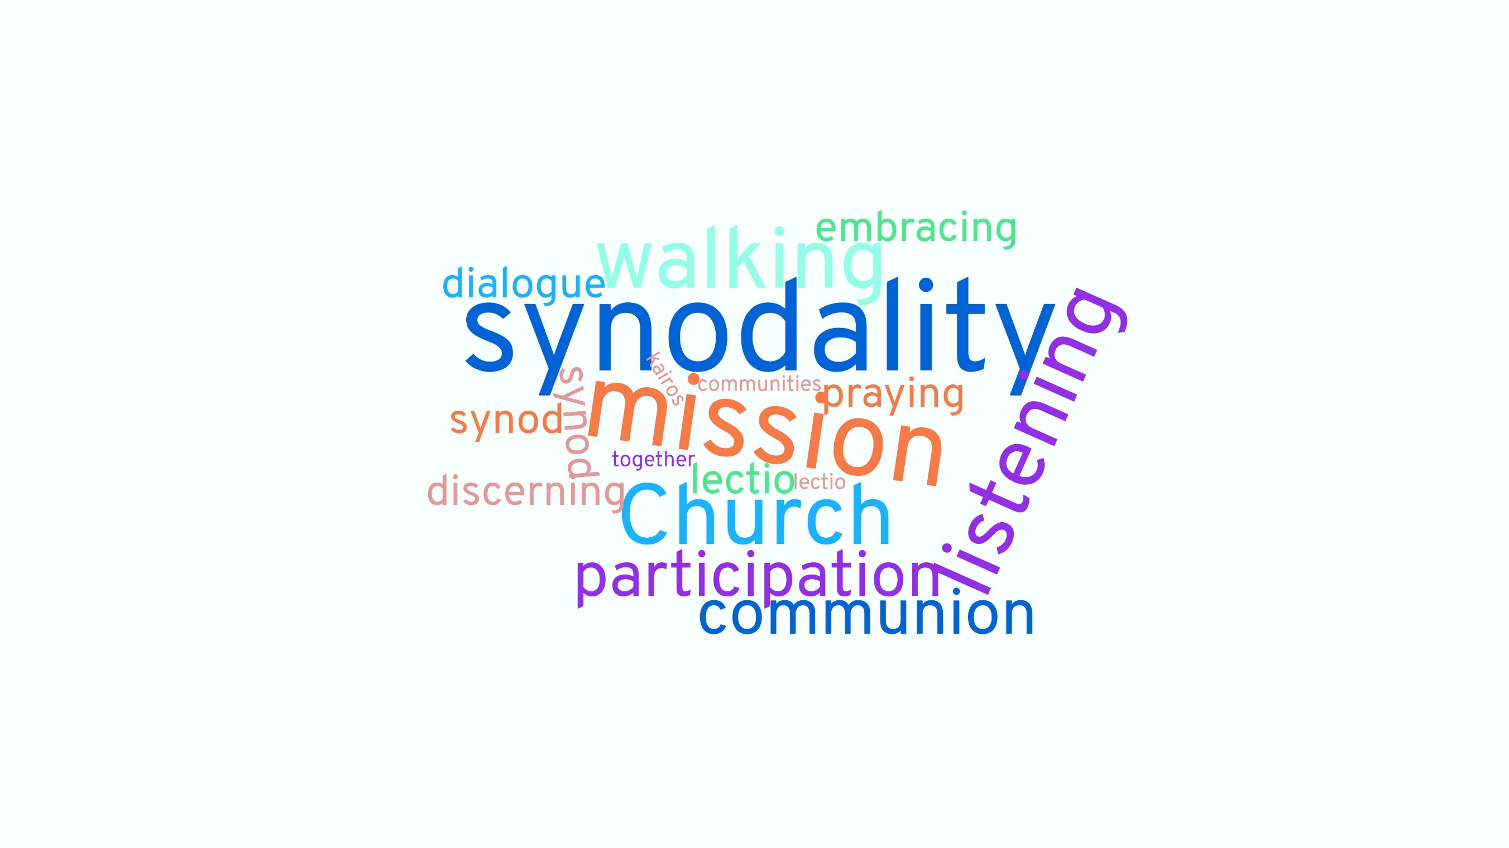
General information on the Synod in
https://www.synod.va/en.html
Local information in the Diocese of Motherwell website

