Slide 1
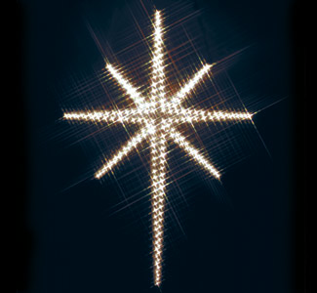
Join in!
If you follow the star tonight,
Over the hills, through the night,
If you follow the star tonight,
You’ll get to Bethlehem.
And the angels will sing,
And the bells will all ring,
And all because Jesus is born.
If you see that star up high,
Shining there in the sky,
If you see that star up high,
Then go to Bethlehem.
If you follow the star tonight,
Over the hills, through the night,
If you follow the star tonight,
You’ll get to Bethlehem.

