Slide 1
The Holy Rosary
Diocese of Motherwell
Teachers’ Resource
Notes:
The Rosary is a prayerful reflection of the Gospels. It comprises 20 Mysteries or significant events in the life of Jesus and Mary. These events are organized into four sets of Mysteries; Joyful, Luminous, Sorrowful and Glorious.
Having a clearer picture of the scene and significance of the Rosary Mystery will greatly enhance your and the children’s meditation. The Holy Rosary should bring about inner peace using both mental and vocal prayer. This is how your mind internalises the events of Jesus’ life.
This Power Point is a comprehensive overview of the Holy Rosary. Each mystery follows the same format and has been designed to be used as a visual stimulus for children while praying the Rosary.
There are teacher’s notes before each new mystery providing additional information including scripture, reflections, questions and prayers to encourage discussion and further reflection during each decade.
There are specific days on which to pray certain mysteries but professional judgement should be used in order to cover the breadth and depth of learning during the progression of lessons.

Slide 2
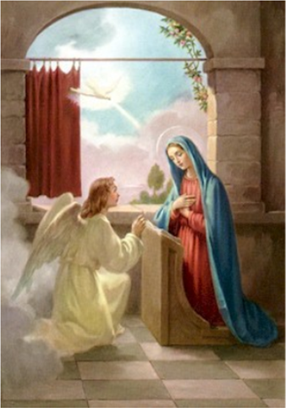
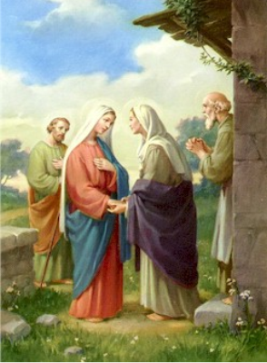
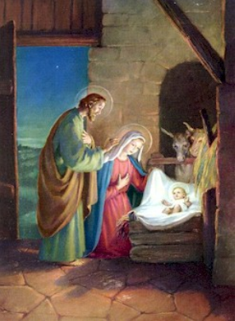
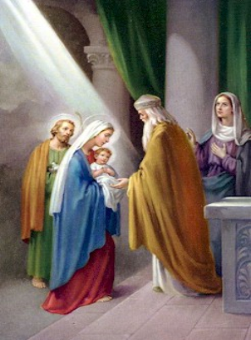
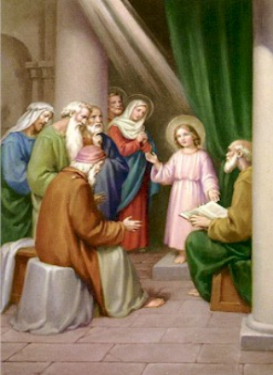
The Joyful Mysteries
The Annunciation
The Visitation
The Birth of Our Lord
The Presentation at the Temple
Finding Jesus in the Temple
Notes:
The Joyful Mysteries are taken mostly from Luke's Gospel in the New Testament. They involve the joyful events of Jesus' childhood. The most joyful event in all of human history is the Incarnation or when God became man and dwelt among us.
When Adam and Eve sinned against God, the gates of heaven were closed. God promised to send a saviour who would open the gates of heaven. Jesus is the fulfilment of God's promise. That is why the Incarnation is the most wonderful event in human history.
The Five Joyful Mysteries of the Rosary are recited on Mondays and Saturdays (except during Lent). They can also be recited on Sundays during Advent and Christmastide.
Jesus is the Incarnation - God made flesh...
"And the Word was made flesh, and dwelt among us, (and we saw his glory, the glory as it were of the only begotten of the Father,) full of grace and truth.“ John 1:14

Slide 3
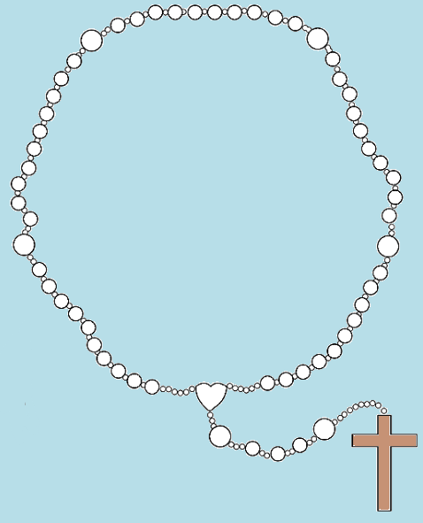
I believe in God, the Father almighty, Creator of heaven and earth, and in Jesus Christ, his only Son, our Lord, who was conceived by the Holy Spirit, born of the Virgin Mary, suffered under Pontius Pilate, was crucified, died and was buried; he descended into hell; on the third day he rose again from the dead; he ascended into heaven, and is seated at the right hand of God the Father almighty; from there he will come to judge the living and the dead.
I believe in the Holy Spirit, the holy catholic Church, the communion of saints, the forgiveness of sins, the resurrection of the body, and life everlasting.
Amen.
Make the sign of the cross and say the…
Apostles’ Creed
Notes:
How to Pray the Rosary
1. Begin by touching the crucifix and praying the Sign of the Cross followed by the Apostle's Creed.
2. On the first large rosary bead, pray the Our Father.
3. On each of the next three beads, pray a Hail Mary.
4. On the next large bead, pray the Glory Be to the Father.
5. At the beginning of each decade, announce the "mystery" to be contemplated, for example, the first joyful mystery is "The Annunciation".
6. After a short pause for reflection, recite the "Our Father", ten "Hail Marys" and the "Glory be to the Father".
After this, repeat stages 5 and 6 for the remaining four decades.
At the end of the Rosary, the Hail Holy Queen.

Slide 4
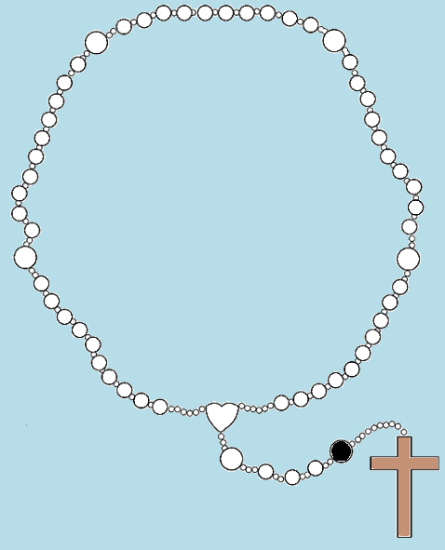
Our Father, who art in heaven,
hallowed be thy name;
thy kingdom come,
thy will be done on earth
as it is in heaven.
Give us this day our daily bread,
and forgive us our trespasses,
as we forgive those who
trespass against us;
and lead us not into temptation,
but deliver us from evil.
Amen.
Say the…
Our Father

Slide 5
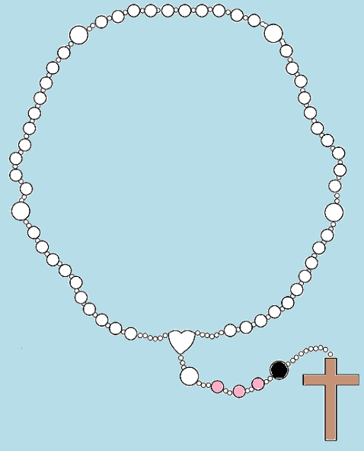
Hail Mary, full of grace.
Our Lord is with thee.
Blessed art thou among women,
and blessed is the fruit of thy womb,
Jesus.
Holy Mary, Mother of God,
pray for us sinners,
now and at the hour of our death.
Amen.
Say three…
Hail Marys

Slide 6
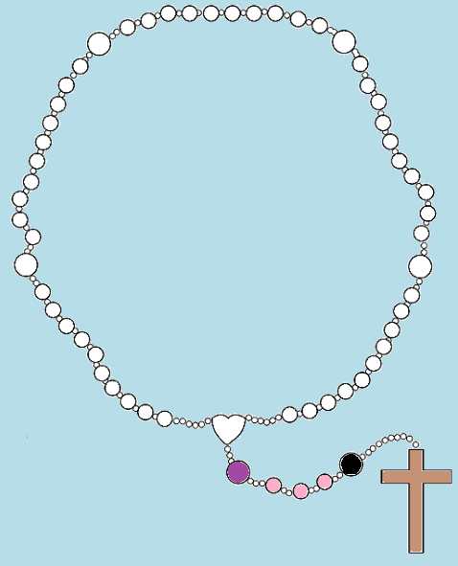
Glory be to the Father, and to the Son, and to the Holy Spirit.
As it was in the beginning, is now, and ever shall be, world without end.
Amen.
Say the…
Glory be to the Father

Slide 7
The First Joyful Mystery
The Annunciation
Notes:
Luke 1: 26-28
²⁶ In the sixth month of Elizabeth’s pregnancy, God sent the angel Gabriel to Nazareth, a town in Galilee, ²⁷ to a virgin pledged to be married to a man named Joseph, a descendant of David. The virgin’s name was Mary. ²⁸ The angel went to her and said, “Greetings, you who are highly favoured! The Lord is with you.”
Reflection
God makes His presence in our lives known in many ways. Sometimes we have an open heart and open mind to hear His voice. Sometimes our minds and hearts are closed by our own selfishness and fear. Mary comes into our lives and asks us to follow her example. God sends the Holy Spirit into our lives to help us.
Questions
Do I open my heart and mind to hear the voice of God calling me to do His will?
Do I say yes to His will regardless of the possible consequences to myself?
We pray for the gift of Humility
We pray that we can open our hearts and minds to hear the will of God in our lives. We pray that we can see the example given to us by our Holy Mother, the Virgin Mary. We pray that we accept the help sent to us through the Holy Spirit.

Slide 8
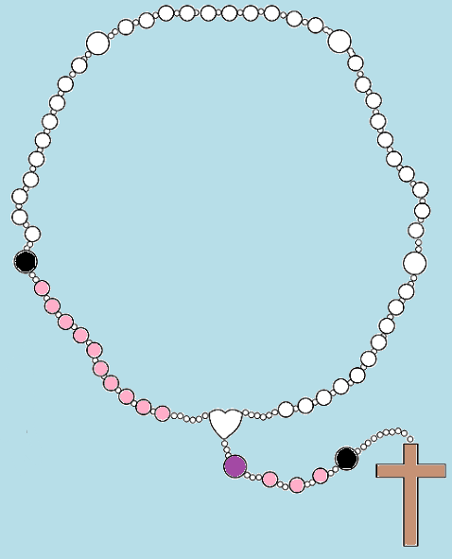
Glory be to the Father, and to the Son, and to the Holy Spirit.
As it was in the beginning, is now, and ever shall be, world without end.
Amen.
Say the…
Glory be to the Father
Notes:
How to Pray the Rosary
Announce the next mystery to be contemplated.
After a short pause for reflection, recite the "Our Father", ten "Hail Marys" and the "Glory be to the Father".

Slide 9
The Second Joyful Mystery
The Visitation
Notes:
Luke 1:39-45
³⁹ At that time Mary got ready and hurried to a town in the hill country of Judea, ⁴⁰ where she entered Zechariah’s home and greeted Elizabeth. ⁴¹ When Elizabeth heard Mary’s greeting, the baby leaped in her womb, and Elizabeth was filled with the Holy Spirit. ⁴² In a loud voice she exclaimed: “Blessed are you among women, and blessed is the child you will bear! ⁴³ But why am I so favoured, that the mother of my Lord should come to me? ⁴⁴ As soon as the sound of your greeting reached my ears, the baby in my womb leaped for joy. ⁴⁵ Blessed is she who has believed that the Lord would fulfil his promises to her!”
Reflections
By visiting her cousin Elizabeth, Mary shows us the perfect model of charity. At a time many of us would have let pride and self-centeredness consume us, she humbly went out of her way to serve someone else. She saw God and His works in another and went to take care of her. She focused on the needs of someone else.
Questions
Do I look outside of myself for opportunities to perform service for others?
Do I humbly serve the will of God, or do I look for personal recognition for what I do?
We pray for the gift of Charity
We pray that we can turn our lives and our wills over to the care of God and that we can act upon it. We pray that we put our faith into action through service to others in need.

Slide 10
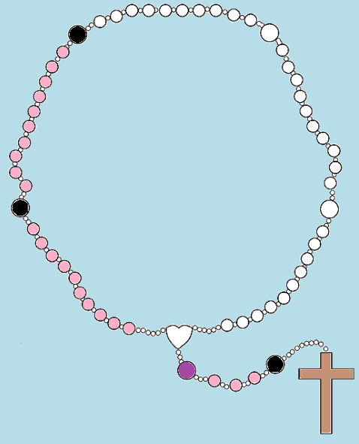
Glory be to the Father, and to the Son, and to the Holy Spirit.
As it was in the beginning, is now, and ever shall be, world without end.
Amen.
Say the…
Glory be to the Father

Slide 11
The Third Joyful Mystery
The Birth of Our Lord
Notes:
Luke 2:1-7
2 In those days Caesar Augustus issued a decree that a census should be taken of the entire Roman world. ² (This was the first census that took place while Quirinius was governor of Syria.) ³ And everyone went to their own town to register.
⁴ So Joseph also went up from the town of Nazareth in Galilee to Judea, to Bethlehem the town of David, because he belonged to the house and line of David. ⁵ He went there to register with Mary, who was pledged to be married to him and was expecting a child. ⁶ While they were there, the time came for the baby to be born, ⁷ and she gave birth to her firstborn, a son. She wrapped him in cloths and placed him in a manger, because there was no guest room available for them.
Reflection
Although poor, Mary and Joseph brought Jesus into this world with perfect love and dignity. The birth of Christ was the perfect model for what is truly important in our lives. God came into this world without any worldly possessions. In Jesus’s birth, God is telling us that nothing is more important than His presence in our lives.
Questions
Am I easily distracted by worldly possessions and other temptations?
Do I humbly bring God into this world through my prayers, thoughts, words, and actions?
We pray for the gift of Detachment from the World
We pray that when we bring Christ into this world, we do so humbly without pride or self-centeredness. We pray that the things of this world do not distract our focus away from what is truly important—God’s presence in our lives and His will for us.

Slide 12
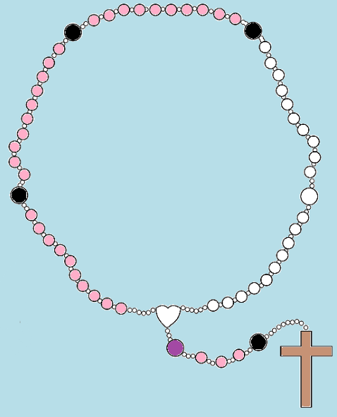
Glory be to the Father, and to the Son, and to the Holy Spirit.
As it was in the beginning, is now, and ever shall be, world without end.
Amen.
Say the…
Glory be to the Father
Notes:
How to Pray the Rosary
Announce the next mystery to be contemplated.
After a short pause for reflection, recite the "Our Father", ten "Hail Marys" and the "Glory be to the Father".

Slide 13
The Fourth Joyful Mystery
The Presentation in the Temple
Notes:
Luke 2:22-28
²² When the time came for the purification rites required by the Law of Moses, Joseph and Mary took him to Jerusalem to present him to the Lord ²³ (as it is written in the Law of the Lord, “Every firstborn male is to be consecrated to the Lord”), ²⁴ and to offer a sacrifice in keeping with what is said in the Law of the Lord: “a pair of doves or two young pigeons.” ²⁵ Now there was a man in Jerusalem called Simeon, who was righteous and devout. He was waiting for the consolation of Israel, and the Holy Spirit was on him. ²⁶ It had been revealed to him by the Holy Spirit that he would not die before he had seen the Lord’s Messiah. ²⁷ Moved by the Spirit, he went into the temple courts. When the parents brought in the child Jesus to do for him what the custom of the Law required, ²⁸ Simeon took him in his arms and praised God.
Reflection
Jesus is not subject to the Law of Moses; yet, to teach obedience, He submits to it. Mary is not subject to the law of purification; yet, in humility she submits to it. In their submission to the law, Simeon confirmed the presence of the Messiah in the world. He publicly prophesied Jesus’ mission and the effect it would have on the world. He also confirmed Mary’s role and the suffering she would endure for Jesus and for us as our mother.
Questions
Do I turn to the traditions and laws of the Church to guide and direct me to God?
Do I turn to devotions, like the Rosary, to give me strength and grace to fulfil God’s will.
We Pray for the Gifts of Obedience and Purity of Heart
We pray that I might use the teaching of the Church created by Christ and nurtured by the Virgin Mary to guide and direct me to God. I pray that I might use suffering in my life to bring me closer to God as shown to me by the lives of Jesus and Mary.

Slide 14
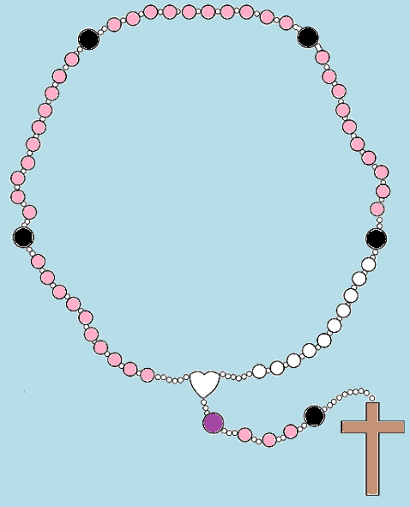
Glory be to the Father, and to the Son, and to the Holy Spirit.
As it was in the beginning, is now, and ever shall be, world without end.
Amen.
Say the…
Glory be to the Father

Slide 15
The Fifth Joyful Mystery
Finding Jesus in the Temple
Notes:
Luke 2:42-49
⁴¹ Every year Jesus’ parents went to Jerusalem for the Festival of the Passover. ⁴² When he was twelve years old, they went up to the festival, according to the custom. ⁴³ After the festival was over, while his parents were returning home, the boy Jesus stayed behind in Jerusalem, but they were unaware of it. ⁴⁴ Thinking he was in their company, they travelled on for a day. Then they began looking for him among their relatives and friends. ⁴⁵ When they did not find him, they went back to Jerusalem to look for him. ⁴⁶ After three days they found him in the temple courts, sitting among the teachers, listening to them and asking them questions. ⁴⁷ Everyone who heard him was amazed at his understanding and his answers. ⁴⁸ When his parents saw him, they were astonished. His mother said to him, “Son, why have you treated us like this? Your father and I have been anxiously searching for you.” ⁴⁹ “Why were you searching for me?” he asked. “Didn’t you know I had to be in my Father’s house?”
Reflection
Mary and Joseph took it for granted that Jesus was with them – what a panic when he wasn’t. We often take it for granted that Jesus is there with us. He is always there in the “temple” doing His Father’s business. We know where to find Him now that He has taught us, but we must go there to be with Him.
Questions
When I lose Jesus in my daily life, do I frantically search for Him like I would my lost child?
Do I know where to find Him? Do I go straight to the obvious place to look for Him?
We Pray for the Gift of Piety
I pray that in those times when I feel like I have lost Jesus Christ in my life I realize that He has not lost me. I pray that I remember where to find Him at all times—He is busy with His Father’s affairs

Slide 16
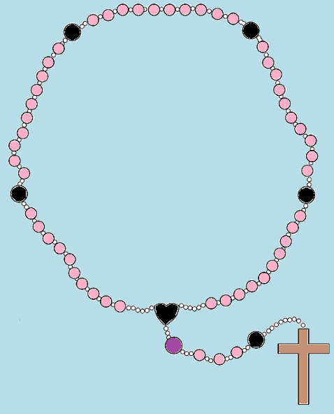
Glory be to the Father, and to the Son, and to the Holy Spirit.
As it was in the beginning, is now, and ever shall be, world without end.
Amen.
Say the…
Glory be to the Father

Slide 17
Hail, Holy Queen Mother of Mercy, our life, our sweetness and our hope!
To thee do we cry, poor banished children of Eve; to thee do we send up our sighs, mourning and weeping in this vale of tears.
Turn then, most gracious advocate, thine eyes of mercy toward us, and after this our exile, show unto us the blessed fruit of thy womb, Jesus.
O clement, O loving, O sweet Virgin Mary!
V: Pray for us, O Holy Mother of God.
R: That we may be made worthy of the promises of Christ.
Let us pray: O God, whose only begotten Son, by His life, death, and resurrection, has purchased for us the rewards of eternal life, grant, we beseech Thee, that meditating upon these mysteries of the Most Holy Rosary of the Blessed Virgin Mary, we may imitate what they contain and obtain what they promise, through the same Christ Our Lord.
Amen.
Say the…
Hail Holy Queen

Slide 18
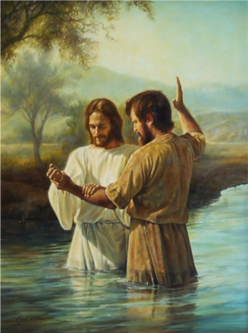
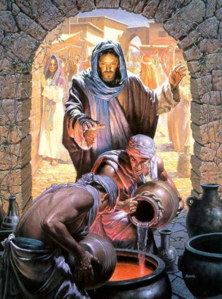
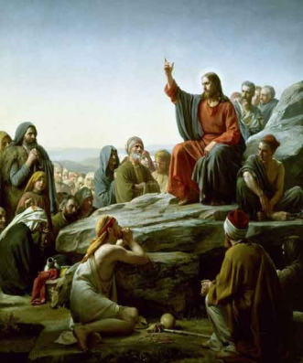
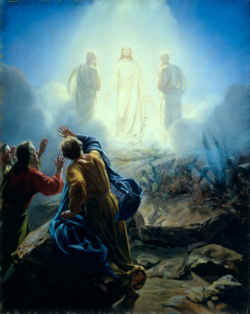
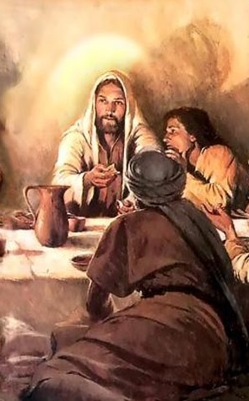
The Luminous Mysteries
Jesus is Baptised
The Wedding at Cana
Proclamation of the Kingdom
Jesus’ Transfiguration
The Institution of the Eucharist
Notes:
What a gift the Luminous Mysteries of the Rosary are. Meditating on these Mysteries of Light bring even deeper understanding to the public life of Jesus.
They fill in the blanks between the childhood of Jesus and His suffering and death on the cross.
As you increase in this depth of knowledge of the life of Jesus, you and the children will also find greater peace within your own lives by meditating upon the Luminous Mysteries of the Holy Rosary.
The Five Luminous Mysteries of the Rosary are recited on Thursdays.
"As long as I am in the world, I am the light of the world." John 9:5

Slide 19
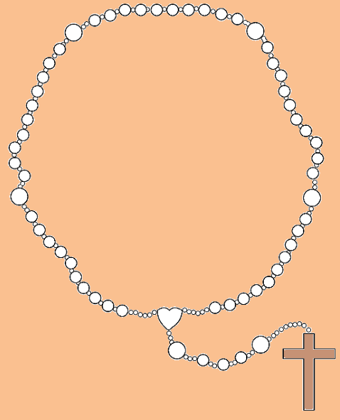
I believe in God, the Father almighty, Creator of heaven and earth, and in Jesus Christ, his only Son, our Lord, who was conceived by the Holy Spirit, born of the Virgin Mary, suffered under Pontius Pilate, was crucified, died and was buried; he descended into hell; on the third day he rose again from the dead; he ascended into heaven, and is seated at the right hand of God the Father almighty; from there he will come to judge the living and the dead.
I believe in the Holy Spirit, the holy catholic Church, the communion of saints, the forgiveness of sins, the resurrection of the body, and life everlasting.
Amen.
Make the sign of the cross and say the…
Apostles’ Creed
Notes:
How to Pray the Rosary
1. Begin by touching the crucifix and praying the Sign of the Cross followed by the Apostle's Creed.
2. On the first large rosary bead, pray the Our Father.
3. On each of the next three beads, pray a Hail Mary.
4. On the next large bead, pray the Glory Be to the Father.
5. At the beginning of each decade, announce the "mystery" to be contemplated, for example, the first luminous mystery is “Jesus is Baptised".
6. After a short pause for reflection, recite the "Our Father", ten "Hail Marys" and the "Glory be to the Father".
After this, repeat stages 5 and 6 for the remaining four decades.
At the end of the Rosary, the Hail Holy Queen.

Slide 20
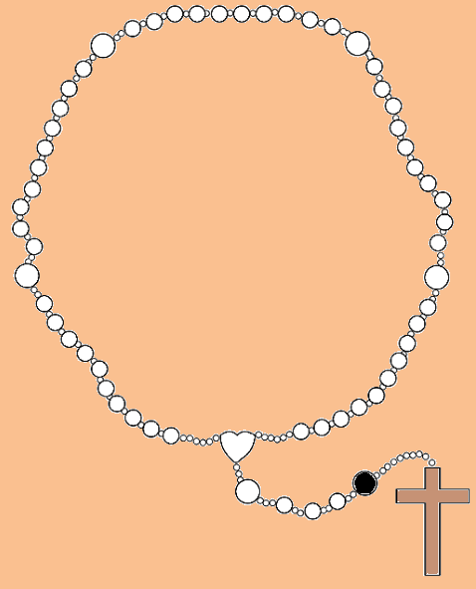
Our Father, who art in heaven,
hallowed be thy name;
thy kingdom come,
thy will be done on earth
as it is in heaven.
Give us this day our daily bread,
and forgive us our trespasses,
as we forgive those who
trespass against us;
and lead us not into temptation,
but deliver us from evil.
Amen.
Say the…
Our Father

Slide 21
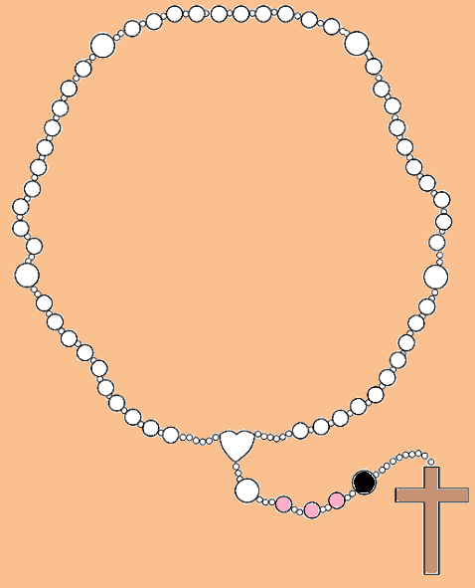
Hail Mary, full of grace.
Our Lord is with thee.
Blessed art thou among women,
and blessed is the fruit of thy womb,
Jesus.
Holy Mary, Mother of God,
pray for us sinners,
now and at the hour of our death.
Amen.
Say three…
Hail Marys

Slide 22
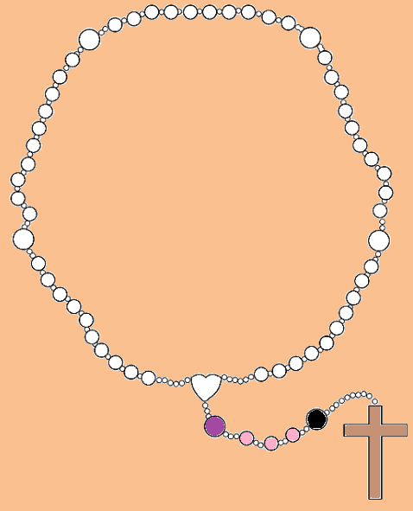
Glory be to the Father, and to the Son, and to the Holy Spirit.
As it was in the beginning, is now, and ever shall be, world without end.
Amen.
Say the…
Glory be to the Father

Slide 23
The First Luminous Mystery
Jesus is Baptised
Notes:
Matthew 3:13-17
¹³ Then Jesus came from Galilee to the Jordan to be baptized by John. ¹⁴ But John tried to deter him, saying, “I need to be baptized by you, and do you come to me?”
¹⁵ Jesus replied, “Let it be so now; it is proper for us to do this to fulfil all righteousness.” Then John consented.
¹⁶ As soon as Jesus was baptized, he went up out of the water. At that moment heaven was opened, and he saw the Spirit of God descending like a dove and alighting on him. ¹⁷ And a voice from heaven said, “This is my Son, whom I love; with him I am well pleased.”
Reflection
In His own baptism, Jesus is calling us to follow Him. It is a personal invitation to all of us. When He reveals Himself to us, He gives us the basis of our faith and the hope of our own salvation. He is showing us how much He loves us by coming personally into our lives. Our baptism is our initiation into our faith—the beginning. In our baptism, God reveals Himself to us and personally invites us to follow Him.
Questions
Do I accept the invitation of God to follow Him, which begins at my baptism and continues each day of my life?
Do I renew my baptism each day by repenting my sins, rejecting sin, and following Jesus?
We Pray for Openness to the Holy Spirit
We pray that each day we recall our baptism of repentance— our beginning; that we are filled with the Holy Spirit and renewed in our faith in God.

Slide 24
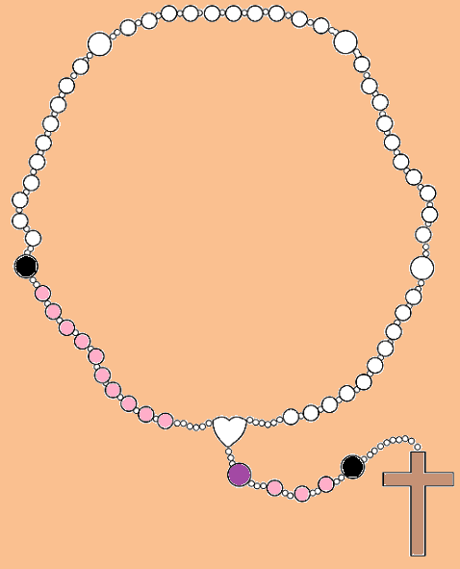
Glory be to the Father, and to the Son, and to the Holy Spirit.
As it was in the beginning, is now, and ever shall be, world without end.
Amen.
Say the…
Glory be to the Father

Slide 25
The Second Luminous Mystery
The Wedding at Cana
Notes:
John 2:1-11
2 On the third day a wedding took place at Cana in Galilee. Jesus’ mother was there, ² and Jesus and his disciples had also been invited to the wedding. ³ When the wine was gone, Jesus’ mother said to him, “They have no more wine.” ⁴ “Woman, why do you involve me?” Jesus replied. “My hour has not yet come.” ⁵ His mother said to the servants, “Do whatever he tells you.” ⁶ Nearby stood six stone water jars, the kind used by the Jews for ceremonial washing, each holding from twenty to thirty gallons.⁷ Jesus said to the servants, “Fill the jars with water”; so they filled them to the brim.⁸ Then he told them, “Now draw some out and take it to the master of the banquet.” They did so, ⁹ and the master of the banquet tasted the water that had been turned into wine. He did not realize where it had come from, though the servants who had drawn the water knew. Then he called the bridegroom aside ¹⁰ and said, “Everyone brings out the choice wine first and then the cheaper wine after the guests have had too much to drink; but you have saved the best till now.” ¹¹ What Jesus did here in Cana of Galilee was the first of the signs through which he revealed his glory; and his disciples believed in him.
Reflection
When His Mother comes to Him with the dilemma. He says to her, “Dear woman, why do you involve Me?” In saying this, Jesus reveals to us that He has not come for Himself. This is not His problem. He has come to serve, not to be served. He shows compassion for the bride and the groom. He converts the water into wine—the common into the finest. Likewise, He has come to convert us, common sinners into faithful believers—the finest to be presented to the “Master of the banquet.”
Questions
Do I recognize that, like Jesus, I too am called to serve?
Am I prepared to be converted from the common to the finest?
We Pray to Jesus Through Mary
We pray that each day we see our opportunities to serve in the manner of Jesus, so that we may be converted from the common to the finest.

Slide 26
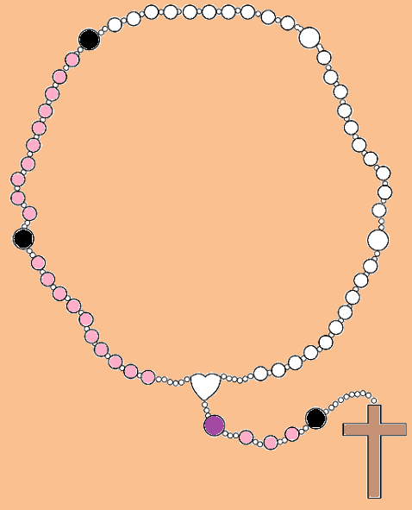
Glory be to the Father, and to the Son, and to the Holy Spirit.
As it was in the beginning, is now, and ever shall be, world without end.
Amen.
Say the…
Glory be to the Father

Slide 27
The Third Luminous Mystery
Proclamation of the Kingdom
Notes:
Mark 1:14-15
¹⁴ After John was put in prison, Jesus went into Galilee, proclaiming the good news of God. ¹⁵ “The time has come,” he said. “The kingdom of God has come near. Repent and believe the good news!”
Reflection
Throughout the Gospels, Jesus reveals the Kingdom of God to us in various ways. But the message is always clear and consistent. We are called to God’s Kingdom through Jesus Christ. He came into our world to show us the way. We are to repent for our sins and trust in God. For He, in His mercy, will forgive our sins and draw us to Him.
Questions
Do I seek the Kingdom of God each day by saying sorry and praying for His mercy?
Do I follow the example of Jesus each day by trusting completely in God for all things?
We Pray for Repentance and Trust in God
We pray for the grace and mercy of God so that we might empty ourselves and enter into His Kingdom by turning all things over to Him.

Slide 28
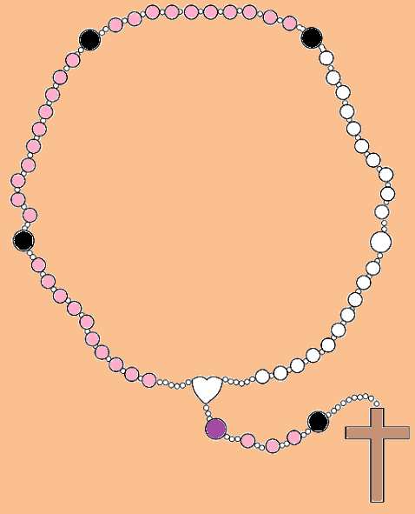
Glory be to the Father, and to the Son, and to the Holy Spirit.
As it was in the beginning, is now, and ever shall be, world without end.
Amen.
Say the…
Glory be to the Father

Slide 29
The Fourth Luminous Mystery
Jesus’ Transfiguration
Notes:
Luke 9:28-35
²⁸ About eight days after Jesus said this, he took Peter, John and James with him and went up onto a mountain to pray. ²⁹ As he was praying, the appearance of his face changed, and his clothes became as bright as a flash of lightning. ³⁰ Two men, Moses and Elijah, appeared in glorious splendour, talking with Jesus. ³¹ They spoke about his departure,^{[a]} which he was about to bring to fulfilment at Jerusalem. ³² Peter and his companions were very sleepy, but when they became fully awake, they saw his glory and the two men standing with him. ³³ As the men were leaving Jesus, Peter said to him, “Master, it is good for us to be here. Let us put up three shelters—one for you, one for Moses and one for Elijah.” (He did not know what he was saying.) ³⁴ While he was speaking, a cloud appeared and covered them, and they were afraid as they entered the cloud. ³⁵ A voice came from the cloud, saying, “This is my Son, whom I have chosen; listen to him.”
Reflection
The transfiguration of Jesus reveals some portion of His true glory to us. In presenting Moses and Elijah, Jesus connects the law and the prophets to Himself for us to clearly see who He is and why He is here. In His brilliant appearance, Jesus gives us a glimpse of where He is leading us — He gives the hope of salvation from sin. The voice of God the Father confirms for us and directs us to “Listen to Him.”
Questions
Do I recognize Jesus for who He really is and why He comes into our lives?
Do I see how He reveals Himself in our world today?
We Pray for the Desire for Holiness
We pray that we may recognise Jesus revealed in our world and that we may be refreshed and filled with hope for the remainder of our personal journey with Christ into the Kingdom of God the Father.

Slide 30
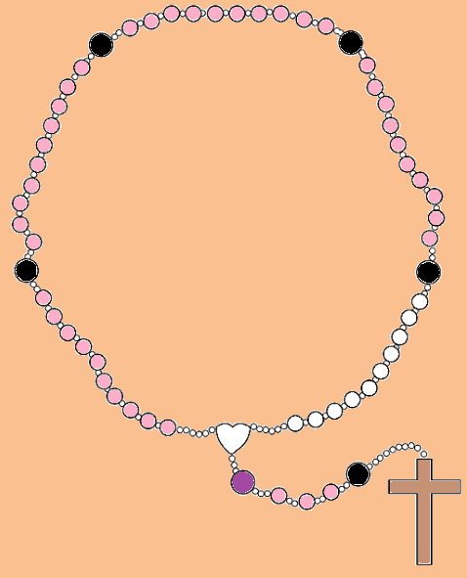
Glory be to the Father, and to the Son, and to the Holy Spirit.
As it was in the beginning, is now, and ever shall be, world without end.
Amen.
Say the…
Glory be to the Father

Slide 31
The Fifth Luminous Mystery
The Institution of the Eucharist
Notes:
Mark 14:22-25
²² While they were eating, Jesus took bread, and when he had given thanks, he broke it and gave it to his disciples, saying, “Take it; this is my body.”
²³ Then he took a cup, and when he had given thanks, he gave it to them, and they all drank from it.
²⁴ “This is my blood of the^{[a]} covenant, which is poured out for many,” he said to them. ²⁵ “Truly I tell you, I will not drink again from the fruit of the vine until that day when I drink it new in the kingdom of God.”
Reflection
Jesus reveals His sacrifice to us—He is willingly giving up His Body and His Blood for us. By taking the Body and Blood of Jesus into ourselves, we are given the grace and strength we need to follow Jesus where He is going. He tells us where He is going when He says “I will not drink again of the fruit of the vine until that day when I drink it anew in the Kingdom of God.” He gives us hope that by following Him, we too will share in His life and drink with Him in the Kingdom of God.
Question
Do I receive the Eucharist in memory of Jesus, understanding what He revealed to us in His sacrifice?
When I receive the Eucharist, do I allow the true living Body and Blood of Jesus Christ to enter me to give me the grace and strength I need to follow Him where He is going?
We Pray for Adoration
We pray that in the Eucharist we accept the true living Body and Blood of Christ to enter and dwell in us, so that we have the grace to carry us with Christ into the Kingdom of God.

Slide 32
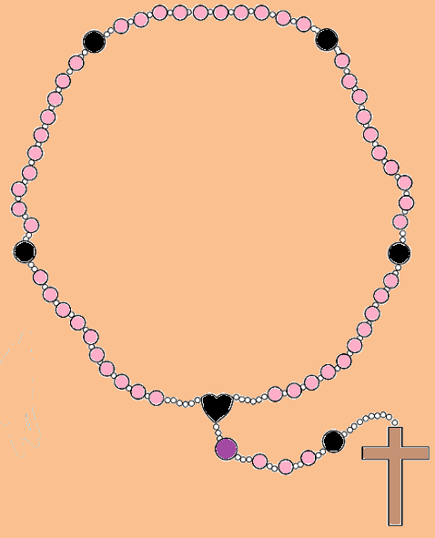
Glory be to the Father, and to the Son, and to the Holy Spirit.
As it was in the beginning, is now, and ever shall be, world without end.
Amen.
Say the…
Glory be to the Father

Slide 33
Hail, Holy Queen Mother of Mercy, our life, our sweetness and our hope!
To thee do we cry, poor banished children of Eve; to thee do we send up our sighs, mourning and weeping in this vale of tears.
Turn then, most gracious advocate, thine eyes of mercy toward us, and after this our exile, show unto us the blessed fruit of thy womb, Jesus.
O clement, O loving, O sweet Virgin Mary!
V: Pray for us, O Holy Mother of God.
R: That we may be made worthy of the promises of Christ.
Let us pray: O God, whose only begotten Son, by His life, death, and resurrection, has purchased for us the rewards of eternal life, grant, we beseech Thee, that meditating upon these mysteries of the Most Holy Rosary of the Blessed Virgin Mary, we may imitate what they contain and obtain what they promise, through the same Christ Our Lord.
Amen.
Say the…
Hail Holy Queen

Slide 34
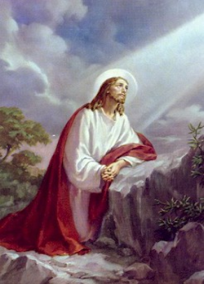
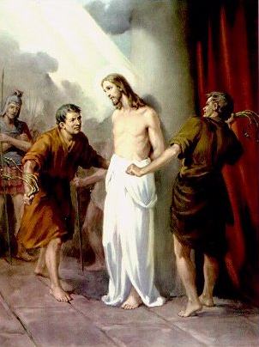
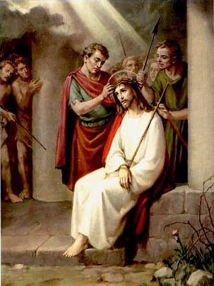
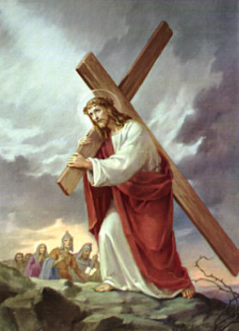
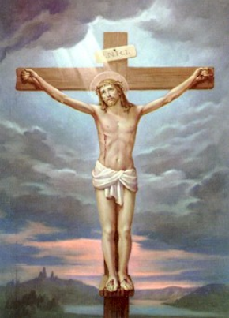
The Sorrowful Mysteries
The Agony in the Garden
The Scourging at the Pillar
The Crowning of Thorns
Jesus Carries His Cross
The Crucifixion
Notes:
Everyone experiences sorrows and heartaches. Meditating upon the Sorrowful Mysteries of the Rosary will help you find peace during life's ups and downs.
The Sorrowful Mysteries of the Rosary remind you of how much Jesus loves you. They recall how He suffered and died just for you. It is very reassuring to know that Someone loves you that much. The fact that Jesus loves you should bring great peace to your mind.
The Sorrowful Mysteries recount all the sadness and sorrows of Jesus' Passion and death.
The Five Sorrowful Mysteries of the Rosary are recited on Tuesdays and Fridays. They may also be recited on Sundays during Lent.
"Peace I leave with you, my peace I give unto you: not as the world giveth, do I give unto you. Let not your heart be troubled, nor let it be afraid." John 14:27

Slide 35
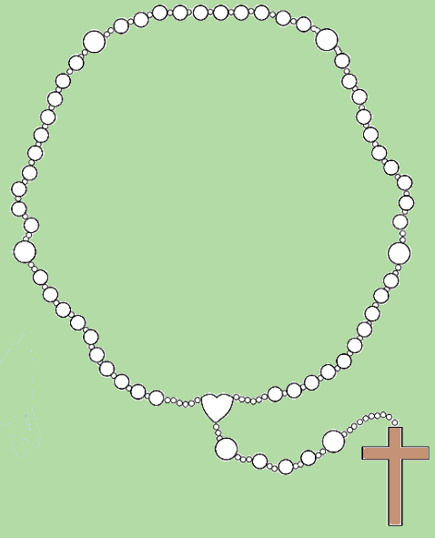
I believe in God, the Father almighty, Creator of heaven and earth, and in Jesus Christ, his only Son, our Lord, who was conceived by the Holy Spirit, born of the Virgin Mary, suffered under Pontius Pilate, was crucified, died and was buried; he descended into hell; on the third day he rose again from the dead; he ascended into heaven, and is seated at the right hand of God the Father almighty; from there he will come to judge the living and the dead.
I believe in the Holy Spirit, the holy catholic Church, the communion of saints, the forgiveness of sins, the resurrection of the body, and life everlasting.
Amen.
Make the sign of the cross and say the…
Apostles’ Creed
Notes:
How to Pray the Rosary
1. Begin by touching the crucifix and praying the Sign of the Cross followed by the Apostle's Creed.
2. On the first large rosary bead, pray the Our Father.
3. On each of the next three beads, pray a Hail Mary.
4. On the next large bead, pray the Glory Be to the Father.
5. At the beginning of each decade, announce the "mystery" to be contemplated, for example, the first sorrowful mystery is The Agony in the Garden".
6. After a short pause for reflection, recite the "Our Father", ten "Hail Marys" and the "Glory be to the Father".
After this, repeat stages 5 and 6 for the remaining four decades.
At the end of the Rosary, the Hail Holy Queen.

Slide 36
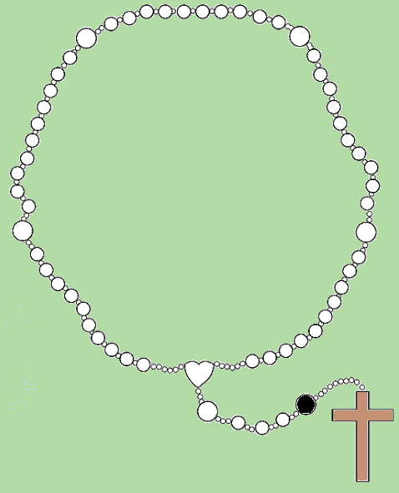
Our Father, who art in heaven,
hallowed be thy name;
thy kingdom come,
thy will be done on earth
as it is in heaven.
Give us this day our daily bread,
and forgive us our trespasses,
as we forgive those who
trespass against us;
and lead us not into temptation,
but deliver us from evil.
Amen.
Say the…
Our Father

Slide 37
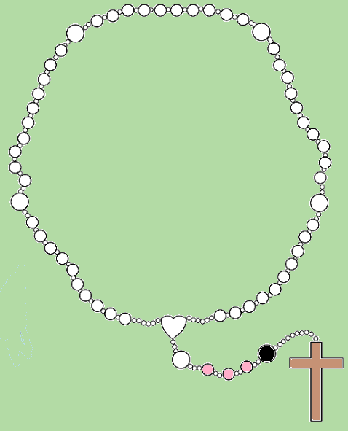
Hail Mary, full of grace.
Our Lord is with thee.
Blessed art thou among women,
and blessed is the fruit of thy womb,
Jesus.
Holy Mary, Mother of God,
pray for us sinners,
now and at the hour of our death.
Amen.
Say three…
Hail Marys

Slide 38
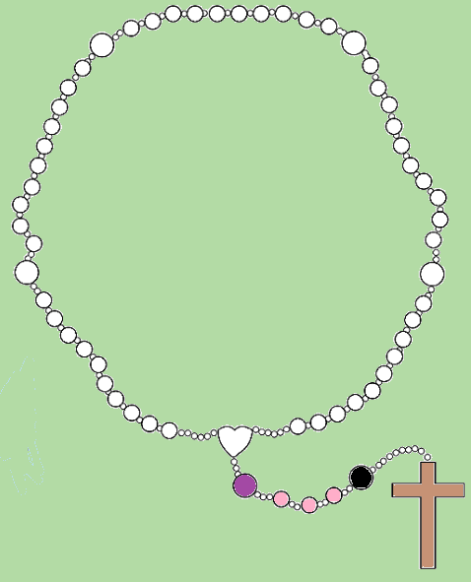
Glory be to the Father, and to the Son, and to the Holy Spirit.
As it was in the beginning, is now, and ever shall be, world without end.
Amen.
Say the…
Glory be to the Father

Slide 39
The First Sorrowful Mystery
The Agony in the Garden
Notes:
Matthew 26:36-46
³⁶ Then Jesus went with his disciples to a place called Gethsemane, and he said to them, “Sit here while I go over there and pray.” ³⁷ He took Peter and the two sons of Zebedee along with him, and he began to be sorrowful and troubled. ³⁸ Then he said to them, “My soul is overwhelmed with sorrow to the point of death. Stay here and keep watch with me.” ³⁹ Going a little farther, he fell with his face to the ground and prayed, “My Father, if it is possible, may this cup be taken from me. Yet not as I will, but as you will.” ⁴⁰ Then he returned to his disciples and found them sleeping. “Couldn’t you men keep watch with me for one hour?” he asked Peter. ⁴¹ “Watch and pray so that you will not fall into temptation. The spirit is willing, but the flesh is weak.” ⁴² He went away a second time and prayed, “My Father, if it is not possible for this cup to be taken away unless I drink it, may your will be done.” ⁴³ When he came back, he again found them sleeping, because their eyes were heavy. ⁴⁴ So he left them and went away once more and prayed the third time, saying the same thing.⁴⁵ Then he returned to the disciples and said to them, “Are you still sleeping and resting? Look, the hour has come, and the Son of Man is delivered into the hands of sinners. ⁴⁶ Rise! Let us go! Here comes my betrayer!”
Reflection
Jesus suffered in many ways for us. His passion was the completion. Because He was human, Jesus suffered fear, doubt, rejection, frustration, hurt, and all other human emotions we associate with abandonment. Because He was God, He knew what was about to happen to Him and its significance. Jesus’ humanity must have suffered immensely that night in the garden. But Jesus, in all His pain, did not despair. He did not lose faith in the Father. He prayed for God’s will, not His own. He gave us the perfect model of choosing God’s will over our own. So, with all of His “God-knowledge” and His human doubt and fear, He went forward.
Questions
Do I choose God’s will over my own despite my fear and doubt, or do I try to escape?
When I am suffering and in pain, do I turn to God and His will for me, or do I fall into despair and self-pity?
We Pray for the Gift of Contrition for Our Sins
We pray that we can better follow His example, despite our fears and doubts. We pray that we can learn to hear the voice of God in our suffering and answer His call.

Slide 40
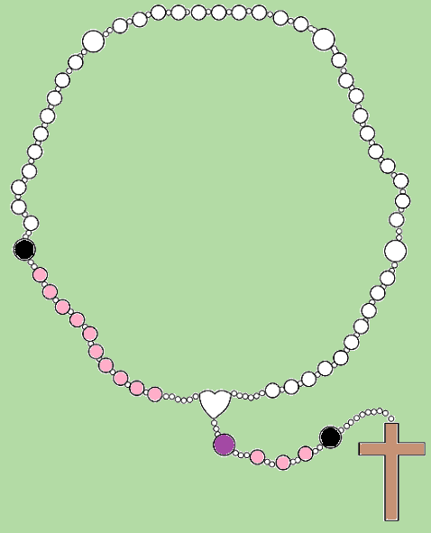
Glory be to the Father, and to the Son, and to the Holy Spirit.
As it was in the beginning, is now, and ever shall be, world without end.
Amen.
Say the…
Glory be to the Father

Slide 41
The Second Sorrowful Mystery
The Scourging at the Pillar
Notes:
Mark 15:1-16
15 Very early in the morning, the chief priests, with the elders, the teachers of the law and the whole Sanhedrin, made their plans. So they bound Jesus, led him away and handed him over to Pilate.² “Are you the king of the Jews?” asked Pilate. “You have said so,” Jesus replied. ³ The chief priests accused him of many things. ⁴ So again Pilate asked him, “Aren’t you going to answer? See how many things they are accusing you of.”⁵ But Jesus still made no reply, and Pilate was amazed. ⁶ Now it was the custom at the festival to release a prisoner whom the people requested. ⁷ A man called Barabbas was in prison with the insurrectionists who had committed murder in the uprising. ⁸ The crowd came up and asked Pilate to do for them what he usually did.⁹ “Do you want me to release to you the king of the Jews?” asked Pilate, ¹⁰ knowing it was out of self-interest that the chief priests had handed Jesus over to him. ¹¹ But the chief priests stirred up the crowd to have Pilate release Barabbas instead.¹² “What shall I do, then, with the one you call the king of the Jews?” Pilate asked them.¹³ “Crucify him!” they shouted.¹⁴ “Why? What crime has he committed?” asked Pilate. But they shouted all the louder, “Crucify him!”¹⁵ Wanting to satisfy the crowd, Pilate released Barabbas to them. He had Jesus flogged, and handed him over to be crucified.
Reflection
Pilate knew Jesus was innocent. But to appease the Jews, he had Him scourged. He took the easy way out. He did what was popular rather than what was right. Jesus suffered humiliating, disfiguring, excruciating pain for Pilate’s weakness and failure to do what was right. How often do we do what is popular rather than what is right. Jesus willingly took on Pilate’s sins at great cost and pain to Himself. When we act like Pilate (not doing what we know is right), Jesus suffers again for us.
Questions
How often do I go along with crowd, even when I know it is wrong? How often do I forgive others’ behaviour toward me? Am I willing to endure and accept ridicule, pain, and suffering to do the right things?
We Pray for the Gift of Purity of Heart
We pray that we have the strength to follow Jesus’s example in the scourging—to do what is right—not what is popular.

Slide 42
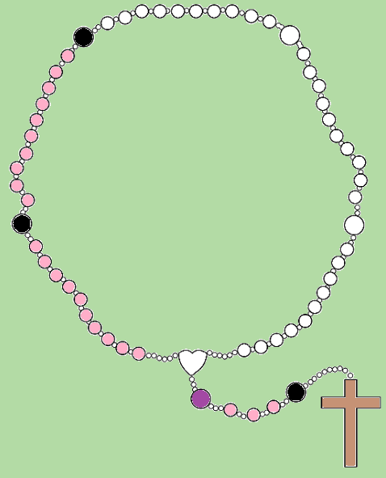
Glory be to the Father, and to the Son, and to the Holy Spirit.
As it was in the beginning, is now, and ever shall be, world without end.
Amen.
Say the…
Glory be to the Father

Slide 43
The Third Sorrowful Mystery
The Crowning of Thorns
Notes:
Matthew 27:27-31
²⁷ Then the governor’s soldiers took Jesus into the Praetorium and gathered the whole company of soldiers around him. ²⁸ They stripped him and put a scarlet robe on him, ²⁹ and then twisted together a crown of thorns and set it on his head. They put a staff in his right hand. Then they knelt in front of him and mocked him. “Hail, king of the Jews!” they said. ³⁰ They spit on him, and took the staff and struck him on the head again and again. ³¹ After they had mocked him, they took off the robe and put his own clothes on him. Then they led him away to crucify him.
Reflection
More humiliation and cruelty piled on top of a savage beating. Jesus’s torturers beat Him mercilessly, but that did not satisfy them, they needed to humiliate Him further by mocking Him. Jesus came into this world humbly to teach the way of salvation. But God’s way is not man’s way. God’s way is through humility: recognising nothing good is possible without God. Man is proud, believing he can achieve greatness without God’s grace. In this pride, man is capable of great cruelty as demonstrated by the crowning with thorns. He did not despair or turn away from God’s will because it was unpopular or because the crowd made fun of Him. In loving tolerance, He forgave all of His tormenters—He saved all of mankind— past, present, and future —from sin. We have but to follow in His path—to follow the model He presented to us when His tormentors crowned Him King of the Jews.
Questions
Do we deny God’s path out of fear of embarrassment or ridicule? Do we back down when challenged or when we are made fun of for choosing Christ’s way? How often have we joined in on the humiliation of another person?
We Pray for Moral Courage
We pray that we humbly pursue Christ’s path of love and tolerance toward those who might persecute or ridicule us; that we do not allow ridicule or embarrassment to ever deter us from Christ’s way.

Slide 44
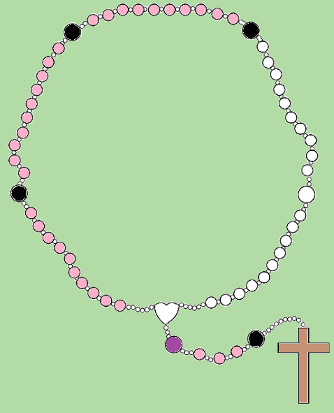
Glory be to the Father, and to the Son, and to the Holy Spirit.
As it was in the beginning, is now, and ever shall be, world without end.
Amen.
Say the…
Glory be to the Father

Slide 45
The Fourth Sorrowful Mystery
Jesus Carries His Cross
Notes:
Mark 15:20-22
²⁰ And when they had mocked him, they took off the purple robe and put his own clothes on him. Then they led him out to crucify him.²¹ A certain man from Cyrene, Simon, the father of Alexander and Rufus, was passing by on his way in from the country, and they forced him to carry the cross. ²² They brought Jesus to the place called Golgotha (which means “the place of the skull”).
Reflection
Jesus was forced to carry His Cross to His own execution. After torture and humiliation Jesus picked up His Cross and headed to Calvary. He had a mission to complete. He experienced in that short period of time all the sin and evil in this world—past, present and future—and now it was all in that Cross. And when His human body could no longer endure the abuse, He fell—but He did not despair. He allowed Simon to show charity. God worked through Simon for us to see. When, in our human frailty we fall, we must not despair. We must find God in others and accept help on the way to fulfilling God’s will for us, regardless of the pain and suffering we might be forced to endure. Conversely, when we see others suffering to fulfil God’s will, we must allow God to work through us, like Simon. He initially did not want to help. However, once he started, he had a conversion and found reward in the very act of charity. We, too, must act in charity.
Questions
Do I act, like Jesus, with complete selflessness in my times of suffering?
Simon did not know the “stranger” was Jesus, the Son of God. Do I see the Son of God in the strangers around me?
We Pray for Patience
We pray that our eyes are opened to see Christ in those around us. We pray that we carry our cross lightly and have charity even in our own suffering. Jesus carried His Cross so that our cross might be bearable—even then, He is there to help us carry ours—for on our own, we are incapable.

Slide 46
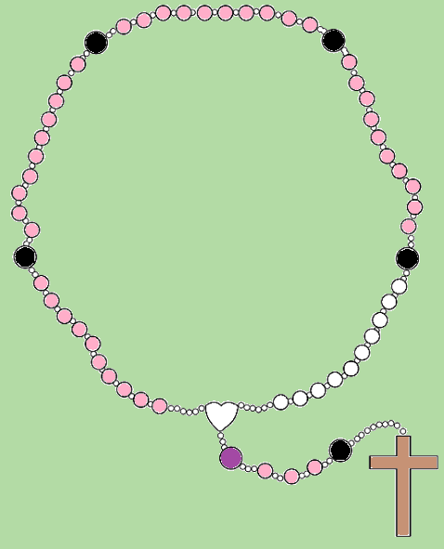
Glory be to the Father, and to the Son, and to the Holy Spirit.
As it was in the beginning, is now, and ever shall be, world without end.
Amen.
Say the…
Glory be to the Father

Slide 47
The Fifth Sorrowful Mystery
The Crucifixion
Notes:
Luke 23:33-46
³³ When they came to the place called the Skull, they crucified him there, along with the criminals—one on his right, the other on his left. ³⁴ Jesus said, “Father, forgive them, for they do not know what they are doing.” And they divided up his clothes by casting lots. ³⁵ The people stood watching, and the rulers even sneered at him. They said, “He saved others; let him save himself if he is God’s Messiah, the Chosen One.” ³⁶ The soldiers also came up and mocked him. They offered him wine vinegar ³⁷ and said, “If you are the king of the Jews, save yourself.” ³⁸ There was a written notice above him, which read: this is the king of the jews. ³⁹ One of the criminals who hung there hurled insults at him: “Aren’t you the Messiah? Save yourself and us!” ⁴⁰ But the other criminal rebuked him. “Don’t you fear God,” he said, “since you are under the same sentence? ⁴¹ We are punished justly, for we are getting what our deeds deserve. But this man has done nothing wrong.” ⁴² Then he said, “Jesus, remember me when you come into your kingdom.” ⁴³ Jesus answered him, “Truly I tell you, today you will be with me in paradise.” ⁴⁴ It was now about noon, and darkness came over the whole land until three in the afternoon, ⁴⁵ for the sun stopped shining. And the curtain of the temple was torn in two. ⁴⁶ Jesus called out with a loud voice, “Father, into your hands I commit my spirit.” When he had said this, he breathed his last.
Reflection
In death, one can only imagine what any other person would be thinking in His place: fear, self-pity, self-preservation, resentment, despair. But not Jesus. His mind and His words were filled with forgiveness, love, and charity. Even in death He teaches us—He showed how abundant His mercy is. He forgave the thief to show we only need to ask to be forgiven and we are, even in the last moments of our life. In His humanity, Jesus showed us what is possible for us—if we only have faith in God and trust in His will. Jesus’s crucifixion is not about despair—it is about hope. It is about what is possible in God. If Jesus in His humanity can display the best of all human characteristics during His trauma, can’t we emulate Him in our lives?
Questions
In my trials and tribulations, do I become a selfish, self-pitying, resentful creature? Do I despair?
We Pray for Perseverance
We pray that we may follow Christ’s example even in our most difficult times to become more Christ-like and continue our mission of faith and hope.

Slide 48
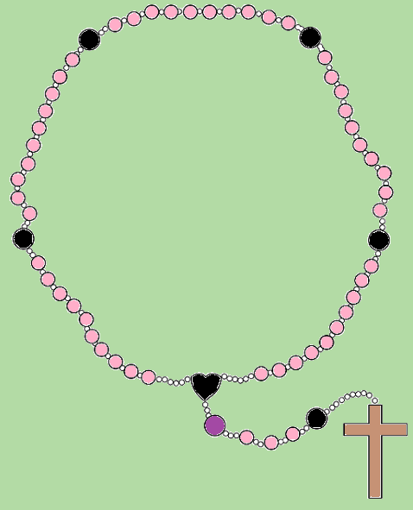
Glory be to the Father, and to the Son, and to the Holy Spirit.
As it was in the beginning, is now, and ever shall be, world without end.
Amen.
Say the…
Glory be to the Father

Slide 49
Hail, Holy Queen Mother of Mercy, our life, our sweetness and our hope!
To thee do we cry, poor banished children of Eve; to thee do we send up our sighs, mourning and weeping in this vale of tears.
Turn then, most gracious advocate, thine eyes of mercy toward us, and after this our exile, show unto us the blessed fruit of thy womb, Jesus.
O clement, O loving, O sweet Virgin Mary!
V: Pray for us, O Holy Mother of God.
R: That we may be made worthy of the promises of Christ.
Let us pray: O God, whose only begotten Son, by His life, death, and resurrection, has purchased for us the rewards of eternal life, grant, we beseech Thee, that meditating upon these mysteries of the Most Holy Rosary of the Blessed Virgin Mary, we may imitate what they contain and obtain what they promise, through the same Christ Our Lord.
Amen.
Say the…
Hail Holy Queen

Slide 50
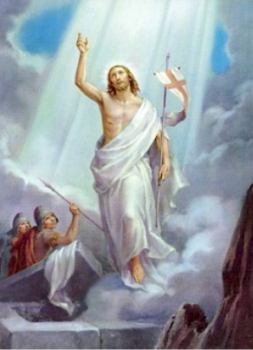
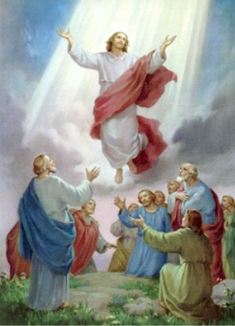
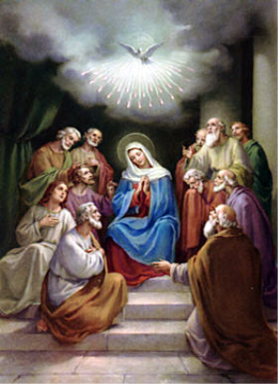
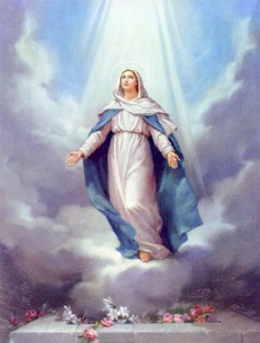
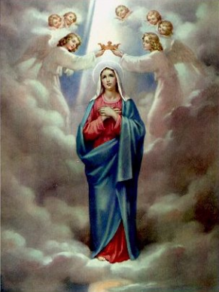
The Glorious Mysteries
The Resurrection
The Ascension
The Descent of the Holy Spirit
The Assumption
The Crowning of Our Lady, Queen of Heaven
Notes:
The Glorious Mysteries are the crown of Jesus' triumphs. How exhilarating to know that Jesus is God and that He rose from the dead thereby destroying death and making you an heir to Heaven. Reminding yourself of these glorious events in the Glorious Mysteries as you pray the Rosary prayer will keep your faith alive and strong.
The Catholic rosary prayers are concluded with these final glorious events. Jesus’ resurrection is the foundation of Christian belief. After the resurrection of Jesus, He ascended into heaven. There He now sits at the right hand of God the Father. He sent the Holy Spirit to strengthen humankind. He took His Mother, body and soul up to Heaven then crowned Her Queen of Heaven and Earth.
The Five Glorious Mysteries of the Rosary are recited on Wednesdays except during Lent and on Sundays From Easter to Advent .
We enter the triumph of our Lord Jesus in His resurrection and the birth of the Church in all of its glory with Mother Mary as Queen of Heaven!

Slide 51
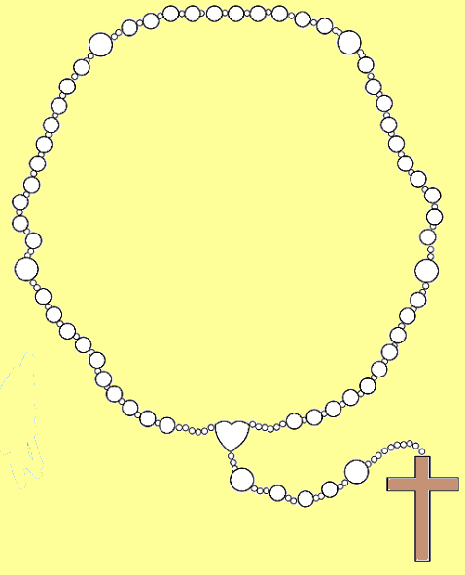
I believe in God, the Father almighty, Creator of heaven and earth, and in Jesus Christ, his only Son, our Lord, who was conceived by the Holy Spirit, born of the Virgin Mary, suffered under Pontius Pilate, was crucified, died and was buried; he descended into hell; on the third day he rose again from the dead; he ascended into heaven, and is seated at the right hand of God the Father almighty; from there he will come to judge the living and the dead.
I believe in the Holy Spirit, the holy catholic Church, the communion of saints, the forgiveness of sins, the resurrection of the body, and life everlasting.
Amen.
Make the sign of the cross and say the…
Apostles’ Creed
Notes:
How to Pray the Rosary
1. Begin by touching the crucifix and praying the Sign of the Cross followed by the Apostle's Creed.
2. On the first large rosary bead, pray the Our Father.
3. On each of the next three beads, pray a Hail Mary.
4. On the next large bead, pray the Glory Be to the Father.
5. At the beginning of each decade, announce the "mystery" to be contemplated, for example, the first glorious mystery is “The Resurrection".
6. After a short pause for reflection, recite the "Our Father", ten "Hail Marys" and the "Glory be to the Father".
After this, repeat stages 5 and 6 for the remaining four decades.
At the end of the Rosary, the Hail Holy Queen.

Slide 52
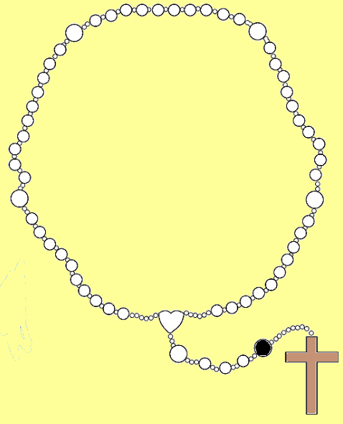
Our Father, who art in heaven,
hallowed be thy name;
thy kingdom come,
thy will be done on earth
as it is in heaven.
Give us this day our daily bread,
and forgive us our trespasses,
as we forgive those who
trespass against us;
and lead us not into temptation,
but deliver us from evil.
Amen.
Say the…
Our Father

Slide 53
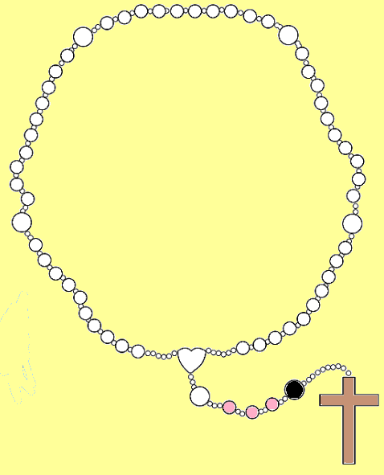
Hail Mary, full of grace.
Our Lord is with thee.
Blessed art thou among women,
and blessed is the fruit of thy womb,
Jesus.
Holy Mary, Mother of God,
pray for us sinners,
now and at the hour of our death.
Amen.
Say three…
Hail Marys

Slide 54
Glory be to the Father, and to the Son, and to the Holy Spirit.
As it was in the beginning, is now, and ever shall be, world without end.
Amen.
Say the…
Glory be to the Father

Slide 55
The First Glorious Mystery
The Resurrection
Notes:
Matthew 28:1-10
28 After the Sabbath, at dawn on the first day of the week, Mary Magdalene and the other Mary went to look at the tomb. ² There was a violent earthquake, for an angel of the Lord came down from heaven and, going to the tomb, rolled back the stone and sat on it. ³ His appearance was like lightning, and his clothes were white as snow. ⁴ The guards were so afraid of him that they shook and became like dead men. ⁵ The angel said to the women, “Do not be afraid, for I know that you are looking for Jesus, who was crucified. ⁶ He is not here; he has risen, just as he said. Come and see the place where he lay. ⁷ Then go quickly and tell his disciples: ‘He has risen from the dead and is going ahead of you into Galilee. There you will see him.’ Now I have told you.” ⁸ So the women hurried away from the tomb, afraid yet filled with joy, and ran to tell his disciples. ⁹ Suddenly Jesus met them. “Greetings,” he said. They came to him, clasped his feet and worshiped him. ¹⁰ Then Jesus said to them, “Do not be afraid. Go and tell my brothers to go to Galilee; there they will see me.”
Reflection
The Resurrection of Christ is about hope. It is the fulfilment of God’s Word. Everything that had ever been prophesied about Him, everything He had ever said or done is fulfilled in His resurrection. Jesus conquered death and sin. He completed His mission to redeem us with the Father so that we can follow Him into eternal life. Christ’s resurrection is the fulfilment of our faith. It is beyond our comprehension. It defies all that we know of our world—of nature itself. It is truly a miracle. The resurrection is proof that all things are possible in Christ.
Questions
Do I have faith that God will fulfil His promise to me in my life?
We Pray for Faith
We pray that each day our faith grows and is strengthened through the power and mystery of Christ’s resurrection.

Slide 56
Glory be to the Father, and to the Son, and to the Holy Spirit.
As it was in the beginning, is now, and ever shall be, world without end.
Amen.
Say the…
Glory be to the Father

Slide 57
The Second Glorious Mystery
The Ascension
Notes:
Luke 24:44-53
⁴⁴ He said to them, “This is what I told you while I was still with you: Everything must be fulfilled that is written about me in the Law of Moses, the Prophets and the Psalms.” ⁴⁵ Then he opened their minds so they could understand the Scriptures. ⁴⁶ He told them, “This is what is written: The Messiah will suffer and rise from the dead on the third day, ⁴⁷ and repentance for the forgiveness of sins will be preached in his name to all nations, beginning at Jerusalem. ⁴⁸ You are witnesses of these things. ⁴⁹ I am going to send you what my Father has promised; but stay in the city until you have been clothed with power from on high.” ⁵⁰ When he had led them out to the vicinity of Bethany, he lifted up his hands and blessed them. ⁵¹ While he was blessing them, he left them and was taken up into heaven. ⁵² Then they worshiped him and returned to Jerusalem with great joy. ⁵³ And they stayed continually at the temple, praising God.
Reflection
As witnesses to this glorious miracle, Jesus’s disciples gain the hope and belief that they will follow Him into heaven. In the same way, Jesus’s ascension gives us hope that we too might follow Him into heaven to be with God the Father. After all, we were created to be with God. All of our faith points us in this direction. Jesus loves us and wants us to follow Him.
Questions
Do I use Jesus’s ascension into heaven to strengthen my faith and hope each day?
Do I allow the Holy Spirit to come to me to guide and direct my life?
We Pray for Hope
We pray that we find faith and hope in Christ’s ascension so we too might follow Him to the Father.

Slide 58
Glory be to the Father, and to the Son, and to the Holy Spirit.
As it was in the beginning, is now, and ever shall be, world without end.
Amen.
Say the…
Glory be to the Father

Slide 59
The Third Glorious Mystery
The Descent of the Holy Spirit
Notes:
John 14:15-21
¹⁵ “If you love me, keep my commands. ¹⁶ And I will ask the Father, and he will give you another advocate to help you and be with you forever— ¹⁷ the Spirit of truth. The world cannot accept him, because it neither sees him nor knows him. But you know him, for he lives with you and will be in you. ¹⁸ I will not leave you as orphans; I will come to you. ¹⁹ Before long, the world will not see me anymore, but you will see me. Because I live, you also will live. ²⁰ On that day you will realize that I am in my Father, and you are in me, and I am in you. ²¹ Whoever has my commands and keeps them is the one who loves me. The one who loves me will be loved by my Father, and I too will love them and show myself to them.”
Reflection
Like Christ’s disciples, it is up to us to accept this gift into our lives. When we do, the confusion and fear about where and how to begin our personal missions melts away and certainty replaces it. The Holy Spirit, once accepted into our lives, speaks to us in many ways. He comes into our thoughts. He speaks through our conscious and through signs all around us. He gives us guidance and direction, strength, and grace to carry out God’s will.
Questions
Do I accept the Holy Spirit into my life to give me strength and wisdom to live and die as Christ did? Do I listen and follow the Holy Spirit’s instructions?
We Pray for Love
We pray that we accept the Holy Spirit into our heart and into our lives. We pray that we follow His direction to become an instrument of God in this world.

Slide 60
Glory be to the Father, and to the Son, and to the Holy Spirit.
As it was in the beginning, is now, and ever shall be, world without end.
Amen.
Say the…
Glory be to the Father

Slide 61
The Fourth Glorious Mystery
The Assumption
Notes:
Catechism of the Catholic Church
965 After her Son's Ascension, Mary "aided the beginnings of the Church by her prayers."⁵⁰⁶ In her association with the apostles and several women, "we also see Mary by her prayers imploring the gift of the Spirit, who had already overshadowed her in the Annunciation."⁵⁰⁷ . . . also in her Assumption… 966 "Finally the Immaculate Virgin, preserved free from all stain of original sin, when the course of her earthly life was finished, was taken up body and soul into heavenly glory, and exalted by the Lord as Queen over all things, so that she might be the more fully conformed to her Son, the Lord of lords and conqueror of sin and death."⁵⁰⁸ The Assumption of the Blessed Virgin is a singular participation in her Son's Resurrection and an anticipation of the resurrection of other Christians.
Reflection
Mary, without sin, was taken, body and soul, directly to God. Because she was without sin, her body was not allowed to be corrupted. If we follow Mary’s example, we too can share in the resurrection.
Questions
Do I try to follow Mary’s example by saying yes when I am called upon to do God’s will?
Is my faith and hope strengthened by Mary’s assumption, body and soul, into heaven?
We Pray for Devotion to Mary
We pray that we are given strength and grace each day so that we are prepared to say yes when we are called to do the will of God.

Slide 62
Glory be to the Father, and to the Son, and to the Holy Spirit.
As it was in the beginning, is now, and ever shall be, world without end.
Amen.
Say the…
Glory be to the Father

Slide 63
The Fifth Glorious Mystery
The Crowning of Our Lady, Queen of Heaven
Notes:
Revelations 12:1
12 And a great sign appeared in heaven: A woman clothed with the sun, and the moon under her feet, and on her head a crown of twelve stars:
Reflection
The Coronation of Mary as the Queen of All Creation is something to celebrate—a joyous event. Once again, Mary shows us that, through the grace of God, all things are possible. Mary could rest on her accomplishment. She could rejoice in the presence of God for the rest of eternity. But she is our mother, and she understands God’s will for us. He does not want any one of us to be left behind. So, Mary like the perfect mother she is, accepts her position in heaven humbly, but immediately sets out once again to serve God in shepherding us to Him. Like the Visitation, Mary comes to us to help us; to lead us to God through Christ. For she will not rest as Queen of Creation until all of God’s children are with Him in heaven.
Questions
Do I follow Mary’s example each day?
Do I open my heart to receive the grace of God through the Holy Spirit?
We Pray for Eternal Happiness
We pray that we might follow Mary’s example each day, and with the help of her intercession, be brought to Christ in heaven to share fully in God the Father’s presence for eternity.

Slide 64
Glory be to the Father, and to the Son, and to the Holy Spirit.
As it was in the beginning, is now, and ever shall be, world without end.
Amen.
Say the…
Glory be to the Father

Slide 65
Hail, Holy Queen Mother of Mercy, our life, our sweetness and our hope!
To thee do we cry, poor banished children of Eve; to thee do we send up our sighs, mourning and weeping in this vale of tears.
Turn then, most gracious advocate, thine eyes of mercy toward us, and after this our exile, show unto us the blessed fruit of thy womb, Jesus.
O clement, O loving, O sweet Virgin Mary!
V: Pray for us, O Holy Mother of God.
R: That we may be made worthy of the promises of Christ.
Let us pray: O God, whose only begotten Son, by His life, death, and resurrection, has purchased for us the rewards of eternal life, grant, we beseech Thee, that meditating upon these mysteries of the Most Holy Rosary of the Blessed Virgin Mary, we may imitate what they contain and obtain what they promise, through the same Christ Our Lord.
Amen.
Say the…
Hail Holy Queen

Slide 66
References
Bible Gateway, (2016) Various Scripture Passages – New International Version. [online] Available from: www.biblegateway.com [Accessed 03/03/16]
Catholic Tradition, (2016) The Mysteries of the Rosary in Pictures [online] Available from: http://www.catholictradition.org/Children/mysteries-rosary.htm [Accessed 03/03/16]
How To Pray The Rosary Every Day, (2016) Fruits of the Rosary [online] Available from:
http://www.how-to-pray-the-rosary-everyday.com/fruits-of-the-rosary.html [Accessed 03/03/16]
Mary’s Touch, (2016) How to Pray the Rosary [online] Available from: http://www.marystouch.org/More/PraytheRosary.htm [Accessed 03/03/16]
Rosary Centre, (2016) How To Pray the Rosary [online] Available from:
http://www.rosary-center.org/howto.htm#loaded [Accessed 03/03/16]
The Holy See, (2016) The Catechism of the Catholic Church: Mary - Mother of Christ, Mother of the Church [online] Available from: http://www.vatican.va/archive/ccc_css/archive/catechism/p123a9p6.htm [Accessed 03/03/16]

