Slide 1
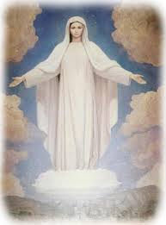
Litany to The Blessed Virgin mary
Notes:
A litany is liturgical form of prayer consisting of a series of invocations or supplications with responses that are the same for a number in succession.

Slide 2
Lord, have mercy on us.
Lord have mercy on us
Christ, have mercy on us.
Christ have mercy on us
Lord, have mercy on us.
Lord have mercy on us.
Christ hear us
Christ Graciously hear us
Notes:
The script in white should be read by the teacher or lead speaker, the yellow text being read by the children.

Slide 3
God the Father of Heaven,
Have mercy on us.
God the Son, Redeemer of the world,
Have mercy on us.
God the Holy Ghost,
Have mercy on us.
Holy Trinity, one God,
Have mercy on us.

Slide 4
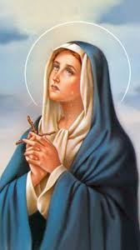
Holy Mary,
pray for us.
Holy Mother of God,
pray for us.
Holy Virgin of virgins,
pray for us.
Mother of Christ,
pray for us.

Slide 5
Mother of divine grace,
pray for us.
Mother most pure,
pray for us.
Mother most chaste,
pray for us.
Mother inviolate,
pray for us.

Slide 6
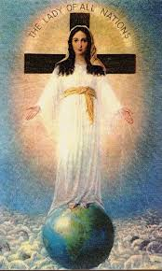
Mother undefiled,
pray for us.
Mother most amiable,
pray for us.
Mother most admirable,
pray for us.
Mother of good counsel,
pray for us.

Slide 7
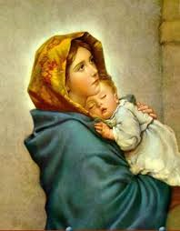
Mother of our Creator,
pray for us.
Mother of our Saviour,
pray for us.
Virgin most prudent,
pray for us.
Virgin most venerable,
pray for us.

Slide 8
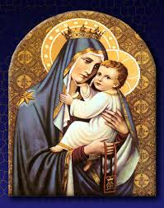
Virgin most renowned,
pray for us.
Virgin most powerful,
pray for us.
Virgin most merciful,
pray for us.
Virgin most faithful,
pray for us.

Slide 9
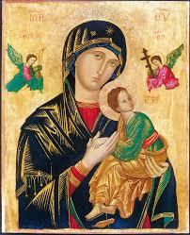
Mirror of justice,
pray for us.
Seat of wisdom,
pray for us.
Cause of our joy,
pray for us.
Spiritual vessel,
pray for us.

Slide 10
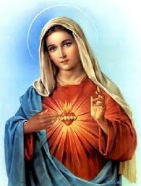
Vessel of honour,
pray for us.
Singular vessel of devotion,
pray for us.
Mystical rose,
pray for us.
Tower of David,
pray for us.

Slide 11
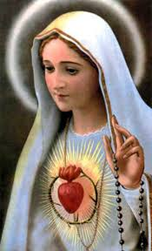
Tower of ivory,
pray for us.
House of gold,
pray for us.
Ark of the Covenant,
pray for us.
Gate of Heaven,
pray for us.

Slide 12
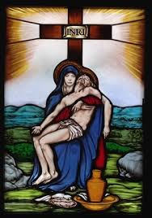
Morning star,
pray for us.
Health of the sick,
pray for us.
Refuge of sinners,
pray for us.
Comforter of the afflicted,
pray for us.

Slide 13
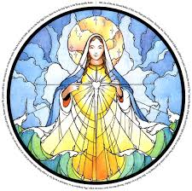
Help of Christians,
pray for us.
Queen of angels,
pray for us.
Queen of patriarchs,
pray for us.
Queen of prophets,
pray for us.

Slide 14
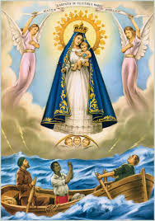
Queen of apostles,
pray for us.
Queen of martyrs,
pray for us.
Queen of confessors,
pray for us.
Queen of virgins,
pray for us.

Slide 15
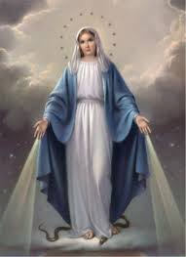
Queen of all saints,
pray for us.
Queen conceived without Original Sin,
pray for us.
Queen assumed into Heaven,
pray for us.
Queen of the most holy Rosary,
pray for us.
Queen of peace,
pray for us.

Slide 16
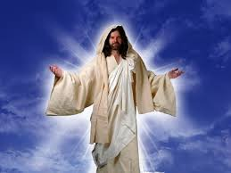
Lamb of God, who takes away the sins of the world,
Spare us, O Lord.
Lamb of God, who takes away the sins of the world,
Graciously hear us, O Lord.
Lamb of God, who takes away the sins of the world,
Have mercy on us.

Slide 17
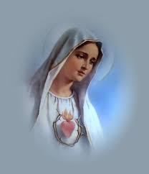
Pray for us, O Holy Mother of God,
That we may be made worthy of the promises of Christ.
Grant, we beseech Thee, O Lord God, that we Thy Servants may enjoy perpetual health of mind and body and by the glorious intercession of the Blessed Mary, ever Virgin, be delivered from present sorrow and enjoy eternal happiness.
Through Christ Our Lord.
Amen.
Notes:
Approved by Pope Sixtus V in 1587

