Slide 1
St. Kentigern (Mungo) Facts
Key date: 13 January
Died 612
Bishop of Strathclyde.
Started the legend that gives Glasgow its arms of ring and fish.

Slide 2
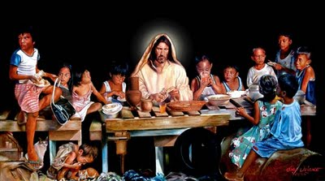
When you give a feast, invite the poor, the crippled, the lame and the blind. Luke 14:13 Think about the picture.

Slide 3
The picture and the quotation from the Bible give us a clue about how Kentigern lived. Do you think he was popular? Do you think he was loved?

Slide 4
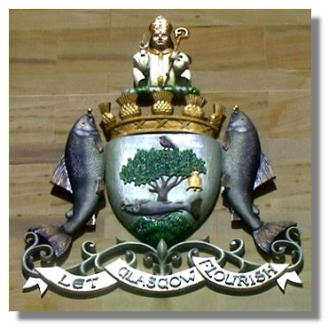
Glasgow
Who do you think is at the top of Glasgow’s coat of arms? All of the symbols on the arms are connected to this person.

Slide 5
Let Glasgow flourish (by the preaching of the Word)
Look at the coat of arms.
There are three words at the bottom. These form the motto of the City of Glasgow.
In what way are the words at the top different?
Why do you think this is?
Notes:
The brackets include the original motto. It was later reduced to what is currently on the coat of arms. The Word referred to is the Word of God.

Slide 6
There's the tree that never grew, There's the bird that never flew, There's the fish that never swam, There's the bell that never rang.
These are the stories and legends associated with Glasgow’s coat of arms.

Slide 7
There's the tree that never grew.
The tree in the coat of arms is now a sturdy oak tree, but it started out as a branch of a hazel tree. The legend says that St. Mungo was in charge of a holy fire in St. Serf's Monastery and fell asleep. Some boys who were envious of his favoured position with St Serf put out the fire. But St. Mungo broke off some frozen branches from a hazel tree and, by praying over them, caused them to burst into flames.

Slide 8
There's the bird that never flew.
Can you find the bird?
This commemorates a wild robin which was tamed by St. Serf and which was accidentally killed. St. Mungo was blamed for the death but he is said to have taken the dead bird, prayed over it and it was restored to life.

Slide 9
There's the fish that never swam.
Kentigern had been away from Scotland. This story comes from the time when he came back. The king at that time was very angry with his wife. She had given a precious ring of his to another man. The king grabbed the ring back and threw it into the river in a temper.
‘Bring back my ring in three days,’ he yelled. ‘Or else…!’
The queen was very upset. How would she get the ring back?
Bishop Kentigern heard all about it, and knew the queen was sorry. He told her not to worry and…he produced the selfsame ring. One of his monks had caught a lovely salmon and, on cutting it open to clean it, had discovered the missing ring inside.

Slide 10
Glasgow
There's the tree that never grew,
There's the bird that never flew,
There's the fish that never swam,
There's the bell that never rang.

