Slide 1
The Stations of the Cross
Diocese of Motherwell
Teachers’ Resource
Notes:
The Stations of the Cross are a 14-step Catholic devotion that commemorates Jesus Christ's last day on Earth as a man. The 14 devotions, or stations, focus on specific events of His last day, beginning with His condemnation. The stations are commonly used as a mini pilgrimage as the class moves from station to station. At each station, the class recalls and meditates on a specific event from Christ's last day. Specific prayers are recited, then the class moves to the next station until all 14 are complete.
The Stations of the Cross are commonly found in churches as a series of 14 small icons or images. They can also appear in church yards arranged along paths. The stations are most commonly prayed during Lent on Wednesdays and Fridays, and especially on Good Friday, the day of the year upon which the events actually occurred.
In this teachers’ resource each station is supported by detailed notes including a scripture passage, reflections for a child and adult to read as well as a concluding prayer. Each slide has a hyperlink, by clicking on the station’s image you will be taking to a short video click which will read the reflections for you over meditating music and images.
These notes can be used separately from the PowerPoint during a mini pilgrimage of the Stations of the Cross throughout the school building, gardens or local church.
At the end of the Stations of the Cross the prayers and children’s reflections can be printed for them to read aloud individually or as a group at each station.

Slide 2
The Stations of the Cross
Notes:
The Stations of the Cross should begin by praying an Act of Contrition.
Then at each station the leader should announce the station and pause for thought. They can then use the Scripture, Reflections or Prayers provided in the notes. Alternatively, pray the prayers below after announcing each station;
Leader: We adore Thee, O Christ, and bless Thee.
All: Because by Thy holy cross Thou hast redeemed the world.
Our Father.... Hail Mary.... Glory Be to the Father....
Leader: Jesus Christ Crucified.
All: Have mercy on Us.
Leader: May the souls of the faithful departed, through the mercy of God, Rest in peace.
All: Amen.
A prayer card is provided in the resources at the end of the PowerPoint.

Slide 3
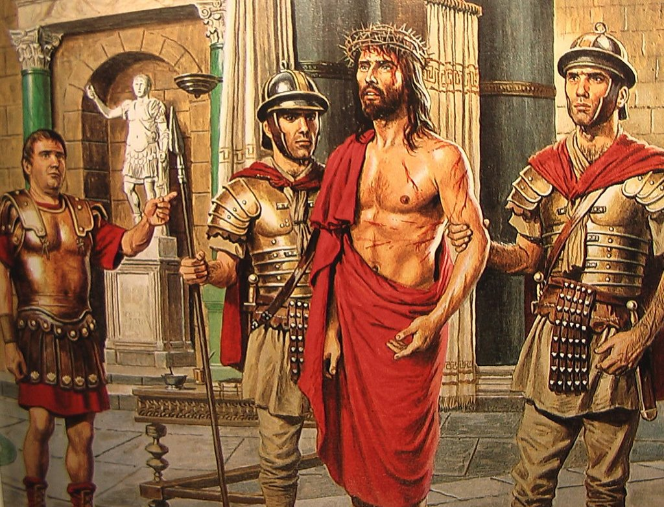
Jesus is condemned to death
I
Notes:
Matthew 27:23-28
²³ “Why? What crime has he committed?” asked Pilate.
But they shouted all the louder, “Crucify him!”
²⁴ When Pilate saw that he was getting nowhere, but that instead an uproar was starting, he took water and washed his hands in front of the crowd. “I am innocent of this man’s blood,” he said. “It is your responsibility!”
²⁵ All the people answered, “His blood is on us and on our children!”
²⁶ Then he released Barabbas to them. But he had Jesus flogged, and handed him over to be crucified.
Reflections
Jesus, you stand all alone before Pilate. Nobody speaks up for you. Nobody helps defend you. You devoted your entire life to helping others, listening to the smallest ones, caring for those who were ignored by others. They don't seem to remember that as they prepare to put you to death. As a child, sometimes I feel alone. Sometimes I feel that others don't stand up for me and defend me when I am afraid. Sometimes I don't feel like I am treated fairly, especially if I am scolded or corrected. As an adult, sometimes I feel abandoned and afraid as well. Sometimes I too, feel like I am treated unfairly or blamed for things unfairly. I have a hard time when people criticize me at home or at work.
Prayer Lord, help me be grateful for what you did for me. Help me to accept criticism and unfairness as you did, and not complain. Help me pray for those who have hurt me.
We ask this through Christ our Lord, Amen

Slide 4
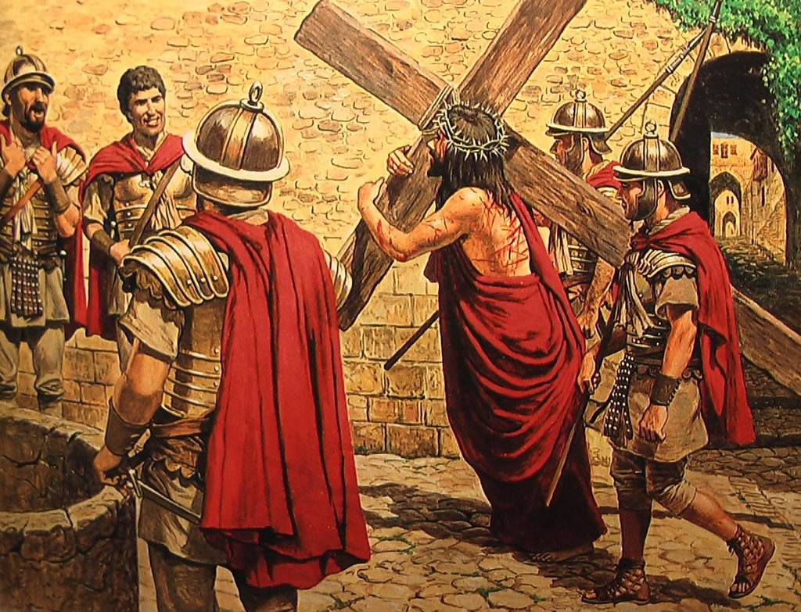
Jesus is made to carry His cross
II
Notes:
John 19:13-17
¹³ When Pilate heard this, he brought Jesus out and sat down on the judge’s seat at a place known as the Stone Pavement (which in Aramaic is Gabbatha). ¹⁴ It was the day of Preparation of the Passover; it was about noon. “Here is your king,” Pilate said to the Jews. ¹⁵ But they shouted, “Take him away! Take him away! Crucify him!” “Shall I crucify your king?” Pilate asked. “We have no king but Caesar,” the chief priests answered. ¹⁶ Finally Pilate handed him over to them to be crucified. So the soldiers took charge of Jesus. ¹⁷ Carrying his own cross, he went out to the place of the Skull (which in Aramaic is called Golgotha).
Reflections
Jesus, as you accepted your cross, you knew you would carry it to your death on Calvary. You knew it wouldn't be easy, but you accepted it and carried it just the same.
As a child, sometimes I don't like the problems that come my way. Sometimes I try to get others to take care of them or solve them for me. Sometimes I become upset and crabby when I'm asked to do even the smallest thing to help others. As an adult I sometimes feel like I'm not appreciated. Sometimes I feel as if I accept more responsibility that I need to. I can feel sorry for myself, even though the crosses others carry are much larger than my own. In my self-pity, I don't reach out to help.
Prayer
Jesus, by your own will you took on the most heavy cross made for you by our sins, make us feel their heavy weight, and remember your suffering as repent and live our lives as you taught us to.
We ask this through Christ our Lord, Amen

Slide 5
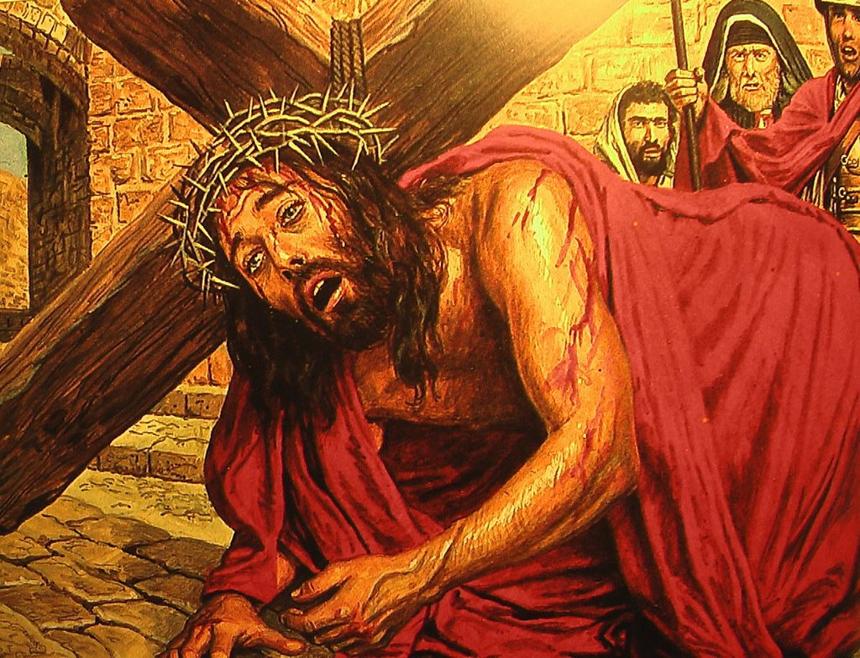
Jesus falls for the first time
III
Notes:
Matthew 11:28-30
²⁸ “Come to me, all you who are weary and burdened, and I will give you rest. ²⁹ Take my yoke upon you and learn from me, for I am gentle and humble in heart, and you will find rest for your souls. ³⁰ For my yoke is easy and my burden is light.”
Reflections
Jesus, the cross you have been carrying is very heavy. You are becoming weak and almost ready to faint, and you fall down. Nobody seems to want to help you. The soldiers are interested in getting home, so they yell at you and try to get you up and moving again. As a child, sometimes I start to do something, but then get tired of it. I hurry to get finished and sometimes don't do my work well. Sometimes I don't pay attention to what I should be doing. When things get hard for me, sometimes I give up. As an adult, I sometimes put things off. I give up too easily, and sometimes don't do my work as well as I know I can.
Prayer Jesus, the heavy burden of our sins is on you, and bears you down beneath the cross. We loathe them, we detest them; we call on you to pardon them; may your grace help us to turn away from sin and listen to your word.
We ask this through Christ our Lord, Amen

Slide 6
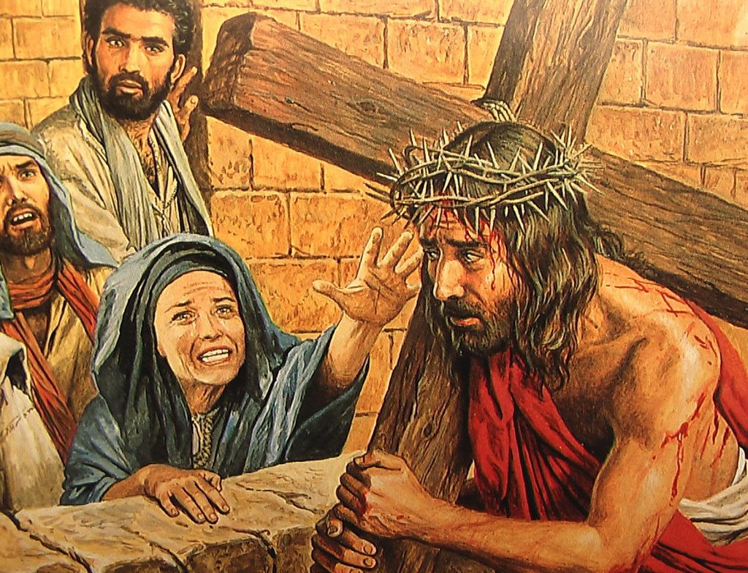
Jesus meets His mother
VI
Notes:
John 19:25-27
²⁵ Near the cross of Jesus stood his mother, his mother’s sister, Mary the wife of Clopas, and Mary Magdalene. ²⁶ When Jesus saw his mother there, and the disciple whom he loved standing nearby, he said to her, “Woman,^{[a]} here is your son,” ²⁷ and to the disciple, “Here is your mother.” From that time on, this disciple took her into his home.
Reflection
Jesus, you feel so alone with all those people yelling and screaming at you. You don't like the words they are saying about you, and you look for a friendly face in the crowd. You see your mother. She can't make the hurting stop, but it helps to see that she is on your side, that she is suffering with you. She does understand and care. As a child, sometimes I feel like too many things are going on. Sometimes other kids pick on me and call me names. I need to look around me for a friendly face, and for the help I need. I need to share my troubles with those who truly care about me. As an adult I sometimes feel overwhelmed by many things. Life is so competitive, and I worry so much about my future and those who have some control over it. I need to remember that being an adult does not mean having to solve every problem all by myself. I need to look around me for a friendly face, for the help I need.
Prayer Jesus most suffering, Mary Mother most sorrowful, if, by our sins, we caused you pain and anguish in the past, by God's assisting grace it shall be so no more.
We ask this through Christ our Lord, Amen

Slide 7
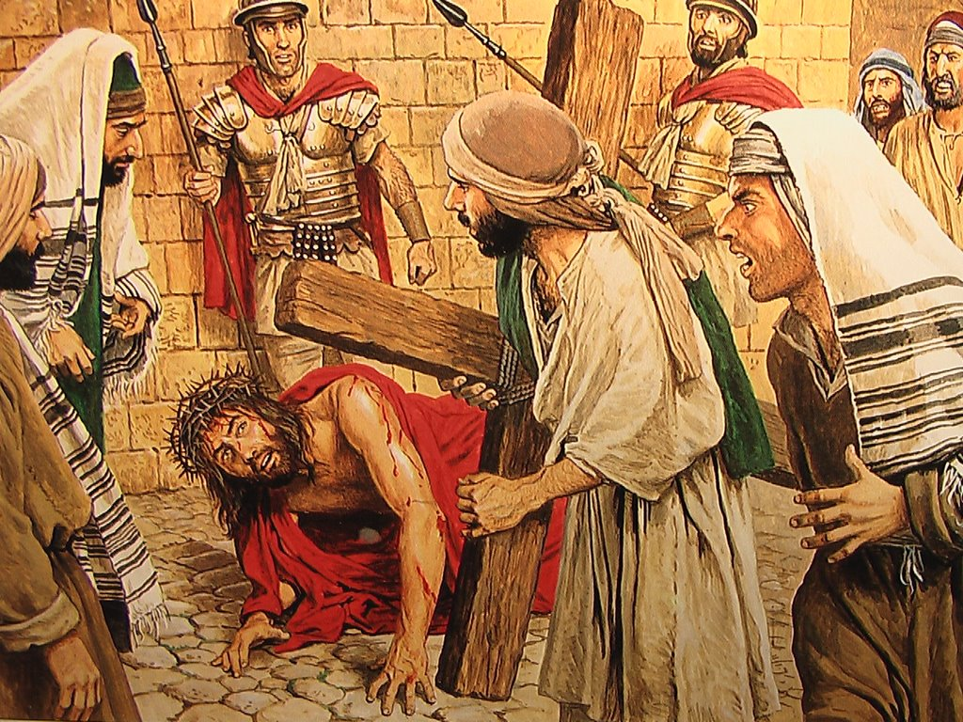
Simon of Cyrene helps Jesus
V
Notes:
Mark 15:21
²¹ A certain man from Cyrene, Simon, the father of Alexander and Rufus, was passing by on his way in from the country, and they forced him to carry the cross.
Reflection
Jesus, the soldiers are becoming impatient. This is taking longer than they wanted it to. They are afraid you won't make it to the hill where you will be crucified. As you grow weaker, they grab a man out of the crowd and make him help carry your cross. He was just watching what was happening, but all of a sudden he is helping you carry your cross. As a child, sometimes I see people who need my help. Sometimes I pretend not to hear when my parents call me. I disappear when I know others could use my help. As an adult, sometimes I try to do as little as I can and still get by. Others might need my help, but I ignore their needs. Even when I'm asked to help, I sometimes claim to be too busy.
Prayer Jesus, blest, was he who aided you to bear the cross. Blest too are we who aid you to bear the cross, by patiently bowing our necks to the crosses you send us during life. Jesus, give us the grace to do so.
We ask this through Christ our Lord, Amen

Slide 8
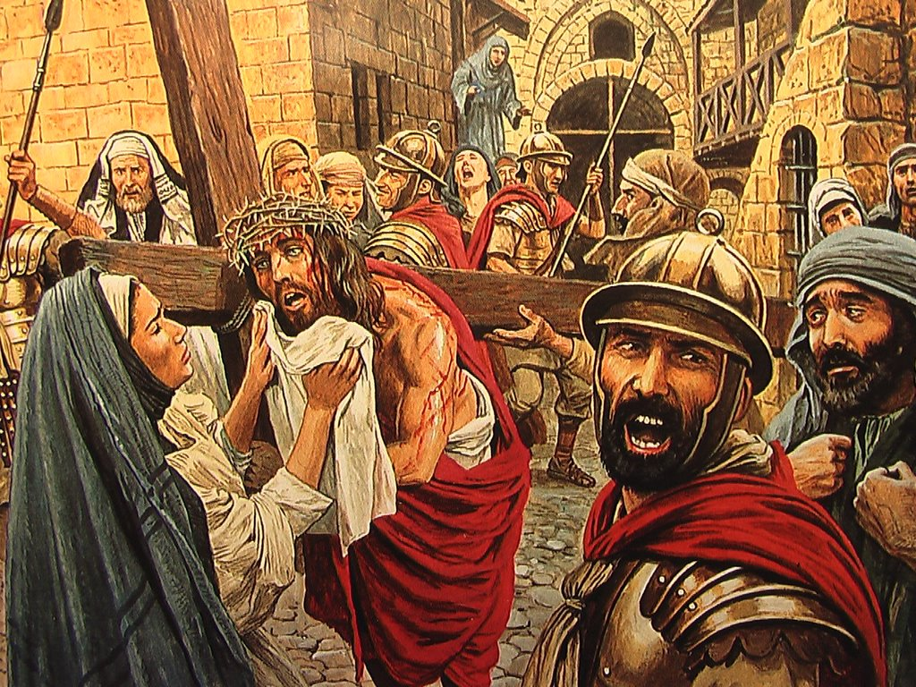
Veronica wipes the face of Jesus
VI
Notes:
Isaiah 53:2-3
² He grew up before him like a tender shoot, and like a root out of dry ground. He had no beauty or majesty to attract us to him, nothing in his appearance that we should desire him. ³ He was despised and rejected by mankind, a man of suffering, and familiar with pain. Like one from whom people hide their faces he was despised, and we held him in low esteem.
Reflections
Jesus, suddenly a woman comes out of the crowd. Her name is Veronica. You can see how she cares for you as she takes a cloth and begins to wipe the blood and sweat from your face. She can't do much, but she offers what little help she can. As a child, sometimes I know someone could use a little help and understanding. They may be picked on or teased by others, or just sad or lonely. Sometimes I feel bad that others don't step in to help, but I don't help either. As an adult, I notice the needs around me. Sometimes my own family members crave my attention, and I don't even seem to notice. Sometimes a co-worker, friend, or family member could use help or understanding, but I don't reach out to help lest I be criticized, or that they demand more of me than I'd like to give.
Prayer
Jesus, in your suffering you printed your sacred face upon the cloth with which Veronica took pity on you and wiped the sweat from your brow, print in our souls deep, we pray, the lasting memory of the pain you suffered for our sins. We ask this through Christ our Lord, Amen

Slide 9
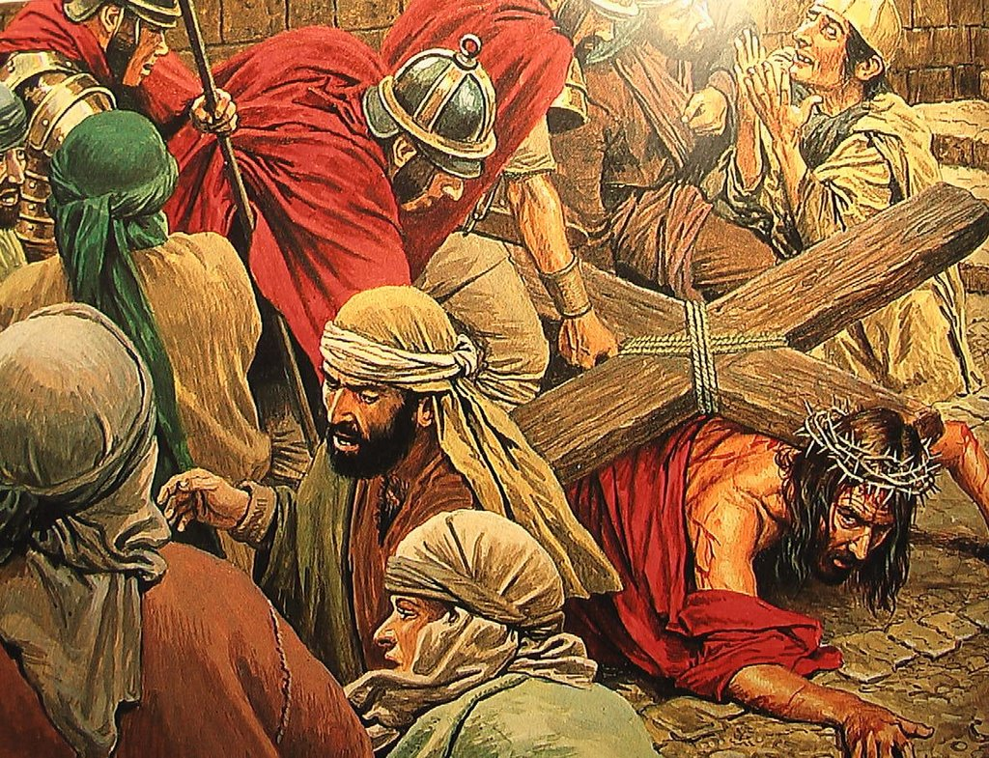
Jesus falls for the second time
VII
Notes:
Psalm 38:17-22
¹⁷ For I am about to fall, and my pain is ever with me. ¹⁸ I confess my iniquity; I am troubled by my sin. ¹⁹ Many have become my enemies without cause;
those who hate me without reason are numerous. ²⁰ Those who repay my good with evil lodge accusations against me,
though I seek only to do what is good.
²¹ Lord, do not forsake me; do not be far from me, my God. ²² Come quickly to help me, my Lord and my Saviour.
Reflections
This is the second time you have fallen on the road. As the cross grows heavier and heavier it becomes more difficult to get up. But you continue to struggle and try until you're up and walking again. You don't give up. As a child, sometimes things get me down. Others seem to find things easier to do or to learn. Each time I fail, I find it harder to keep trying. As an adult, sometimes I think I should know more than I do. I become impatient with myself and find it hard to believe in myself when I fail. It is easy to despair over small things, and sometimes I do.
Prayer Jesus, often we have sinned and fell short of your example. Help us to use your grace that we may never fall again. Help us when things seem too difficult. Even when it's hard, help us get up and keep trying as you did. Help us do our best without comparing ourselves with others.
We ask this through Christ our Lord, Amen

Slide 10
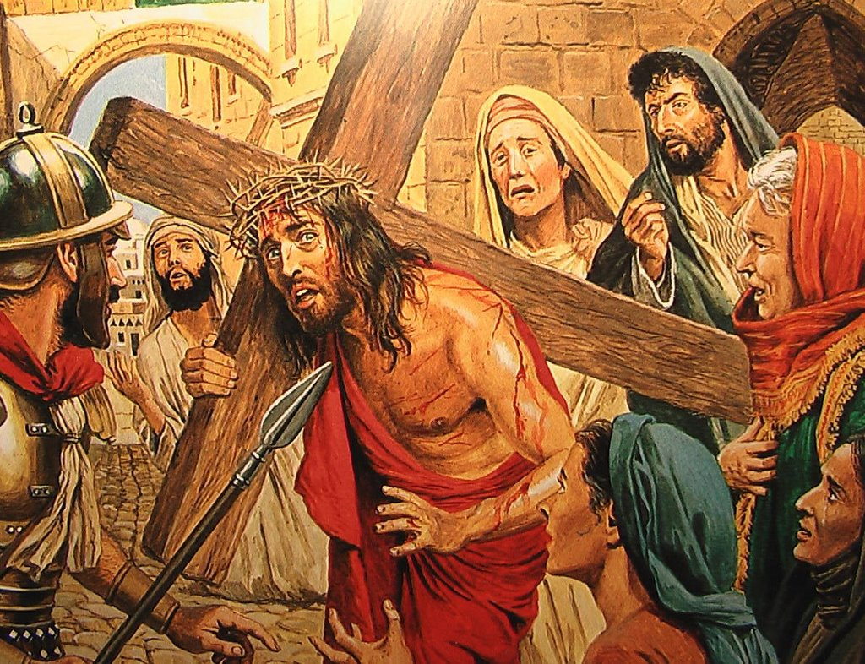
Jesus meets the women of Jerusalem
VIII
Notes:
Luke 23:27-31
²⁷ A large number of people followed him, including women who mourned and wailed for him. ²⁸ Jesus turned and said to them, “Daughters of Jerusalem, do not weep for me; weep for yourselves and for your children. ²⁹ For the time will come when you will say, ‘Blessed are the childless women, the wombs that never bore and the breasts that never nursed!’ ³⁰ Then “‘they will say to the mountains, “Fall on us!” and to the hills, “Cover us!”’³¹ For if people do these things when the tree is green, what will happen when it is dry?”
Reflections
Jesus, as you carry your cross you see a group of women along the road. As you pass by you see they are sad. You stop to spend a moment with them, to offer them some encouragement. Although you are have been abandoned by your friends and are in pain, you stop and try to help them. As a child, sometimes I think a lot about myself. I think about what I want and would like people to spend their lives pleasing me. As an adult, sometimes I act like a child. I become so absorbed in myself and what I'd like that I forget about the needs of others. I take them for granted, and often ignore their needs.
Prayer
Jesus, you comforted the pious women of Jerusalem who wept for you, comfort our souls with your tender pity, for in our pity lies our trust. May our hearts ever answer you. Help us to think more about others. Help us to remember that others have problems, too. Help us to respond to them even when we are busy or preoccupied with our on problems.
We ask this through Christ our Lord, Amen

Slide 11
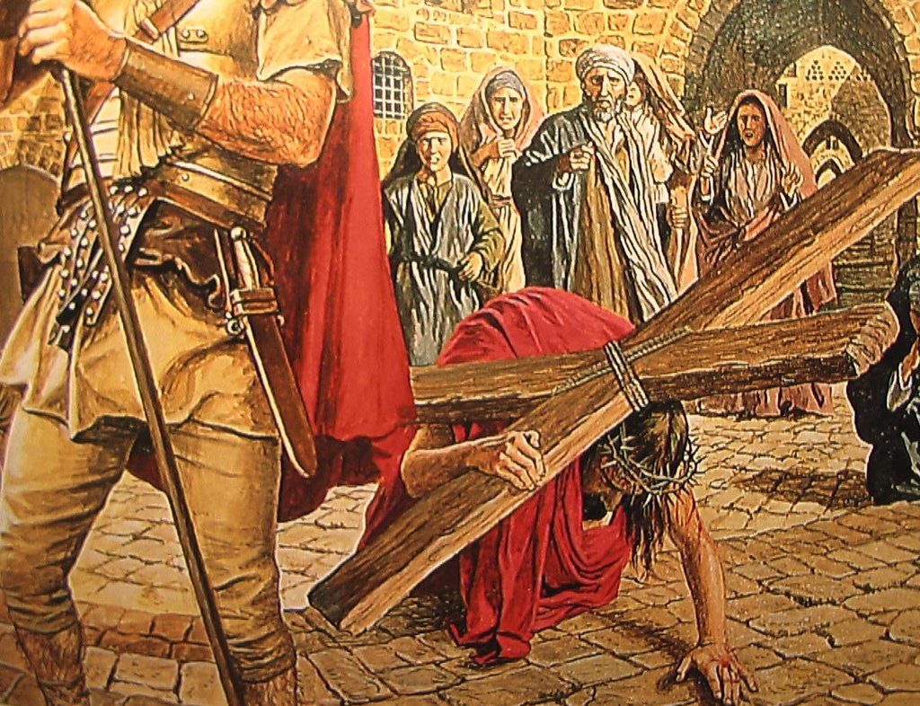
Jesus falls a third time
IX
Notes:
Psalm 37:23-24
²³ The Lord makes firm the steps of the one who delights in him; ²⁴ though he may stumble, he will not fall, for the Lord upholds him with his hand.
Reflections
Jesus, your journey has been long. You fall again, beneath your cross. You know your journey is coming to an end. You struggle and struggle. You get up and keep going. As a child, sometimes I fail time and time again. I find it hard to get along with my sisters and brothers, sometimes I'm not honest, sometimes I'm lazy. I'm tempted to stop trying. It's just too hard sometimes. As an adult, I often feel I should have conquered my weaknesses by now. I become discouraged when I'm confronted by the same problems over and over again. Sometimes I get weary. When I have health problems, I can become discouraged and depressed. Prayer
Jesus, by all the suffering you endured when for the third time the heavy cross forced you to the earth, never, we pray, let us fall again into sin. Help us to think of the cross you carried. Help us to continue to hope that we can make the changes in our lives we need to. You didn't give up. May we too have the strength to get up again as well.
We ask this through Christ our Lord, Amen

Slide 12
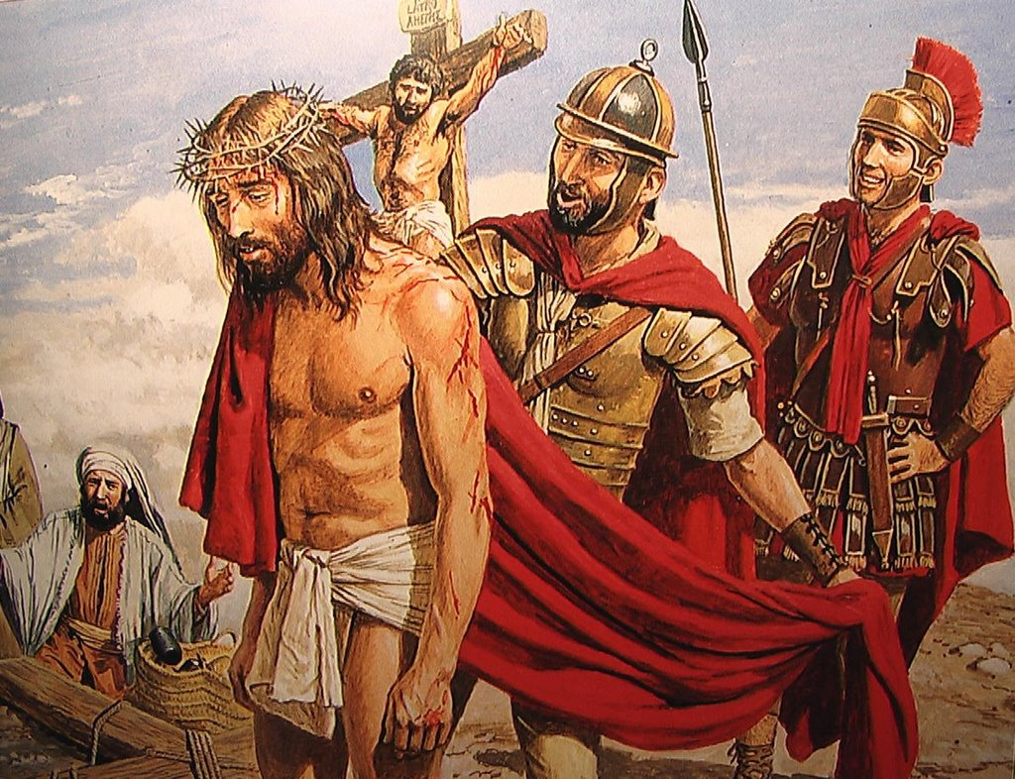
Jesus is stripped of his garments
X
Notes:
John 19:23-24
²³ When the soldiers crucified Jesus, they took his clothes, dividing them into four shares, one for each of them, with the undergarment remaining. This garment was seamless, woven in one piece from top to bottom. ²⁴ “Let’s not tear it,” they said to one another. “Let’s decide by lot who will get it.” This happened that the scripture might be fulfilled that said, “They divided my clothes among them and cast lots for my garment.” So this is what the soldiers did.
Reflections
The soldiers notice you have something of value. They remove your cloak and throw dice for it. Your wounds are torn open once again. Some of the people in the crowd make fun of you. They tease you and challenge you to perform a miracle for them to see. They're not aware that you'll perform the greatest miracle of all! As a child, sometimes I'm tempted to repeat stories I know are unclean and disrespectful. I sometimes try to act grown up by using crude and bad words. As an adult, sometimes I repeat stories that are disrespectful of others. I can entertain thoughts that are not clean. Sometimes I give the young people around me a bad example to follow.
Prayer Jesus, stripped of your garments and ridiculed, strip us of all our inequities and cleanse us of our sins. Help us to say things that build up the people around us. Help us to overcome worldly desires that we may become more like Jesus. Help us to set a good example for others to follow.
We ask this through Christ our Lord, Amen

Slide 13
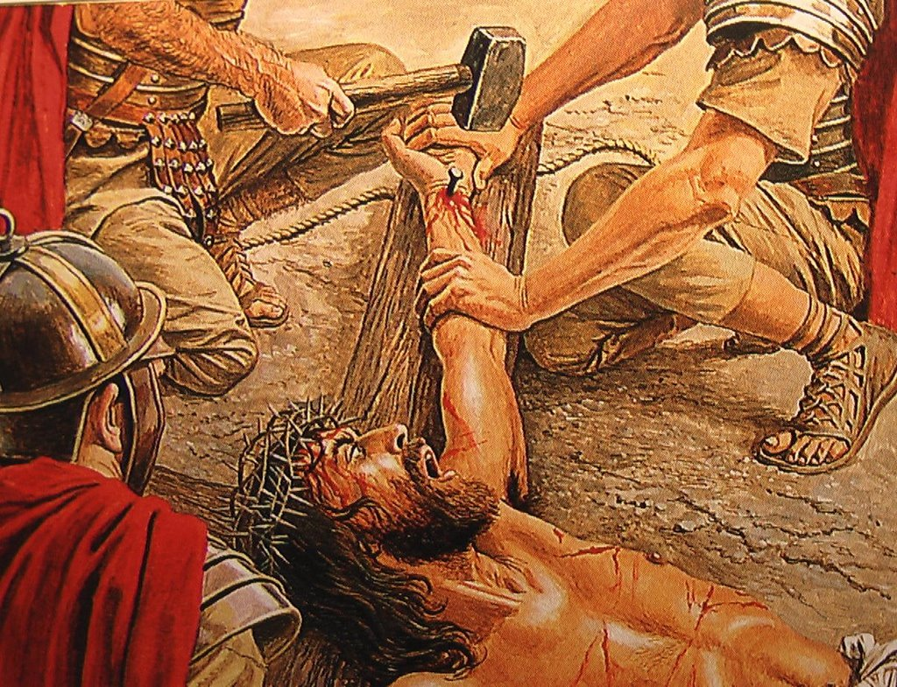
Jesus is nailed to the cross
XI
Notes:
Luke 23:33-43
³³ When they came to the place called the Skull, they crucified him there, along with the criminals—one on his right, the other on his left. ³⁴ Jesus said, “Father, forgive them, for they do not know what they are doing.”
Reflections
You are stretched out on the cross you have carried so far. The soldiers take big nails and drive them into your hands and feet. You feel abandoned by the people you loved so much. People seem to have gone mad. You have done nothing but good, yet they drive nails through your hands and feet. As a child, sometimes I hurt others. Sometimes I join with friends and decide not to like another. We gang up against another and cause them hurt and pain. Sometimes I say or do hurtful things to my brothers and sisters. I can wonder what they'd think about themselves if they believed everything I told them about themselves. As and adult, sometimes I discriminate against others. Even without thinking, I judge others because of their colour, intelligence, income level or name. I forget that I am to live as a brother or sister to all people. Sometimes I use harsh words when I speak to my children and family members. I can find it easy to look for something that isn't very important and make it very important.
Prayer Jesus, when the agony of the cruel nails pierced your tender hands and feet and fixed them to the cross, you endured the ultimate pain and suffering for us. Help us look again at the people around us. Help us see the hurt and pain we have caused in others. Be with us Lord to help us make amends for the harm we have done.
We ask this through Christ our Lord, Amen

Slide 14
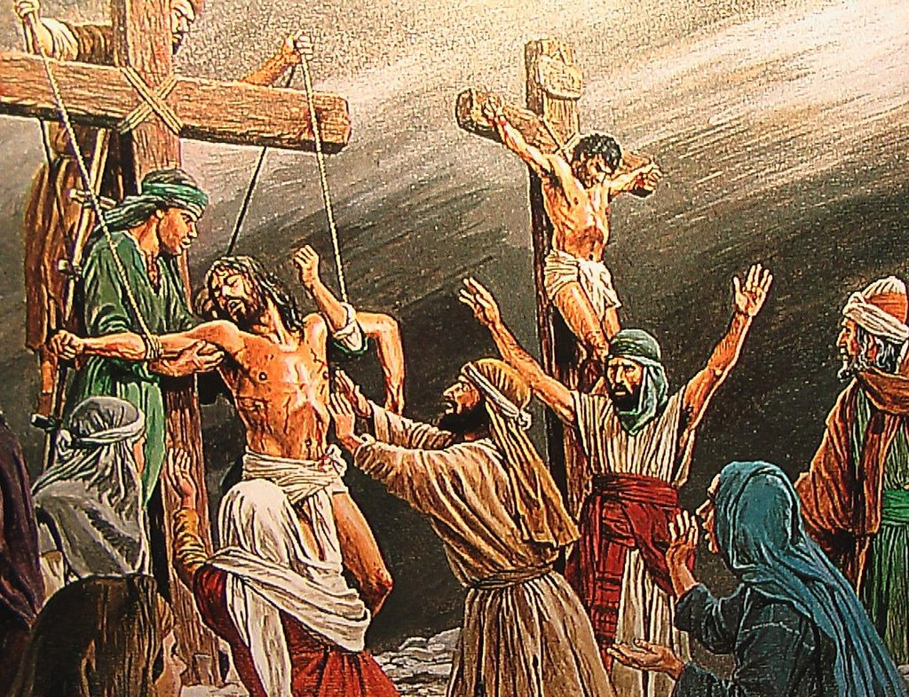
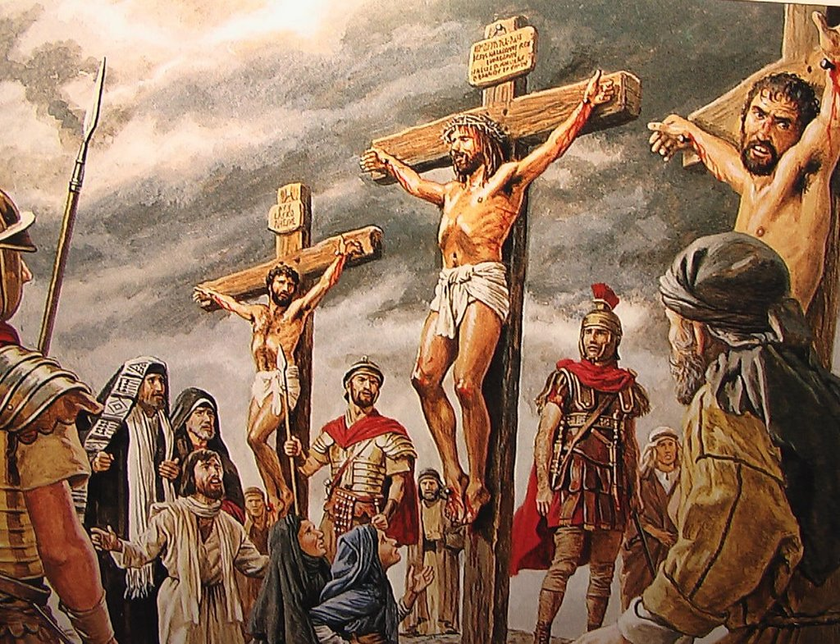
Jesus dies on the cross
XII
Notes:
Luke 23:35-49
³⁵ The people stood watching, and the rulers even sneered at him. They said, “He saved others; let him save himself if he is God’s Messiah, the Chosen One.” ³⁶ The soldiers also came up and mocked him. They offered him wine vinegar ³⁷ and said, “If you are the king of the Jews, save yourself.” ³⁸ There was a written notice above him, which read: this is the king of the jews.
³⁹ One of the criminals who hung there hurled insults at him: “Aren’t you the Messiah? Save yourself and us!” ⁴⁰ But the other criminal rebuked him. “Don’t you fear God,” he said, “since you are under the same sentence? ⁴¹ We are punished justly, for we are getting what our deeds deserve. But this man has done nothing wrong.” ⁴² Then he said, “Jesus, remember me when you come into your kingdom.” ⁴³ Jesus answered him, “Truly I tell you, today you will be with me in paradise.” ⁴⁴ It was now about noon, and darkness came over the whole land until three in the afternoon, ⁴⁵ for the sun stopped shining. And the curtain of the temple was torn in two. ⁴⁶ Jesus called out with a loud voice, “Father, into your hands I commit my spirit.”^{[c]} When he had said this, he breathed his last. ⁴⁷ The centurion, seeing what had happened, praised God and said, “Surely this was a righteous man.” ⁴⁸ When all the people who had gathered to witness this sight saw what took place, they beat their breasts and went away. ⁴⁹ But all those who knew him, including the women who had followed him from Galilee, stood at a distance, watching these things.
Reflection
As Jesus hung on the cross, he forgave the soldiers who had crucified him, and prayed for his mother and friends. Jesus wanted all of us to be able to live forever with God, so he gave all he had for us. Prayer Jesus, you hung for hours in agony on the cross, and then died for us;, let us take a few moments now to consider your love for us. Help us thank you for your willingness to go to your death for our sins. Help us express our love for you in everything we do.
We ask this through Christ our Lord, Amen

Slide 15
Jesus is taken down from the cross
XIII
Notes:
John 19:38-40
³⁸ Later, Joseph of Arimathea asked Pilate for the body of Jesus. Now Joseph was a disciple of Jesus, but secretly because he feared the Jewish leaders. With Pilate’s permission, he came and took the body away. ³⁹ He was accompanied by Nicodemus, the man who earlier had visited Jesus at night. Nicodemus brought a mixture of myrrh and aloes, about seventy-five pounds.⁴⁰ Taking Jesus’ body, the two of them wrapped it, with the spices, in strips of linen. This was in accordance with Jewish burial customs.
Reflections
Jesus, how brutally you were put to death. How gently your are taken from the cross. Your suffering and pain are ended, and you are put in the lap of your mother. The dirt and blood are wiped away. You are treated with love. As a child, sometimes I treat others better when they're sad or in pain. When somebody dies, I become very gentle and kind. I notice the good and kind things people say about those who have died. As an adult, I seem to be kinder when someone dies. If only I could learn to see the good things about them while they were alive. If only I would tell those around me how much I love them, while I still have the opportunity to do so.
Prayer Jesus, help us look for the good in those around us, especially those we love the most. Help us live this day as if it were our last. Help us become more gentle and loving people through our understanding of the sacrifice you made for us and a greater appreciation for those around us.
We ask this through Christ our Lord, Amen

Slide 16
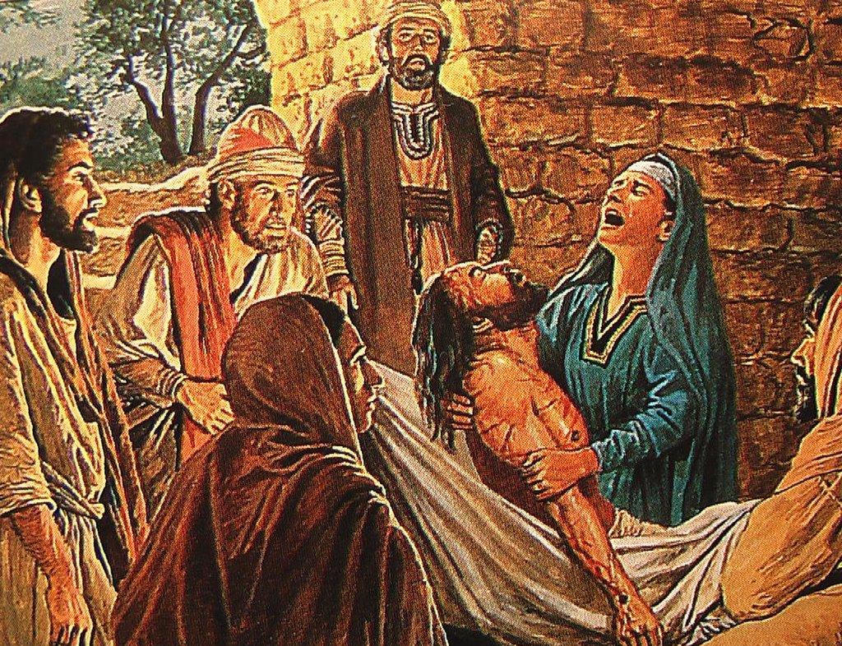
Jesus is laid in the tomb
XIV
Notes:
Matthew 27:59-61
⁵⁹ Joseph took the body, wrapped it in a clean linen cloth, ⁶⁰ and placed it in his own new tomb that he had cut out of the rock. He rolled a big stone in front of the entrance to the tomb and went away. ⁶¹ Mary Magdalene and the other Mary were sitting there opposite the tomb.
Reflections
Jesus, your body is prepared for burial. Joseph gave you his own tomb. He laid your body there and rolled a large stone in front of it, then went home. What a sad day it has been for so many people. As a child, sometimes I try to keep everything for myself. I find it hard to share my things with my brothers or sisters and with my friends. As an adult, I can be selfish too. I can accumulate things and keep them for myself. I try to make sure I have what I want before I share what I have with anybody else. Prayer Jesus, help me think of Joseph of Arimathea, who risked his own life as he accepted Jesus' body for burial. Help me think of how Joseph loved Jesus so much that through his generosity and love he gave him his own tomb. We ask that through his example and your grace we can show our love for your and those around us by our charity.
We ask this through Christ our Lord, Amen

Slide 18
First Station: Jesus is condemned to death
As a child, sometimes I feel alone. Sometimes I feel that others don't stand up for me and defend me when I am afraid. Sometimes I don't feel like I am treated fairly, especially if I am scolded or corrected.

Slide 19
Second Station: Jesus is made to carry his cross
As a child, sometimes I don't like the problems that come my way. Sometimes I try to get others to take care of them or solve them for me. Sometimes I become upset and angry when I'm asked to do even the smallest thing to help others.

Slide 20
Third Station: Jesus falls for the first time
As a child, sometimes I start to do something, but then get tired of it. I hurry to get finished and sometimes don't do my work well. Sometimes I don't pay attention to what I should be doing. When things get hard for me, sometimes I give up.

Slide 21
Fourth Station: Jesus meets His mother
As a child, sometimes I feel like too many things are going on. Sometimes other kids pick on me and call me names. I need to look around me for a friendly face, and for the help I need. I need to share my troubles with those who truly care about me.

Slide 22
Fifth Station: Simon of Cyrene helps Jesus
As a child, sometimes I see people who need my help. Sometimes I pretend not to hear when my parents call me. I disappear when I know others could use my help.

Slide 23
Sixth Station: Veronica wipes the face of Jesus
As a child, sometimes I know someone could use a little help and understanding. They may be picked on or teased by others, or just sad or lonely. Sometimes I feel bad that others don't step in to help, but I don't help either.

Slide 24
Seventh Station: Jesus falls for the second time
As a child, sometimes things get me down. Others seem to find things easier to do or to learn. Each time I fail, I find it harder to keep trying.

Slide 25
Eighth Station: Jesus meets the women of Jerusalem
As a child, sometimes I think a lot about myself. I think about what I want and would like people to spend their lives pleasing me.

Slide 26
Ninth Station: Jesus falls a third time
As a child, sometimes I fail time and time again. I find it hard to get along with my sisters and brothers, sometimes I'm not honest, sometimes I'm lazy. I'm tempted to stop trying. It's just too hard sometimes.

Slide 27
Tenth Station: Jesus is stripped of His garments
As a child, sometimes I'm tempted to repeat stories I know are unclean and disrespectful. I sometimes try to act grown up by using crude and bad words.

Slide 28
Eleventh Station: Jesus is nailed to the cross
As a child, sometimes I hurt others. Sometimes I join with friends and decide not to like another. We gang up against another and cause them hurt and pain. Sometimes I say or do hurtful things to my brothers and sisters. I can wonder what they'd think about themselves if they believed everything I told them about themselves.

Slide 29
Twelfth Station: Jesus dies on the cross
As Jesus hung on the cross, he forgave the soldiers who had crucified him, and prayed for his mother and friends. Jesus wanted all of us to be able to live forever with God, so he gave all he had for us.

Slide 30
Thirteenth Station: Jesus is taken down from the cross
As a child, sometimes I treat others better when they're sad or in pain. When somebody dies, I become very gentle and kind. I notice the good and kind things people say about those who have died.

Slide 31
Fourteenth Station: Jesus is laid in the tomb
As a child, sometimes I try to keep everything for myself. I find it hard to share my things with my brothers or sisters and with my friends.

Slide 32
Prayer Card
O my God, I thank you for loving me. I am sorry for all my sins, for not loving others and not loving you. Help me to live like Jesus and not sin again . Amen
Leader: We adore Thee, O Christ, and bless Thee. All: Because by Thy holy cross Thou hast redeemed the world.
Our Father, Who art in heaven Hallowed be Thy Name; Thy kingdom come, Thy will be done, on earth as it is in heaven. Give us this day our daily bread, and forgive us our trespasses, as we forgive those who
trespass against us; and lead us not into temptation, but deliver us from evil. Amen.
Leader: Jesus Christ Crucified. All: Have mercy on Us. Leader: May the souls of the faithful departed, through the mercy of God, Rest in peace. All: Amen.
Hail Mary, full of grace. The Lord is with thee. Blessed art thou amongst women, and blessed is the fruit of thy womb, Jesus. Holy Mary, Mother of God, pray for us sinners, now and at the hour of our death. Amen.
Glory be to the Father and to the Son and to the Holy Spirit, as it was in the beginning, is now and ever shall be, world without end. Amen.

